Slide 1
Felids
Dr. Tara Harrison

Slide 2
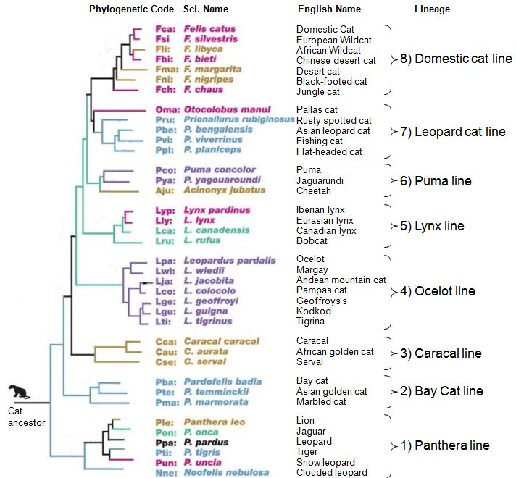
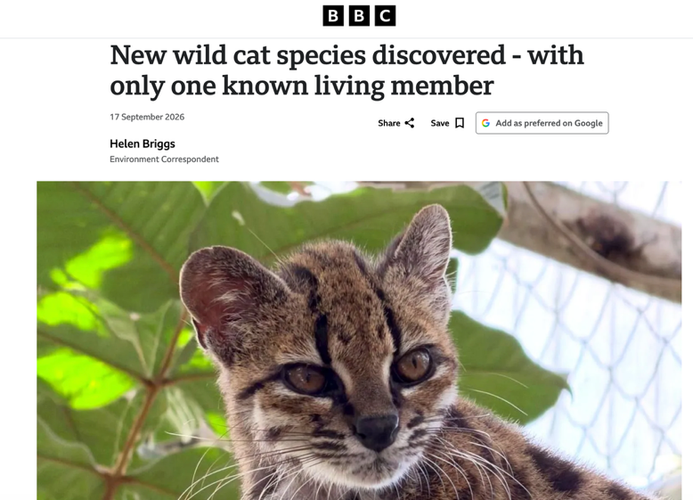
Phylogenetic Tree of Felids
Notes:
https://dl0.creation.com/articles/p117/c11724/fig-3-a.jpg
Leopardus tilcayo

Slide 3
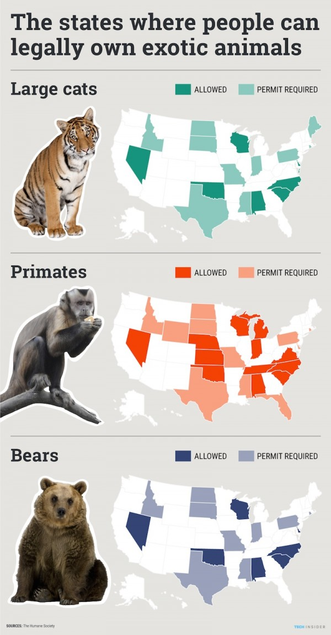
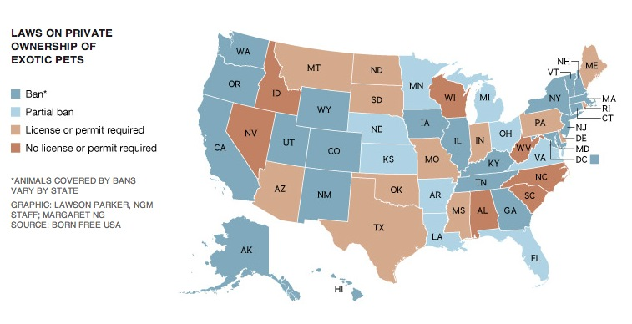
NC Laws

Slide 4
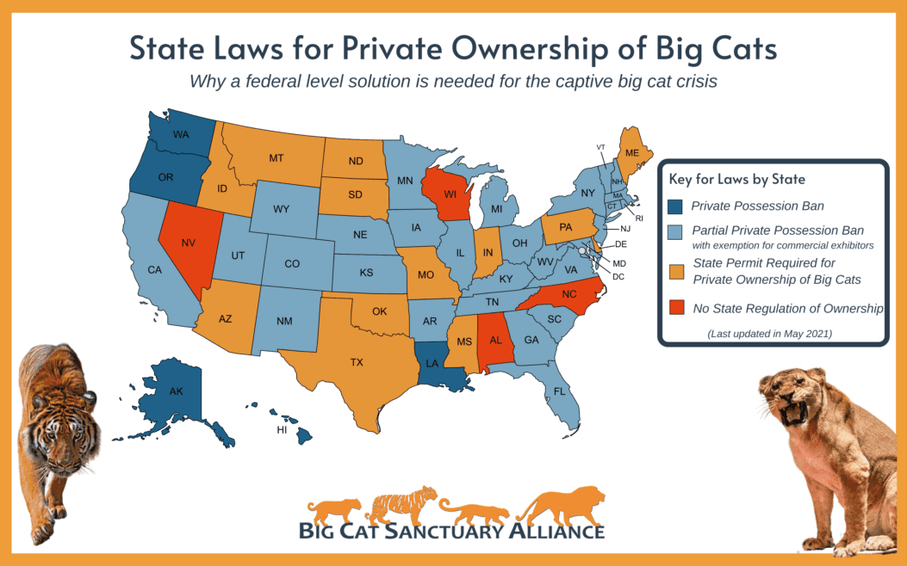
https://bigcatrescue.org/state-laws-exotic-cats/

Slide 5
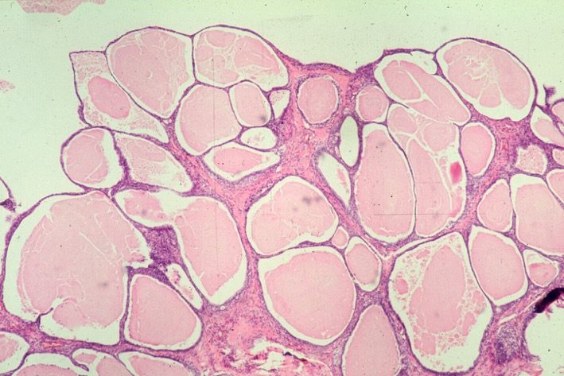
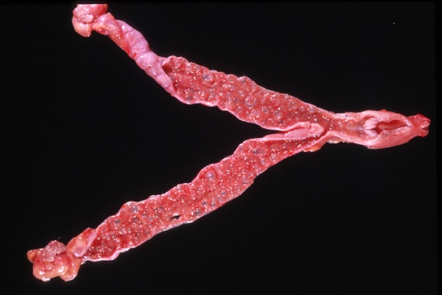
MGA Implants
Replace every two years
Inserted between the scapulae intra-muscularly
Side Effects: Some felids develop uterine or mammary carcinoma (jaguars, tigers)(canids develop endometrial hyperplasia)

Slide 6
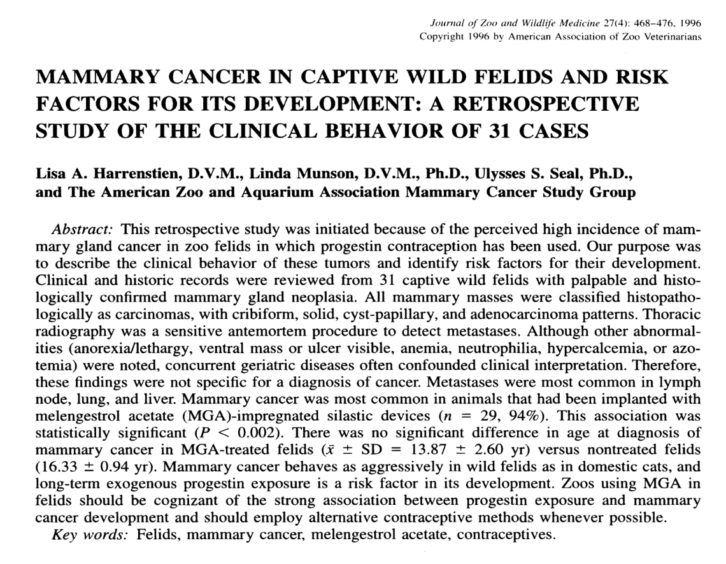
Seminal article

Slide 7
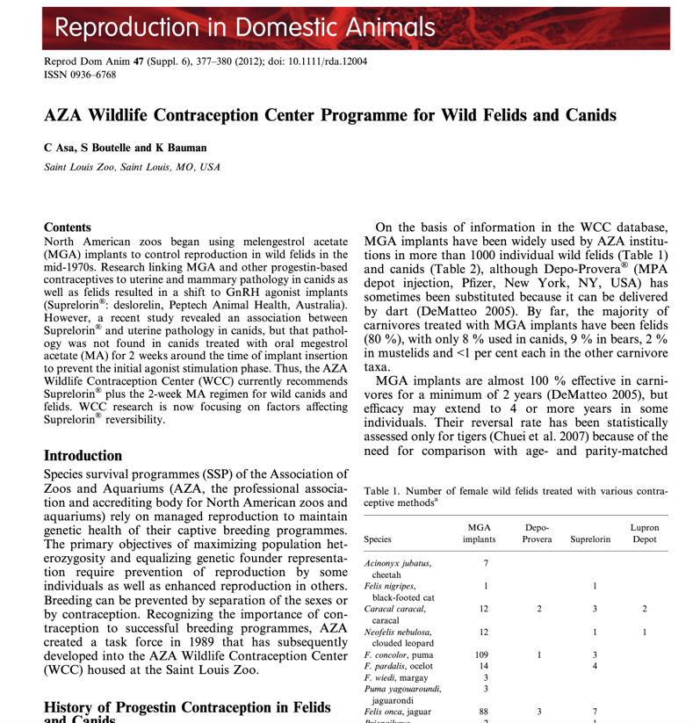
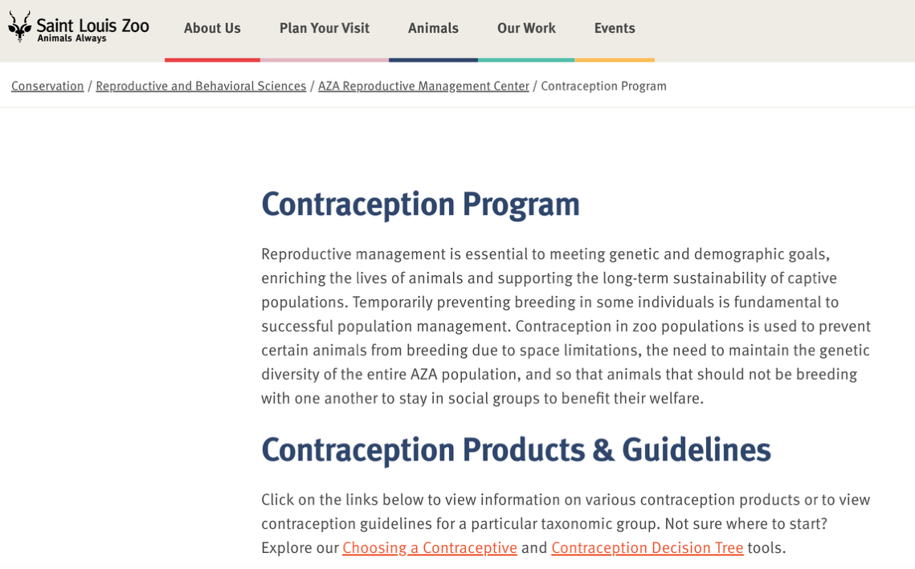
Contraception and Zoological Animals

Slide 8
Deslorelin
GnRH agonist
Dissolvable implant
Super-ovulates and then stops ovulation, can decrease testosterone levels
Used in felids, females and males
Placed subcutaneously in the inner thigh now, replaced annually
Reversibility? 1-2 years depending on implant size and if implant is removed

Slide 9
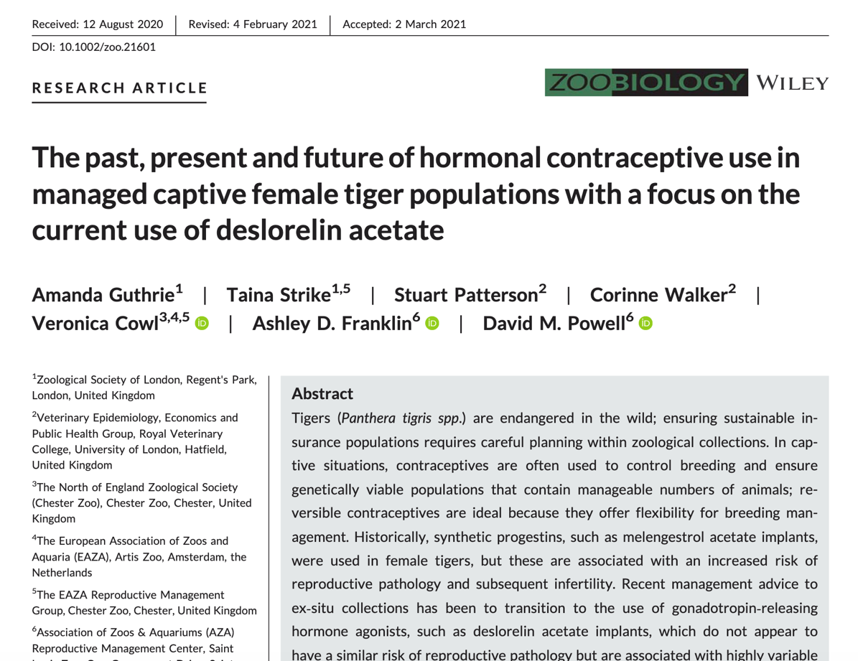
Deslorelin

Slide 10

Norplant (levonoregestrel acetate) Implants
Synthetic progestin
Takes 1-3 days following IM insertion and 1 week following SQ insertion for effect
Effective up to 5 years in humans, the length of duration is unknown in other species
Used in primates and some carnivores in North American zoos

Slide 11
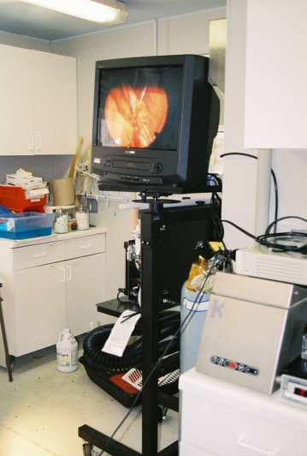
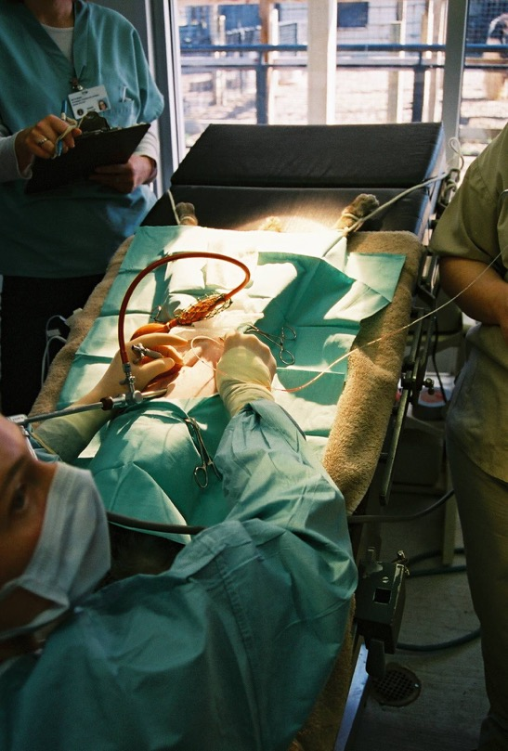
Breeding
Animals may need assistance
Egg recovery (Fishing Cat)
Artificial insemination
  Used in elephants, cheetah, clouded leopards, bongo, eland…
Tried in snow leopard in Michigan

Slide 12
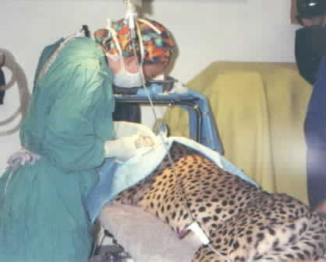
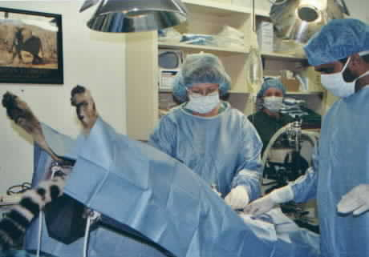

Slide 13
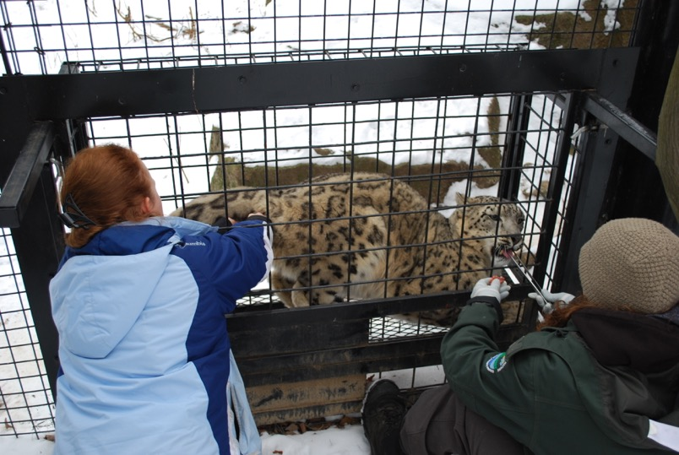
Snow Leopard AI
Attempted AI in MI
  Vaginal cytology
  Blood estrogen and progesterone
  Fecal estradiols and progesterone
  Awake AI cervically

Slide 14


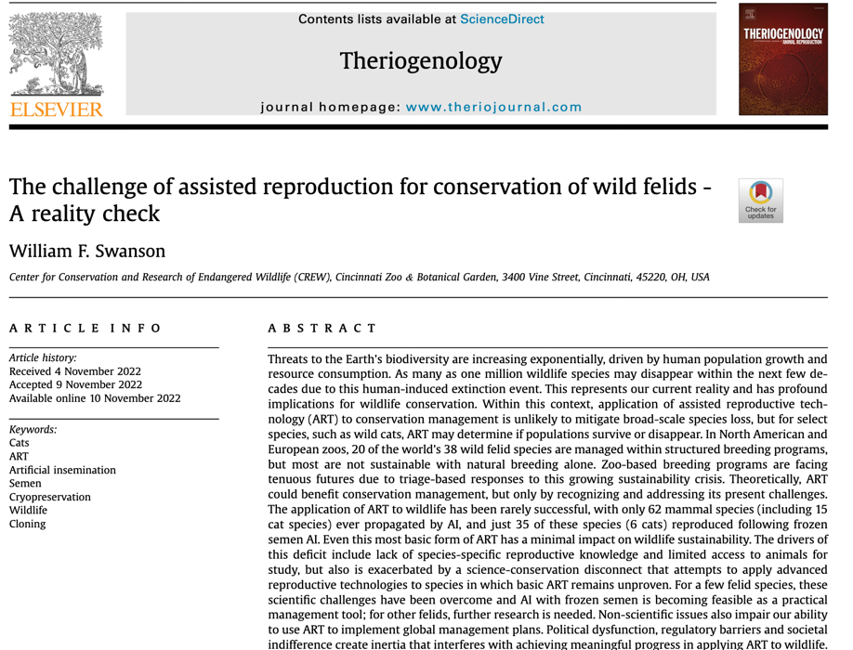
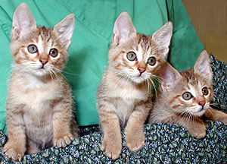
Research
Cloning
Embryo transfer
Frozen Zoo

Slide 15
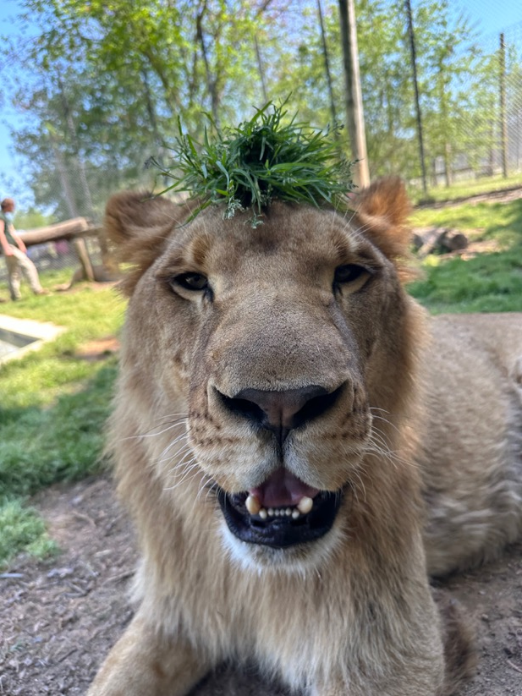
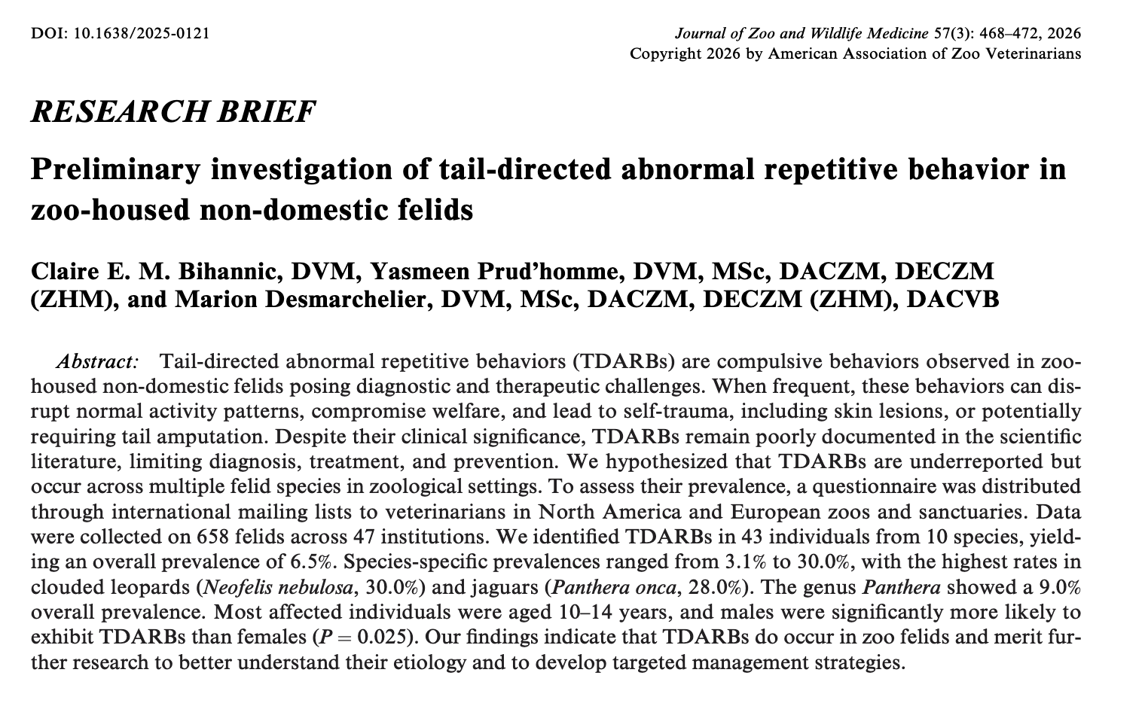
Behavior article

Slide 16
Question
Which of the following factors was significantly associated with a higher prevalence of tail-directed abnormal repetitive behavior in zoo-housed nondomestic felids?
A. Age (younger > older)
B. Age (older > younger)
C. Sex (males > females)
D. Sex (females > males)

Slide 17
Answer
Which of the following factors was significantly associated with a higher prevalence of tail-directed abnormal repetitive behavior in zoo-housed nondomestic felids?
A. Age (younger > older)
B. Age (older > younger)
C. Sex (males > females)
D. Sex (females > males)
Notes:
Answer: C. Sex (males > females)

Slide 18
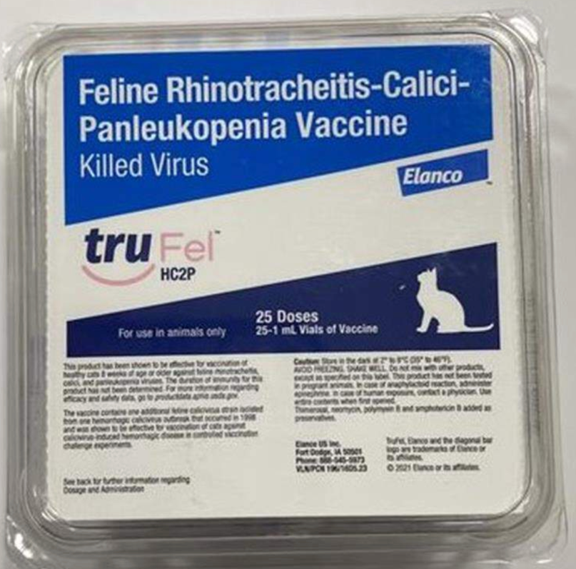
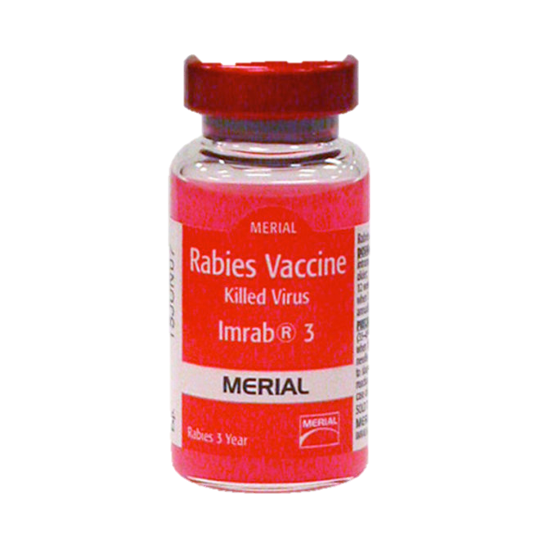
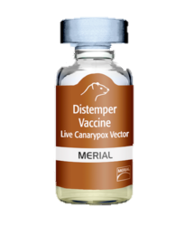
Vaccines

Slide 19
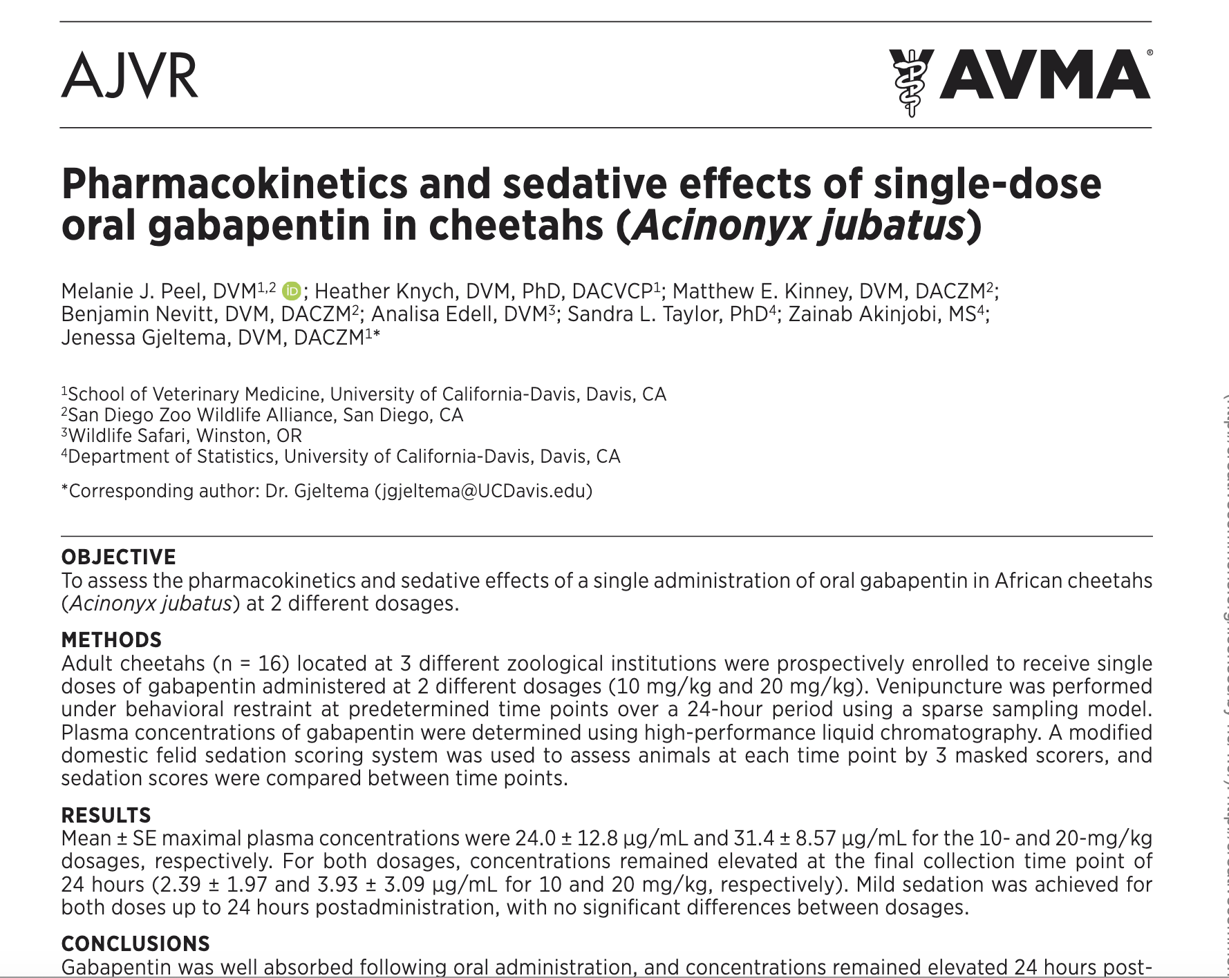

Slide 20
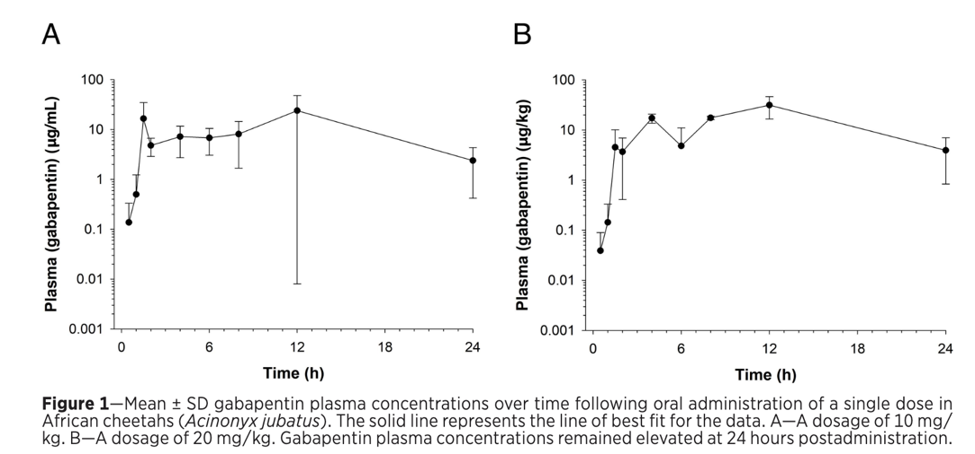
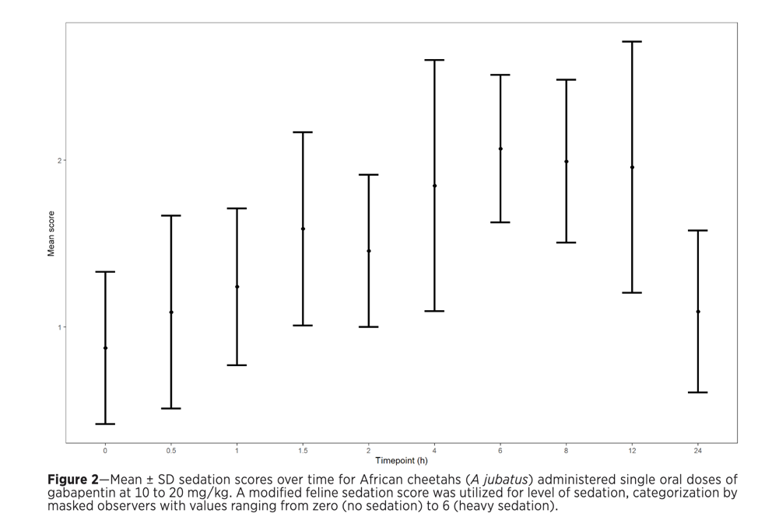

Slide 21
Question
A zoo cheetah is being considered for oral gabapentin to facilitate low-stress handling for a procedure scheduled the following morning. Based on the pharmacokinetic and sedative findings of this study, which statement is most appropriate?
A. Gabapentin produces the greatest sedation during the first few hours after administration.
B. Gabapentin produces more substantial and consistent sedation at high doses.
C. Gabapentin produces mild sedation that can persist approximately 24 hours.
D. Gabapentin is poorly absorbed orally, resulting in low plasma concentrations.
E. Gabapentin does not produce any sedative effect in cheetahs.

Slide 22
Answer
A zoo cheetah is being considered for oral gabapentin to facilitate low-stress handling for a procedure scheduled the following morning. Based on the pharmacokinetic and sedative findings of this study, which statement is most appropriate?
A. Gabapentin produces the greatest sedation during the first few hours after administration.
B. Gabapentin produces more substantial and consistent sedation at high doses.
C. Gabapentin produces mild sedation that can persist approximately 24 hours.
D. Gabapentin is poorly absorbed orally, resulting in low plasma concentrations.
E. Gabapentin does not produce any sedative effect in cheetahs.
Notes:
Answer C – both 10mg/kg and 20 mg/kg produce similar effects, mild sedation up to 24 hr but peak plasma concentration not until 12 hours

Slide 23
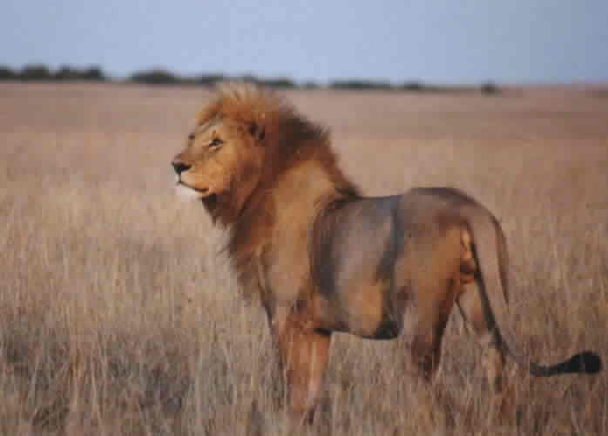
Diseases - Toxoplasma
  Intestinal coccidium of the cat family
  Extraintestinal cycles can result in cyst forms (bradyzoites) in skeletal muscle, brain, CNS, heart muscle, retinal tissue or fetal tissue
  Cysts can persist for years or a lifetime
  Most infections transient and subclinical but myocarditis, splenomegaly, encephalitis, or congenital disease may be observed

Slide 24
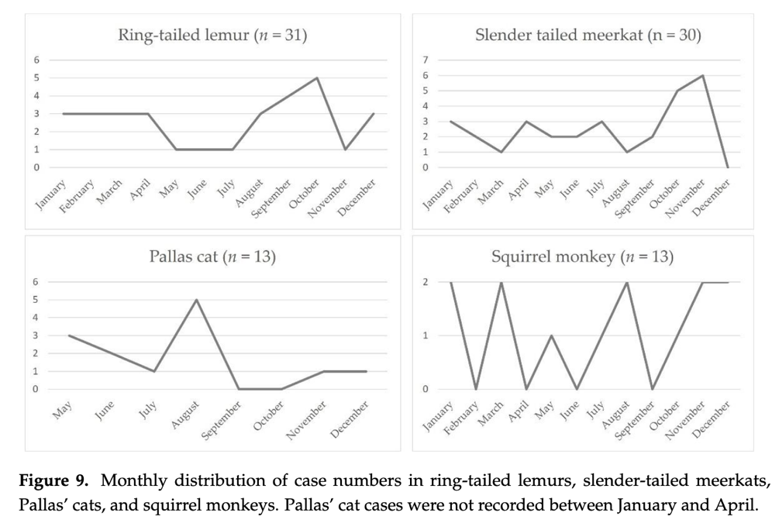
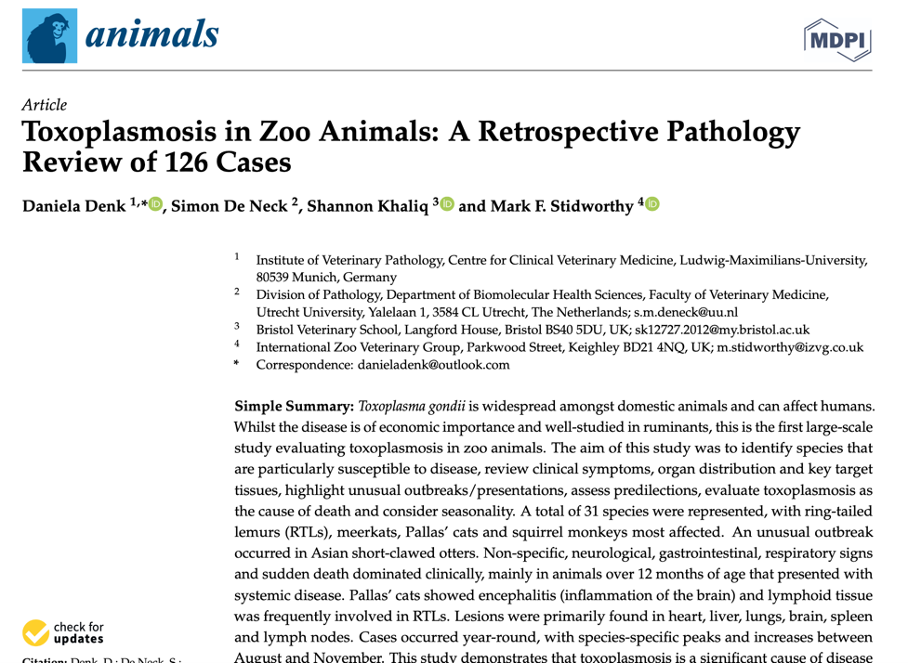
Toxoplasmosis

Slide 25
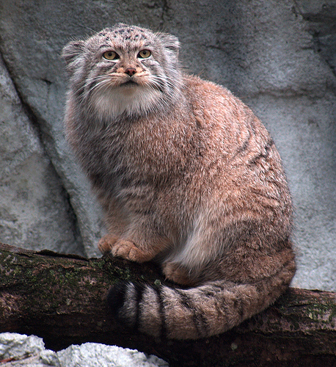
Toxoplasma
Pallas Cats in wild have no titers
Pallas Cats in captivity have acquired titers
Developing diseases in kittens that are fatal
Stress can produce disease in adults
Need to feed meat without cysts (i.e. canned cat food)

Slide 26
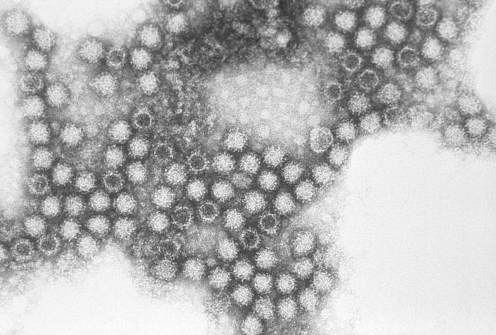
Diseases - Calicivirus
Viral disease
Typically upper respiratory symptoms
New strain evolved – virulent systemic
Stray/feral cats
Remains in environment for multiple days
https://en.wikipedia.org/wiki/Feline_calicivirus

Slide 27
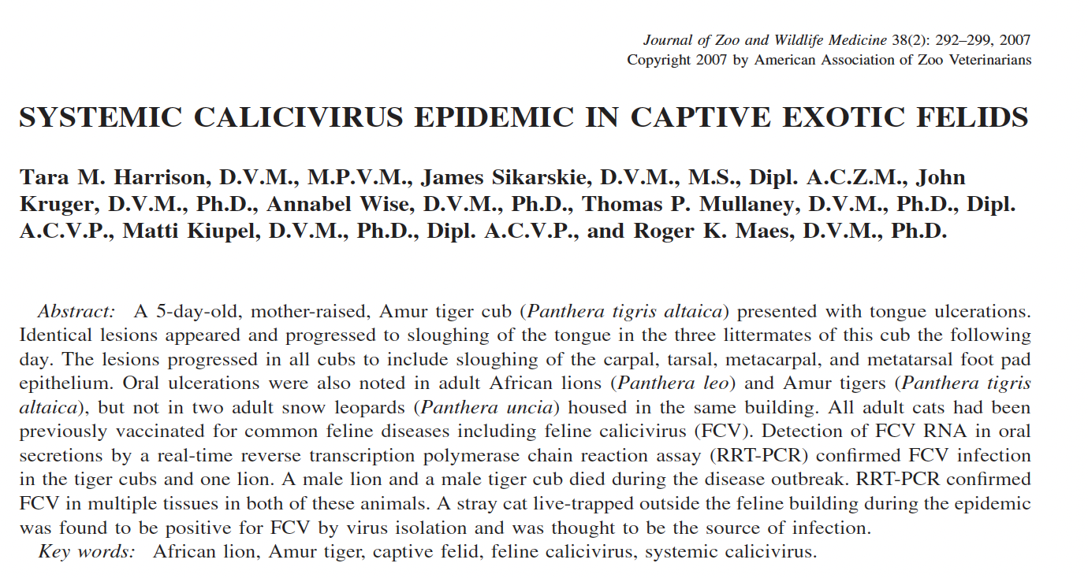

Slide 28
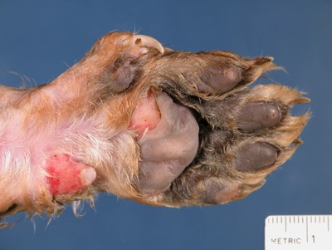
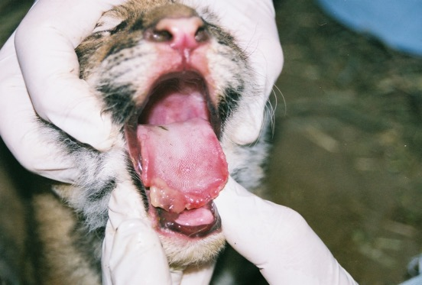
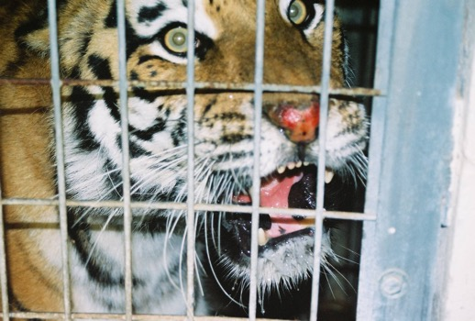
Calicivirus
Epidemic at Potter Park Zoo
Likely from stray cat
Lion and tiger cub died during epidemic
Developed new vaccine
Safe and better titers

Slide 29
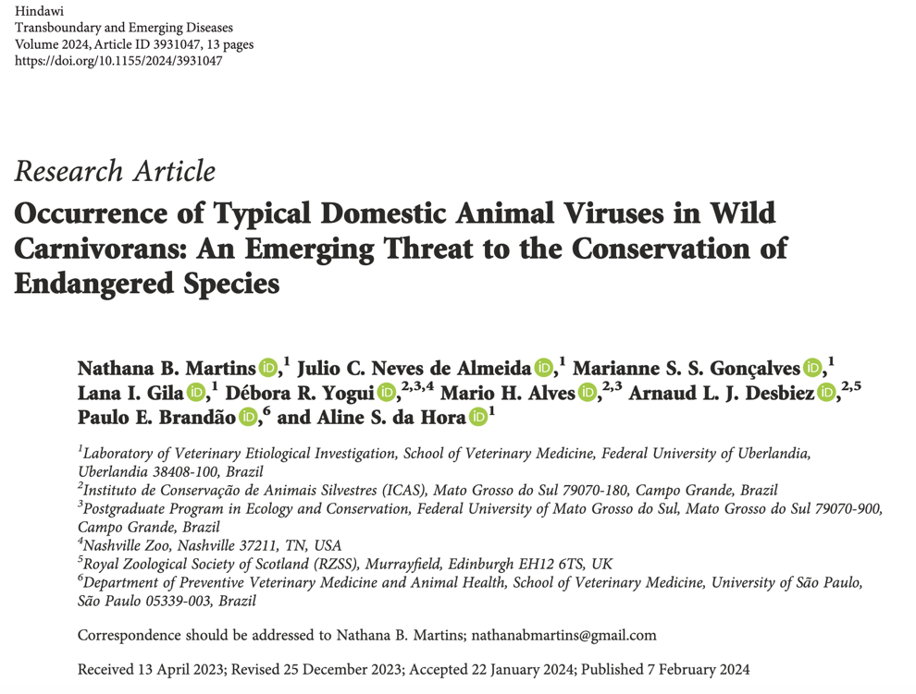
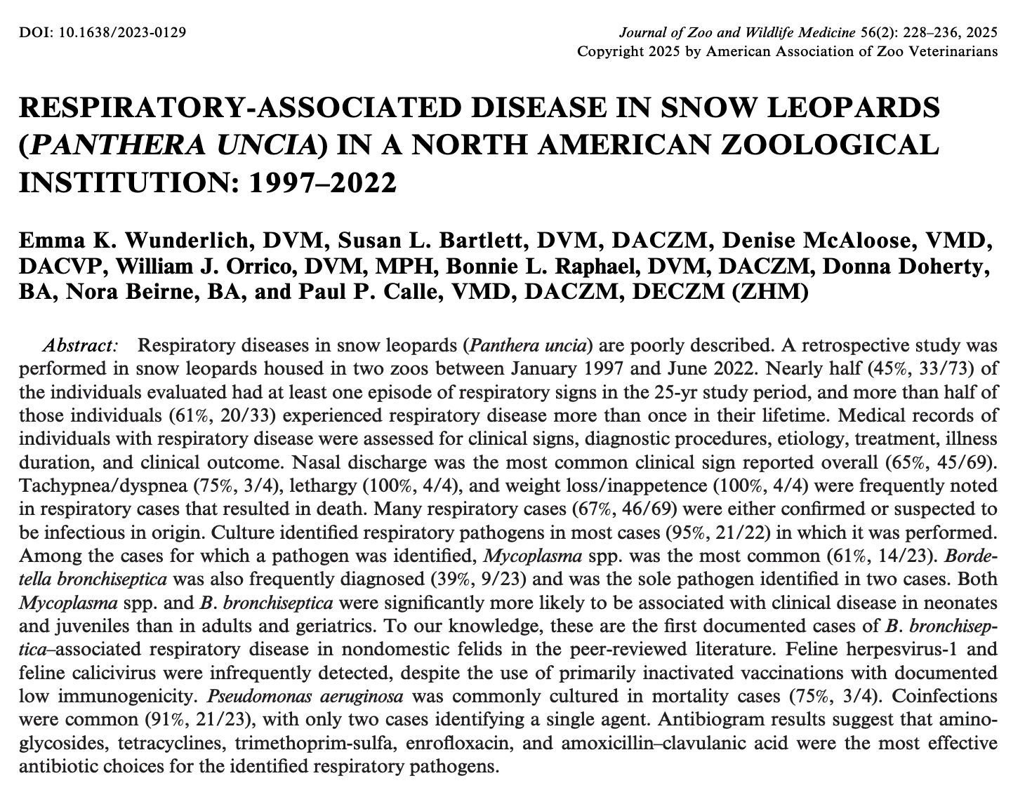
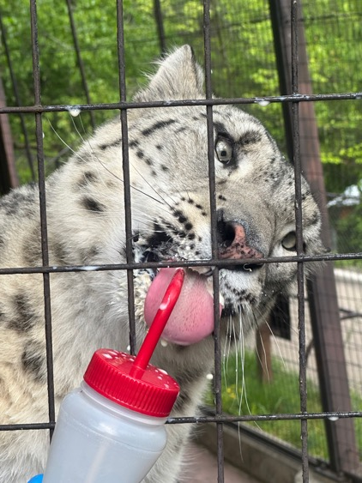

Slide 30
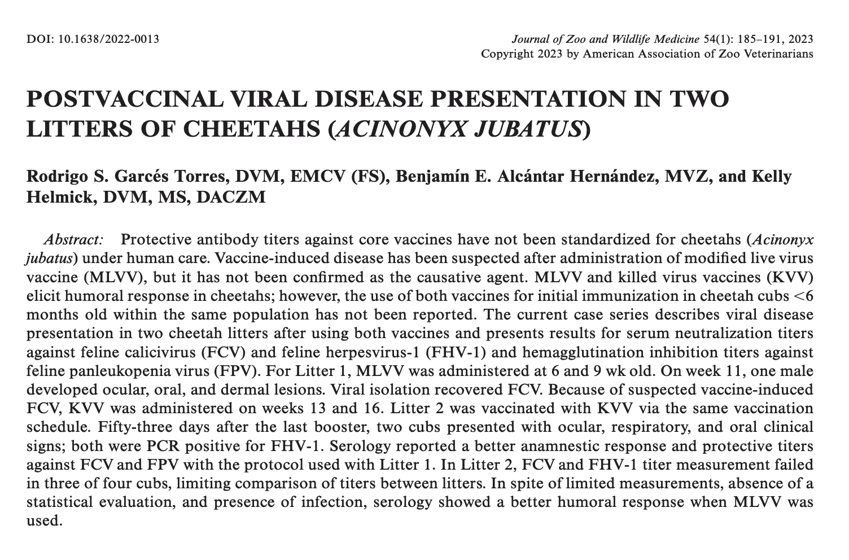

Slide 31
Diseases – Feline Leukemia Virus
Typically not a problem in non-domestic cats
Not vaccinated for in zoos
Animals developing problems are immune suppressed

Slide 32
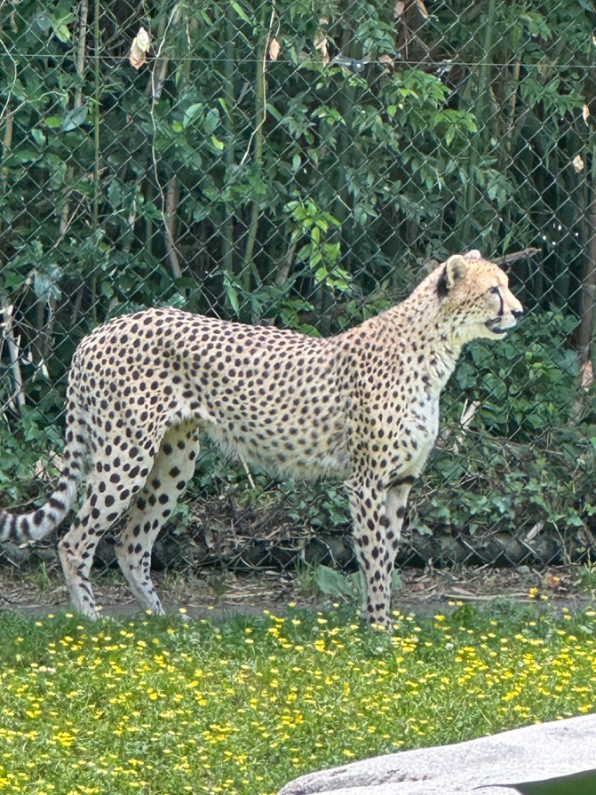
Diseases - Herpesvirus
Feline-specific
Typically upper respiratory symptoms
Spread by stray cats
More severe problems in cheetahs – proliferative lesions around eyes and nose

Slide 33
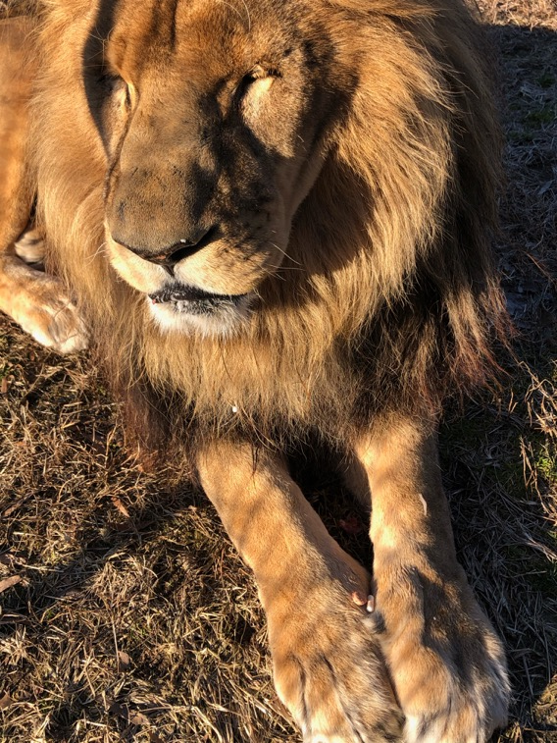
Diseases – Feline Immunodeficiency Virus
Retrovirus
May cause retinal lesions, gingivitis, and neurologic defects in lions, found in wild lions
High seroprevalence in Florida panthers, increased susceptibility to other problems?

Slide 34
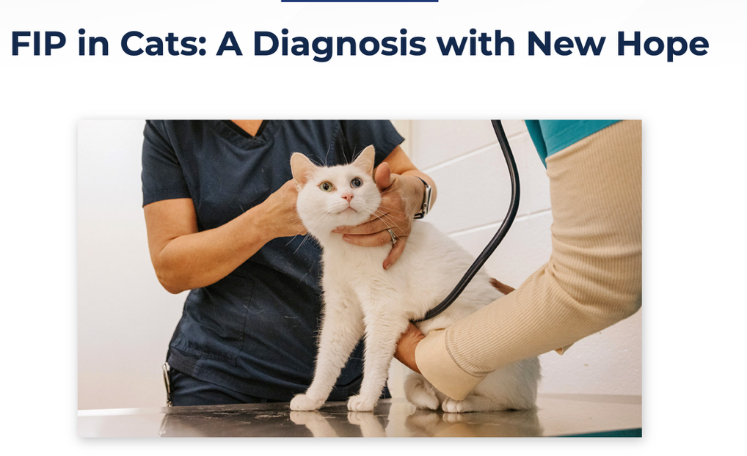
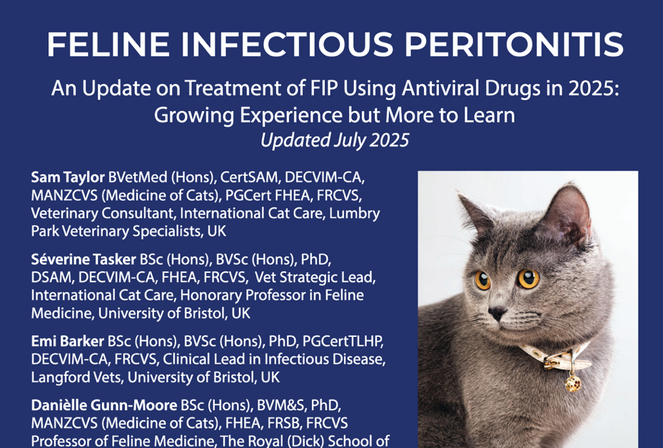
Feline Infectious Peritonitis
https://catvets.com/wp-content/uploads/2025/09/FelineVMA_FIP_Guide_2025.pdf
Notes:
https://vetmed.illinois.edu/pet-health-columns/fip-in-cats-a-diagnosis-with-new-hope/
remdesivir, GS-441524, molnupiravir, and EIDD-1931, which are all nucleoside
analogues, acting by interfering with viral RNA replication. There are also black market products. Oral GS-441524 (available as a suspension 50 mg/mL
and tablets 50 mg) can be used from the start of, and
for the entire, FIP treatment course (typically 6-12-
weeks/42- 84-days. Injectable veterinary reformulated remdesivir (10
mg/mL) or human-licensed remdesivir (100mg/vial)
is effective in the treatment of FIP but is associated
with side effects, particularly pain on subcutaneous
injection. Previous FIP treatment protocols
suggested that remdesivir should be used at the
start of FIP treatment, before transitioning to oral
GS-441254, but we now know that oral GS-441524 is
effective when given from the start of FIP treatment.

Slide 35
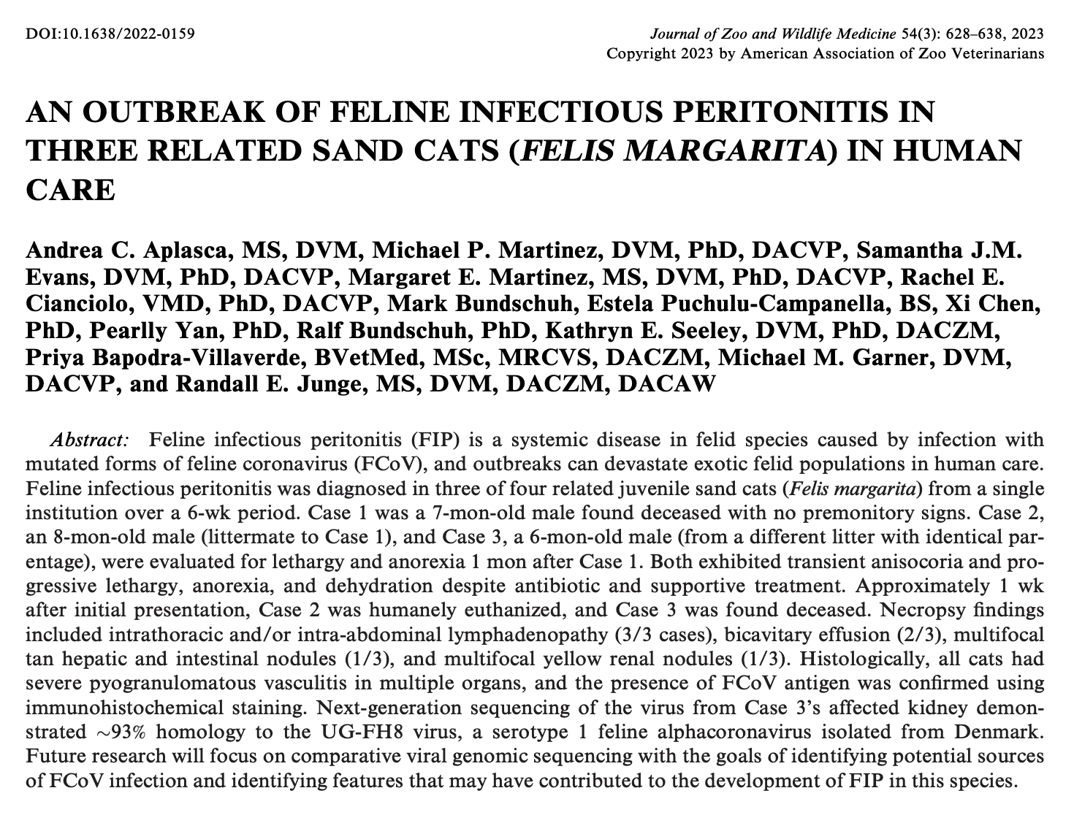
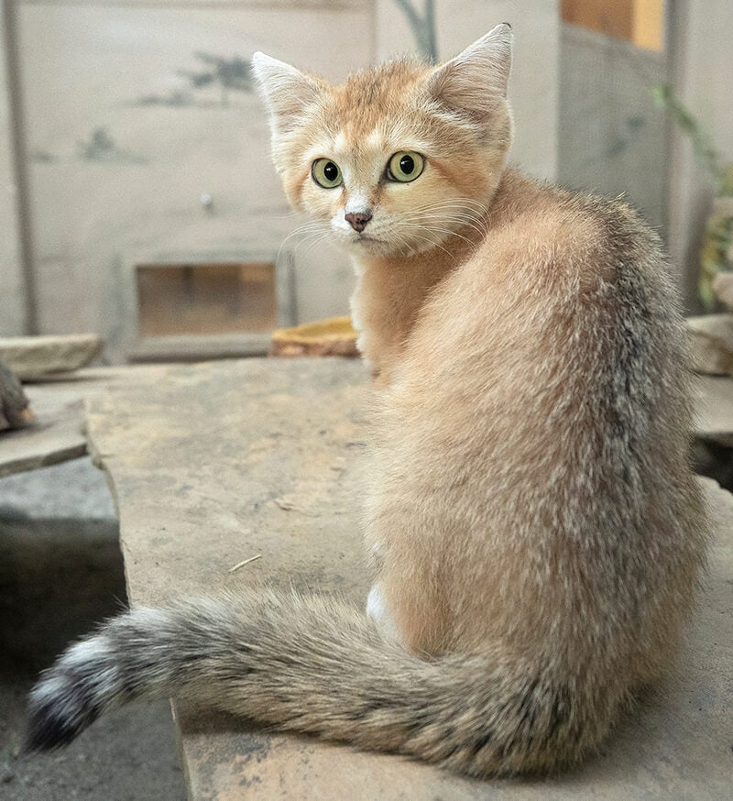
FIP in Sand Cats
https://sandiegozoowildlifealliance.org/story-hub/zoonooz/sand-cat

Slide 36
Papillomavirus
Viral
Proliferative lesions on skin or oral cavity
Domestic cats, Florida panther, bobcats, lions, snow leopards, clouded leopards
Snow leopard papillomas or squamous cell carcinomata should be removed by laser surgery or cyrosurgery
Vaccine developed, awaiting FDA approval

Slide 37
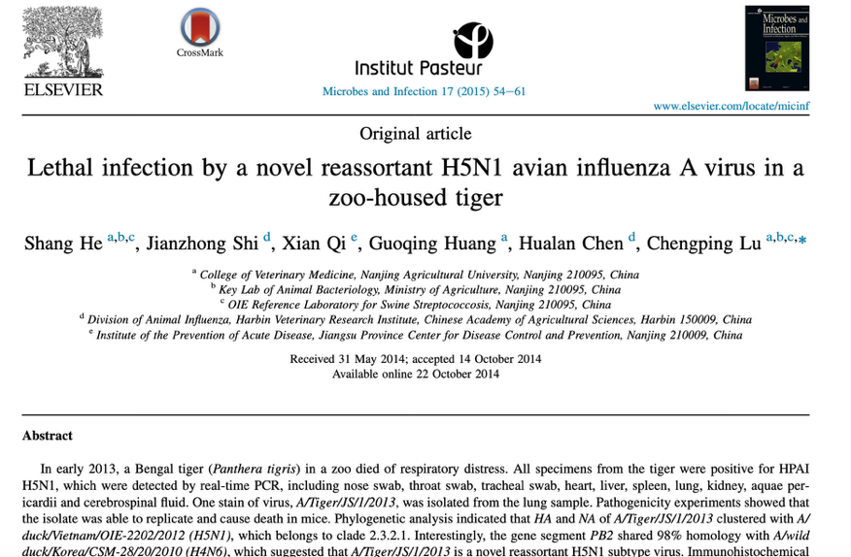
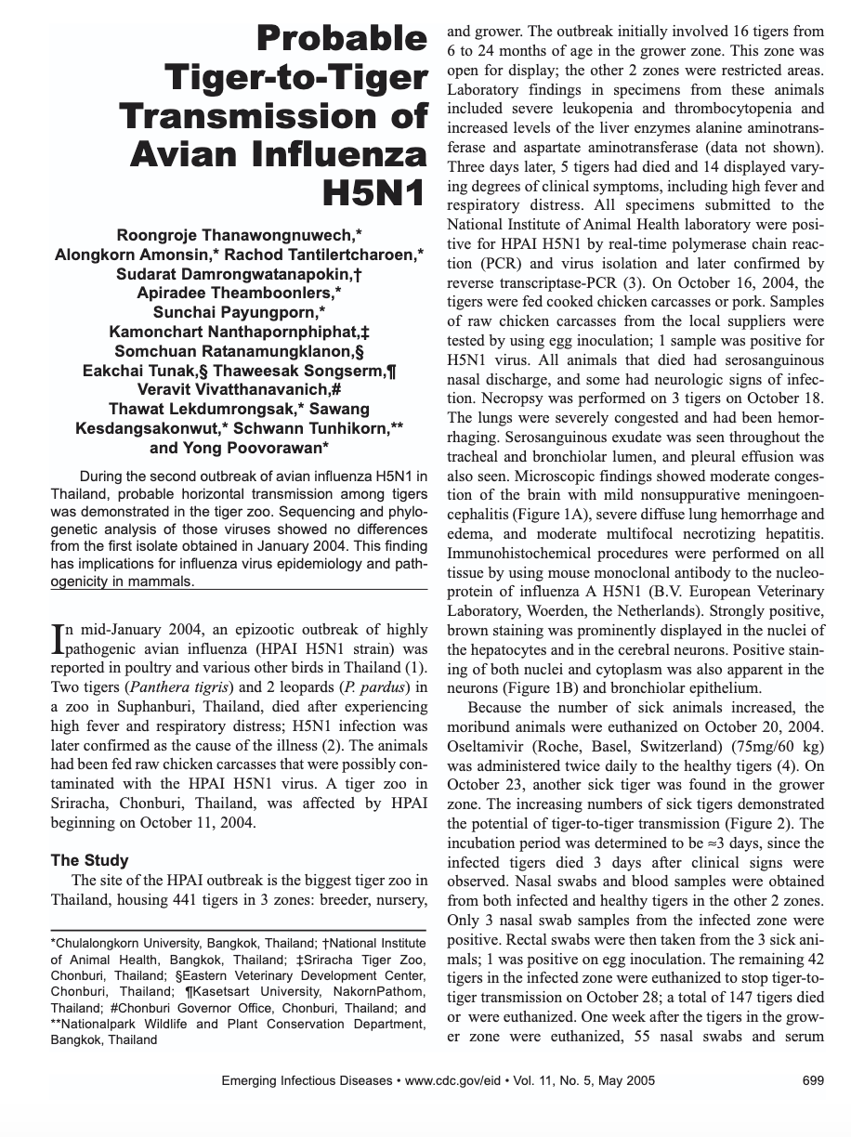
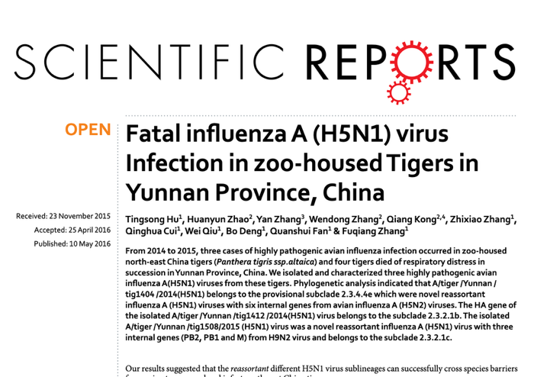
Notes:
Multiple cases of HPAI in tigers and some that have been fatal in other parts of the world, no cases in AZA zoos

Slide 38
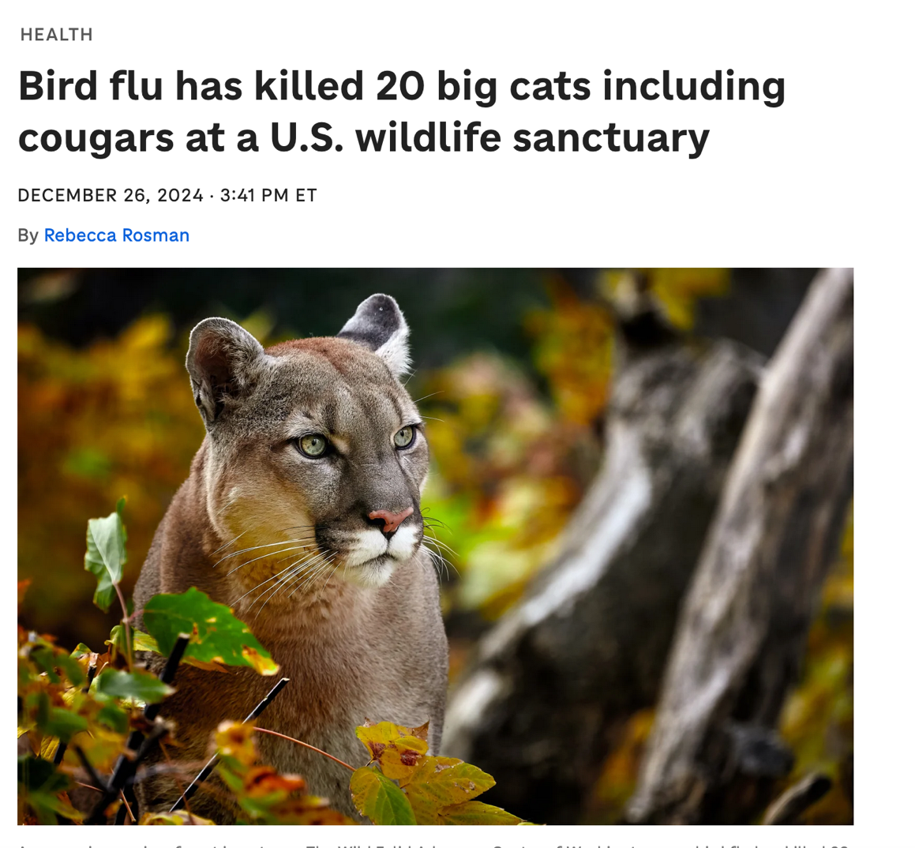
HPAI
Notes:
Likely due to contaminated meat fed to the cats, ie fed infected birds

Slide 39
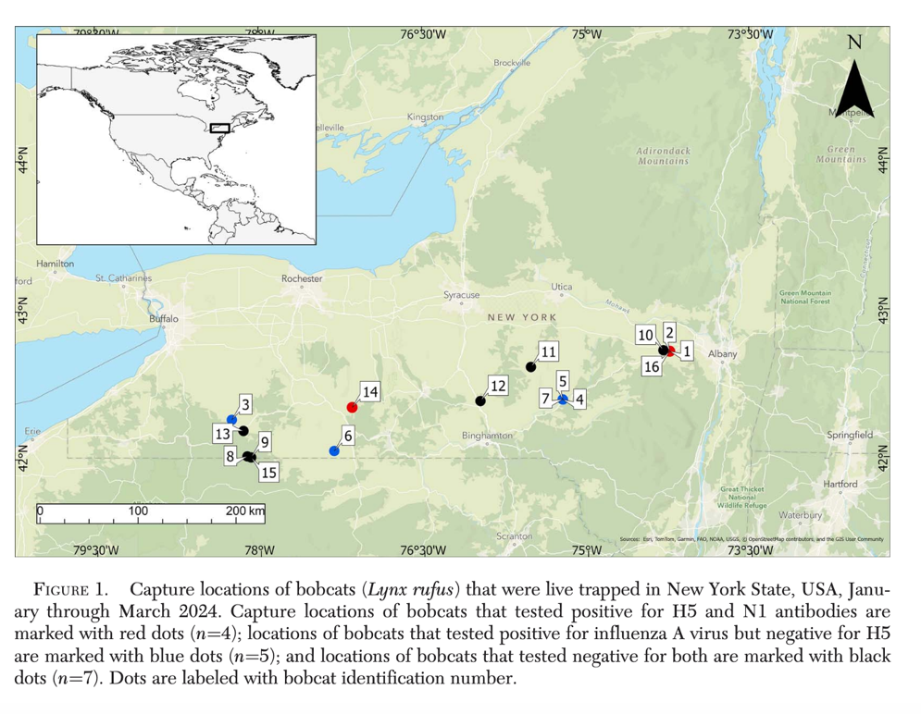

HPAI

Slide 40
Question
A free-ranging bobcat is found deceased, and the animal is suspected to have died of highly pathogenic avian influenza (HPAI). What is the current clade of HPAI that has been known to infect carnivores, and what tissues should you prioritize testing for the antigen.

Slide 41
Answer
The current HPAI is H5N1 of Eurasian lineage goose/Guangdong clade 2.3.4.4b that has been spreading throughout the US since December 2021. Lesions are often seen in the brain and lungs, and RT-PCR can be performed on both tissues. Brain has been the most common tissue to have the strongest amplification signal on RT-PCR which is consistent with meningoencephalitis being a primary lesion, and lesions were noted in the lungs in a bobcat that died of the disease in New York, USA (this bobcat was noted to have influenza A virus in the lungs and brain). Lesions such as GI parasitism and hemorrhage have also been reported in mesocarnivores with influenza A infections.

Slide 42

Diseases – H1N1
Also called “swine flu”
  Genes of virus similar to strains in swine in Europe
  Different than NA swine strains
  2 strains from Europe swine, and avian genes and human genes = quadruple reassortment virus
Has infected people, swine, dogs, cats, ferrets, turkeys, cheetahs and other big cats

Slide 43

H5N1
Widespread in waterfowl in USA
No current person to person
71 cases since 2024
2 human deaths
Notes:
https://www.cdc.gov/bird-flu/situation-summary/index.html

Slide 44

What are your rule outs?

Slide 45


SARS CoV2

Slide 46


SARS CoV2

Slide 47



Slide 48


SARS CoV2

Slide 49
Question
A retrospective survey of SARS-CoV-2 infection in tigers housed in North American zoos reported 39 infected tigers from 15 institutions. Which of the following best describes the study's findings regarding vaccination and disease severity?
A. Two-dose vaccination completely prevented SARS-CoV-2 infection in tigers
B. Vaccinated tigers were significantly less likely to develop moderate or severe disease
C. Unvaccinated tigers were significantly more likely to die from SARS-CoV-2 infection
D. A single vaccine dose was sufficient to prevent severe clinical disease
E. No apparent trend between vaccination status and disease severity was identified, and vaccine efficacy could not be determined from the study

Slide 50
Answer
A retrospective survey of SARS-CoV-2 infection in tigers housed in North American zoos reported 39 infected tigers from 15 institutions. Which of the following best describes the study's findings regarding vaccination and disease severity?
A. Two-dose vaccination completely prevented SARS-CoV-2 infection in tigers
B. Vaccinated tigers were significantly less likely to develop moderate or severe disease
C. Unvaccinated tigers were significantly more likely to die from SARS-CoV-2 infection
D. A single vaccine dose was sufficient to prevent severe clinical disease
E. No apparent trend between vaccination status and disease severity was identified, and vaccine efficacy could not be determined from the study
Notes:
Answer: E.
Vaccination did not appear to decrease case severity and did not prevent infection, the study could not correlate vaccine efficacy due to the small number of infected animals that had received 2-dose vaccination protocol, and lack of appropriate comparison groups.

Slide 51

Helicobacter
Gastritis in cheetahs
Helicobacter pylori
Present in wild cheetahs without gastritis
Part of examinations includes endoscopy and biopsies

Slide 52


Seminal Papers

Slide 53

Current Helicobacter work

Slide 54

Stress
Cheetahs are the poster-child
Due to exhibit size
Due to cage mates
Due to visitors

Slide 55


Stress
Causes decreased reproduction
Causes disease (cheetahs)
Increases susceptibility to disease – immune suppression (?)

Slide 56


Snow Leopard Coloboma

Slide 57


Coloboma

Slide 58
Question
Which of the following best reflects the study's conclusions regarding the potential inheritance of eyelid coloboma in snow leopards?
A. The findings suggest autosomal dominant inheritance, but a specific genetic link remains undetermined.
B. The findings suggest autosomal recessive inheritance, but a specific genetic link remains undetermined.
C. The familial pattern supports a possible heritable component, but a specific genetic link remains undetermined.
D. The familial pattern suggested maternal transmission as affected offspring were associated with affected dams.
E. There were no patterns that supported any suspicion of genetic involvement.

Slide 59
Answer
Which of the following best reflects the study's conclusions regarding the potential inheritance of eyelid coloboma in snow leopards?
A. The findings suggest autosomal dominant inheritance, but a specific genetic link remains undetermined.
B. The findings suggest autosomal recessive inheritance, but a specific genetic link remains undetermined.
C. The familial pattern supports a possible heritable component, but a specific genetic link remains undetermined.
D. The familial pattern suggested maternal transmission as affected offspring were associated with affected dams.
E. There were no patterns that supported any suspicion of genetic involvement.
Notes:
Answer: C.
73% of individuals had at least 1 affected relative within 2 generations, however genetic cause has not been proven.

Slide 60

Antimicrobial Resistance

Slide 61



Slide 62
Question
Fecal samples from wild pumas and jaguars in Costa Rica were found to have the highest frequency antibiotic resistance genes against which drug class?
A. Fluoroquinolones
B. Cephalosporins
C. Tetracyclines
D. Chloramphenicols
E. Sulfonamides

Slide 63
Answer
Fecal samples from wild pumas and jaguars in Costa Rica were found to have the highest frequency antibiotic resistance genes against which drug class?
A. Fluoroquinolones
B. Cephalosporins
C. Tetracyclines
D. Chloramphenicols
E. Sulfonamides
Notes:
Answer: C. Tetracyclines - frequent selection of tetracycline ARGs was expected as tetracyclines are one of the most commonly used AB groups in agricultural and livestock production

Slide 64

Questions?

