Slide 1
Mycobacteriosis – Mostly Mammals
Tara Harrison, DVM, MPVM, DACZM, DACVPM, DECZM (ZHM), CVA

Slide 2
Mycobacteriosis
Genus Actinobacteria
Family Mycobacteriaceae
Aerobic, nonmotile (except Mycobacterium marinum)
Possess capsules
M. marinum and M. bovis have been shown to sporulate
Thick cell wall
Growth 25 deg C to over 50 deg C
Acid-fast

Slide 3
Mycobacterium
Mtb complex
  Mycobacterium bovis
  Mycobacterium tuberculosis
  Mycobacterium pinnipedii
Non-Mtb complex/Atypical mycobacteria
  Mycobacterium avium
  Mycobacterium intracellulare
  Etc.

Slide 4
General
Gold Standard – Culture – 8 weeks
Humans – skin test (aka Mantoux tuberculin skin test) – 48-72 hours - preferred
Humans – blood test – if vaccinated
Genotyping
https://www.cdc.gov/tb/topic/testing/tbtesttypes.htm
Notes:
Culture is the gold standard for diagnosis, yet it can take 8 weeks or more. Human cases only have 50% proof of bacilli in samples. The human skin test is 0.1 ml of tuberculin injected into the inside lower part of the arm, and then is read in 48 to 72 hours later. A positive test requires additional testing. The skin test is the preferred test for children less than 5 years of age. The blood test is the interferon-gamma release assay (IGRA), there are two tests available (QuantiFERON-TB God In-Tube test (QFT-GIT), and the T-SPOT TB test (T-Spot). The blood test is for people who have received the TB vaccine or who can’t return for the skin test check.

Slide 5
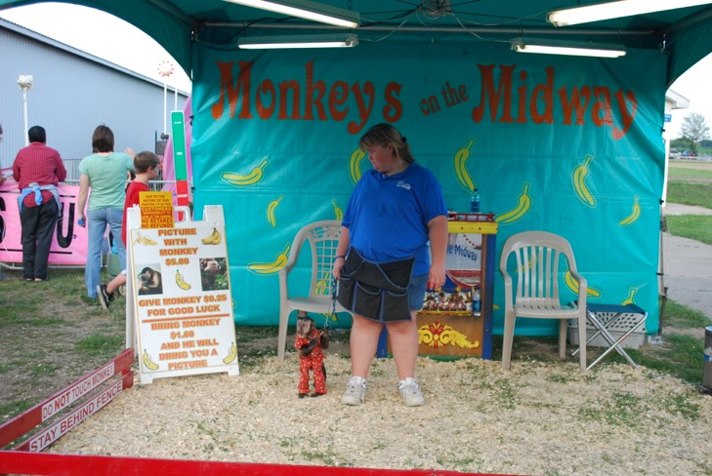
General
Intermittent shedding
Low quantity in internal fluids
Direct detection in blood – 50-80% sensitivity
Notes:
The low quantity in internal fluids lowers the sensitivity of the test even if the molecular test has excellent intrinsic sensitivity frequent collection like repeated trunk washes helps. Direct detection in blood is used for detecting extrapulmonary disseminated forms. This test is 50-80% sensitivity. And has been used in deer.

Slide 6
Diagnosis
Acid Fast - use caution (Nocardia)
Immunohistochemistry
Amplified M. tuberculosis direct test (MTD)
Multiplex polymerase chain reaction (PCR)
Gene probes
PCR (fresh and formalin-fixed tissues)
Antigens – Antigen 85 (Ag85)
Notes:
Be cautious of acid fast staining as other organisms can stain positive such as Nocardia

Slide 7
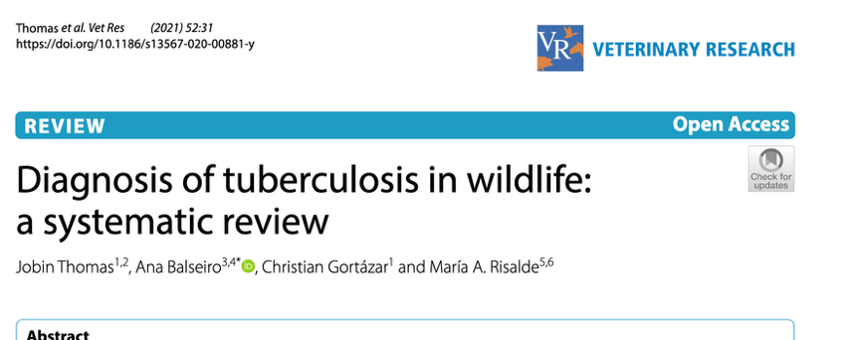
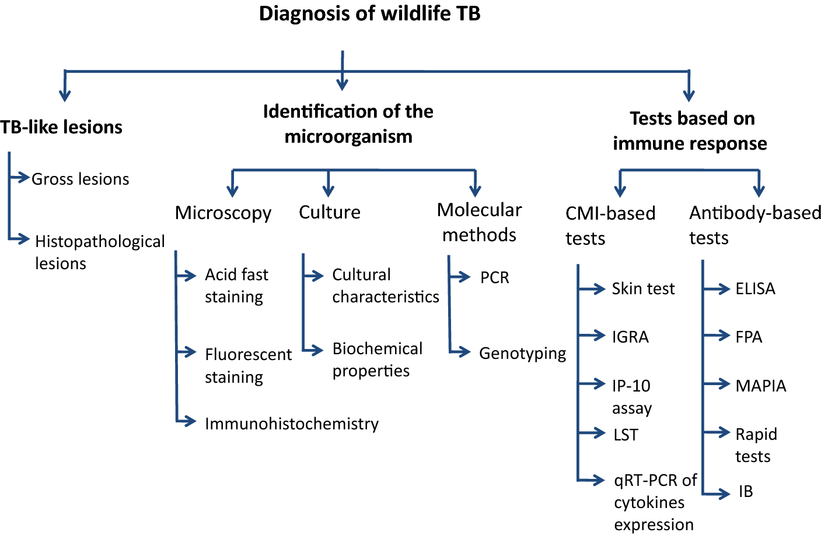

Slide 8
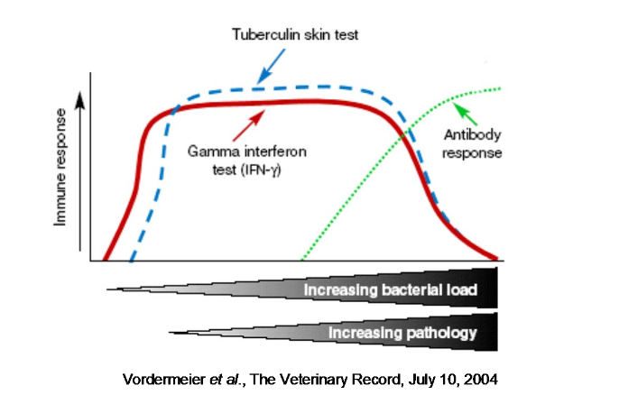
Tuberculosis Testing
Humoral response
Cellular response

Slide 9
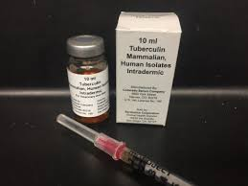
Cell-Mediated Immunologic Test
Intradermal test
  0.1 ml (5,000 tuberculin units)
  Purified protein derivative (PPD) – M. bovis, M. avium
  Purified protein derivative (PPD) – Old Tuberculin (OT) from M. tuberculosis or M. bovis; or Mammalian Old Tuberculin (MOT)

Slide 10
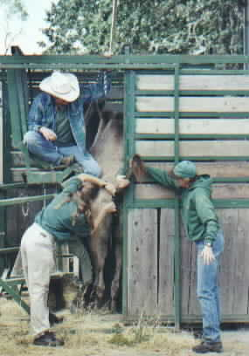
Intra-dermal test sites
Caudal tail-fold
Cervical skin
Upper eyelid
Chest skin
Lateral thorax
Axillary skin
Abdomen
Ear

Slide 11
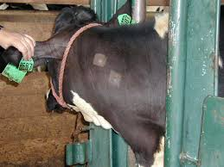
Intra-dermal testing
Injection
Measure
48 hours – primates and swine
72 hours – ungulates
Comparative Cervical Testing (CCT)
https://www.michigan.gov/documents/emergingdiseases/Web-bovinetuberculosislivestocktesting-sara_137663_7_421100_7.pdf
Notes:
Comparative cervival testing has to be done by the state; definitive TB test end at 72 hours for primates

Slide 12
Bovid Intradermal testing
Caudal tail fold
Examine 72 hours +/- 6 hours
Feel and observe site
Reactor – comparative cervical test
Examine 72 hours +/- 6 hours later

Slide 13
Intra-dermal testing
Antinergic responses
Variability in response
  75% PPV when infection prevalence >10%
  <PPV when lower prevalence
False positive/negative
Non-specific reactions (tapirs, bongo, reindeer, orangutans)
Notes:
Even in humans the positive predictive value for tb skin test varies in tested populations, with a ppv greater than 75% when infection prevalence is above 10% but decreased PPV in populations with lower prevalence. Increased likelihood of nonspecific reactions including tapirs, bongo, reindeer and orangutans

Slide 14
Dual Path Platform VetTB Assay (DPP)
Primary test for deer
Approved in farmed and captive elk, red deer, white-tailed deer, fallow deer, reindeer
2 ml serum
Only accredited veterinarian
Test at NVSL or APHIS-approved laboratory
https://www.aphis.usda.gov/animal_health/animal_diseases/cwd/downloads/faqs_for_cervid_tb_dpp_testing.pdf
Notes:
Vet has to have had official training on DPP testing too

Slide 15
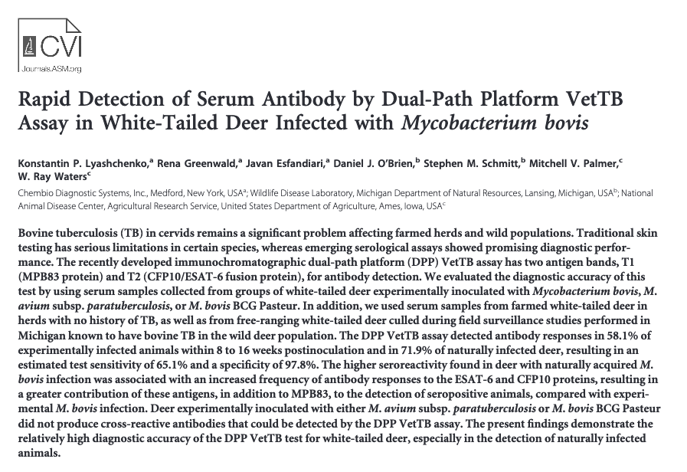
Vet TB Assay in White Tailed Deer

Slide 16
DPP Test
Positive
Reactor
Depopulate
Necropsy
Histopathology
Culture
PCR
Notes:
If positive retested in 30 days if positive on second test then classified
as a reactor

Slide 17
Interferon Gamma Testing
Measure in vitro cytokine production by lymphocytosis in a blood sample when exposed to mycobacterial agents
Measure adaptive immune response
Indirect measure of exposure
Bovigam or Primagam
Add positive control
Good for early detection cellular immune response
Notes:
This is good for early detection in the subclinical phase where the cellular immune response dominant, which correlates with low bacterial load. With progressive course of disease, the bacterial load increases and the interferon gamma decreases and the humoral immune response increases

Slide 18
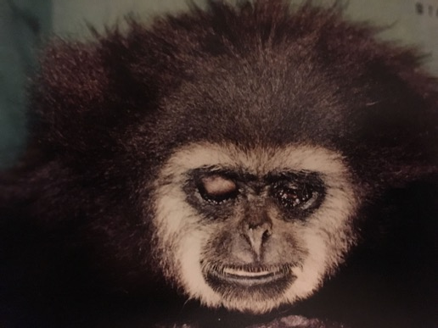
Primates
M. tuberculosis and M. bovis, M. ,microti, TB complexes
Intradermal skin test
24, 28, 72 hours
Higher tuberculin units required (1,500 units for old mammalian tuberculin)
Tuberculin testing sites – upper eyelid, abdominal skin
0.1 ml larger animals; 0.05 ml smaller
Use 25 or 27 ga needle
Notes:
Intradermal TB test only test approved by laboratory animal research and CDC for tuberculosis testing of animals in import quarantine; note the smaller volume is only approved for animals that are from a TB free captive colony or passed through a CDC quarantine facility. Abdominal skin most often done for repeat testing

Slide 19
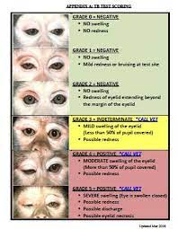
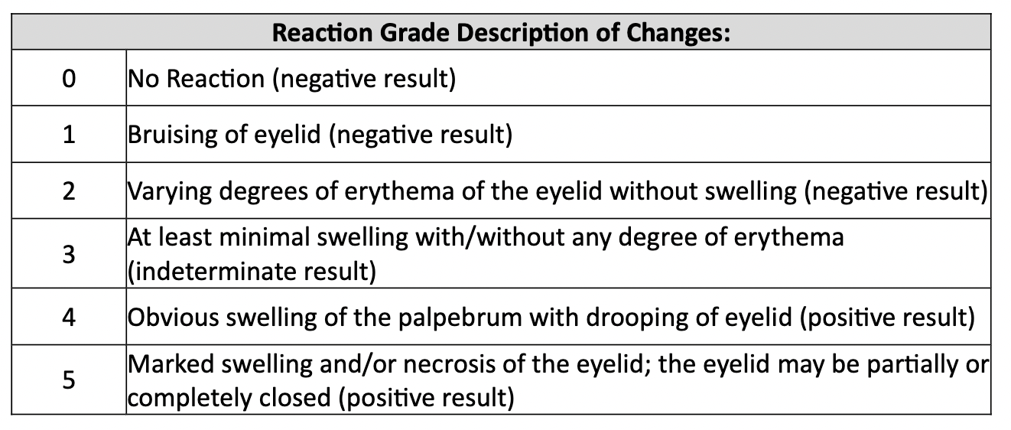
Primate Tuberculosis Grading
https://www.nationalacademies.org/documents/embed/link/LF2255DA3DD1C41C0A42D3BEF0989ACAECE3053A6A9B/file/DF1560C6A62317AC99A5C8A37FB3DD62D701893B7F2B?noSaveAs=1

Slide 20
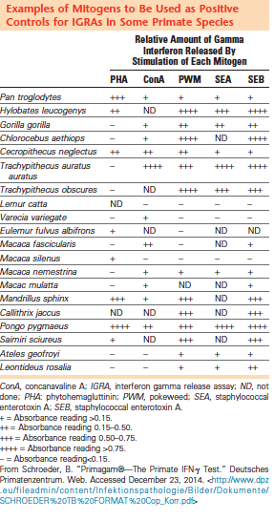
Primates
Modification of BOVIGAM
Cell mediated immunity test
Positive by cytokine IFN-gamma
http://www.dpz.eu/fileadmin/content/Infektionspathologie/Bilder/Dokumente/SCHROEDER%20TB%20FORMAT%20Cop_Korr.pdf
Notes:
Lymphocytes from TB infected animals produce IFN-amma, lymphocytes from non-infected animals do NOT produce it

Slide 21
PRIMAGAM
2 stages
Blood incubated with tuberculin PPD to stimulate lymphocytes
Second – EIA to find IFN-gamma
All bacterial and viral have base-line IFN-gamma =need controls
100% specificity for macaques, 92% sensitivity (similar to skin test)
Baboons are only species where contradictory results reported
Primary screening test or auxiliary test in combination with others
Notes:
IFN-gamma in plasma of each blood is determined with a sandwich EIA. The IFN-gamma in the sample binds to antibodies to primate IFN-gamma bound to a solid support and is visualized with a second anti-primate IFN-gamma antibody labeled with a color. The darker the color the more there are

Slide 22
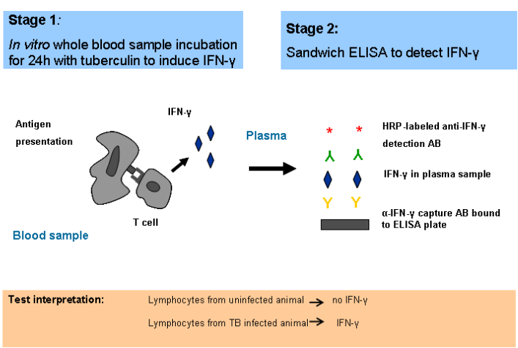
PRIMAGAM

Slide 23
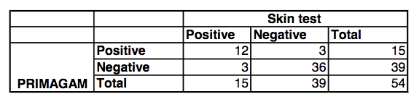
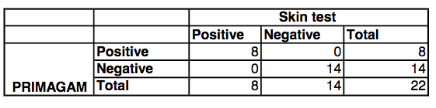
Math….
Species tested by PRIMAGAM
Rhesus macaques

Slide 24
Math….
Species tested by PRIMAGAM
Sensitivity = a/(a+c)
Specificity =d/(b+d)
Sensitivity = a/(a+c) = 12/15 = 80%
Specificity =d/(b+d) = 36/39 = 92%

Slide 25
Math
Rhesus macaques
Sensitivity = a/(a+c)
Specificity =d/(b+d)
Sensitivity = a/(a+c) = 8/8 = 100%
Specificity =d/(b+d) = 14/14 = 100%

Slide 26

Diagnostic Tests
Screening Test = high sensitivity
Confirmatory Test = high specificity
Notes:
For screening tests you want to have a high sensitivity. That way you are more likely to identify animals that are infected. For a confirmatory test you want a high specificity, so that you correctly identified an infected animal. In using these statistics you are comparing the test to a gold standard or a guaranteed way to diagnose if the animal truly has the disease or not

Slide 27
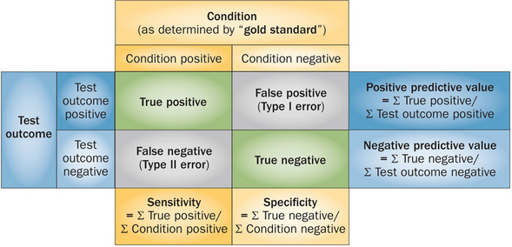
Tests
http://www.nature.com/nrneph/journal/v10/n4/fig_tab/nrneph.2013.281_F1.html

Slide 28
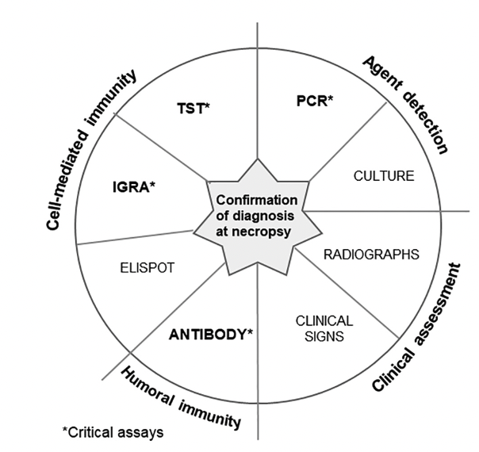
Comparison of
Tests

Slide 29
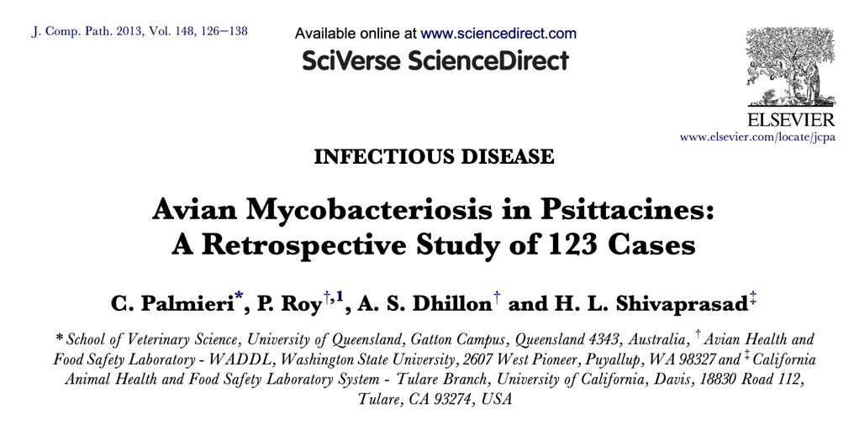
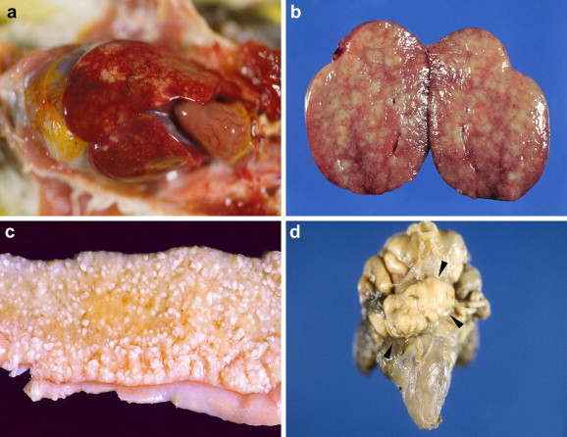
Mycobacteria in Avians
M. Avium subspecies avium
M. genevanvnse
Atypical mycobacetria
Rod shaped and vary in length
Survives in soil up to 4 years
Notes:
Mostly Amazons and grey cheeked parakeets, pale livers and spleens and thickened small intestines and nodules. M avium serotypes 1, 2, 3, and 6 and M genavense

Slide 30
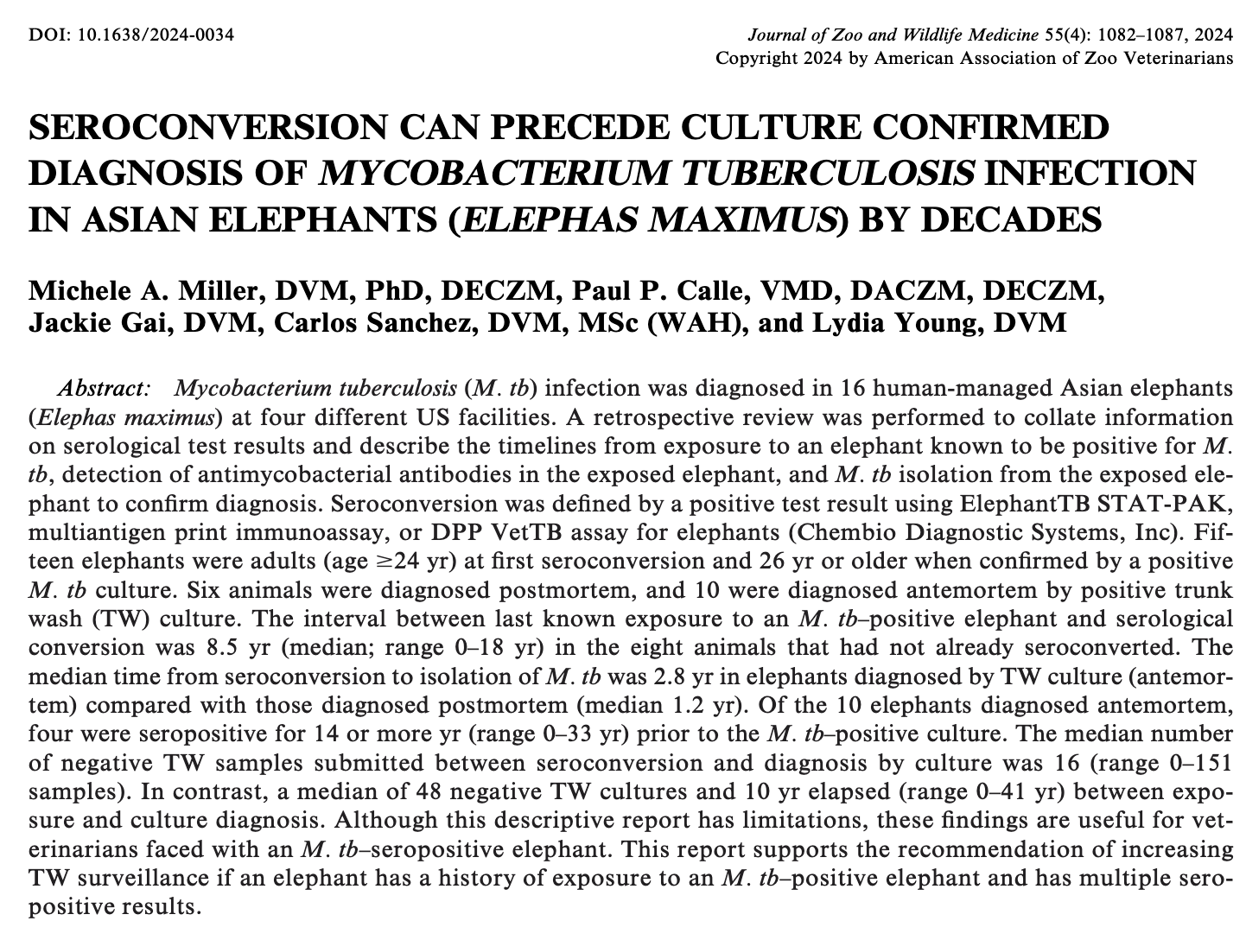
Elephant TB Seroconversion
Greenfield-Feig

Slide 31
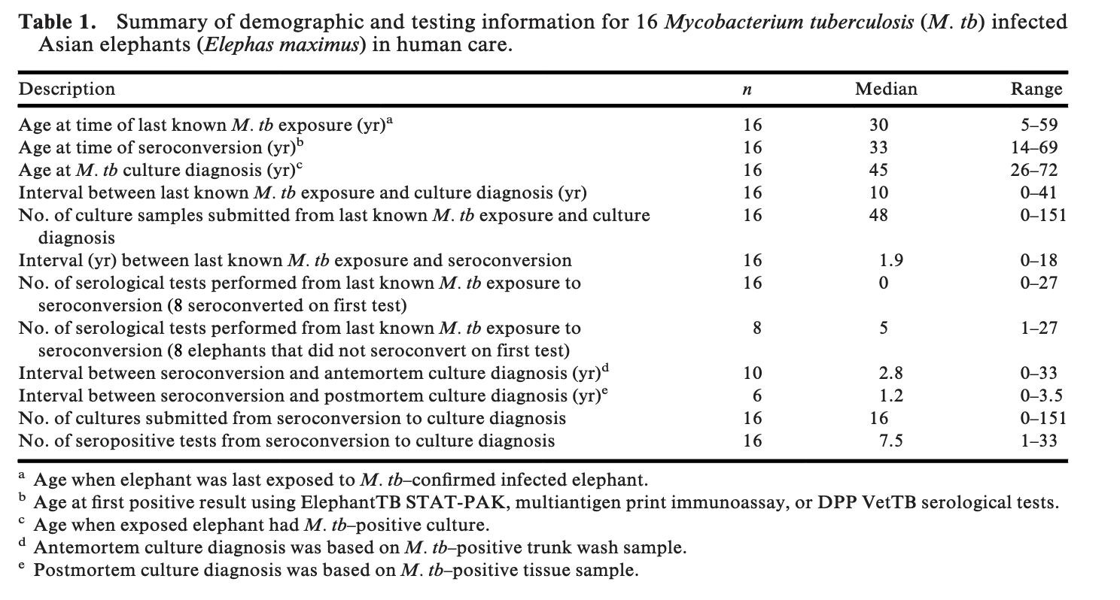
Elephant TB Seroconversion or Culture

Slide 32
Question
In a study evaluating Mycobacterium tuberculosis infection in Asian elephants (Elephas maximus), which of the following statements is correct?
a) Trunk wash culture is a highly sensitive method for detecting M. tuberculosis infection in elephants.
b) Most elephants in the study were calves or juveniles at the time of first seroconversion.
c) Seroconversion typically occurred within a few months of exposure to a positive elephant.
d) Elephants could remain seropositive for decades prior to a positive culture results.
e) All M. tuberculosis–positive elephants were diagnosed antemortem with a positive culture.

Slide 33
Answer
In a study evaluating Mycobacterium tuberculosis infection in Asian elephants (Elephas maximus), which of the following statements is correct?
a) Trunk wash culture is a highly sensitive method for detecting M. tuberculosis infection in elephants.
b) Most elephants in the study were calves or juveniles at the time of first seroconversion.
c) Seroconversion typically occurred within a few months of exposure to a positive elephant.
d) Elephants could remain seropositive for decades prior to a positive culture results.
e) All M. tuberculosis–positive elephants were diagnosed antemortem with a positive culture.
Answer: D; A - trunk wash cultures are insensitive method for diagnosis; B - most elephants adults; C - could be years between exposure and seroconversion; D - could be years between seropositive and culture positive; E - some were only positive postmortem on isolation

Slide 34
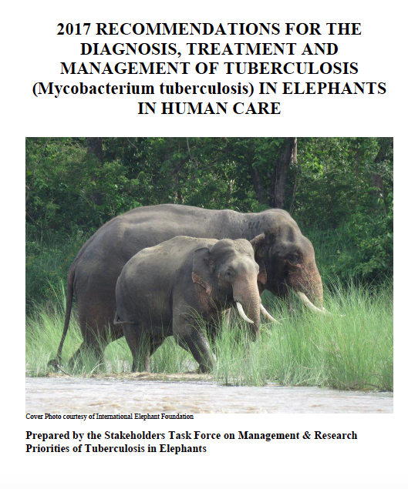
Elephant tuberculosis
Mycobacterium tuberculosis (Mtb)
Transmission
Notes:
Transmission is by droplet nuclei (1-5 microns in diameter) that is airborne in humans, in elephants all verified transmissions between elephants and humans involved facility employees working with or exposed to housing environment of an infected animal

Slide 35
Trunk wash
Trained elephant (2-4 weeks)
Materials – sterile 0.9% saline, sterile 60 ml syringe, 1 gallon zip bag, 50 ml screw top plastic jar or centrifuge tube
Series of 3 collected on separate days in 1 week
No food/water for 2 hours minimum before
Notes:
This can take 2-4 weeks to train for this behavior.

Slide 36
Trunk wash
Restrain trunk, tip up
60ml saline into nostril
Lift trunk
Drain/exhale fluid into bag
Should have 40 ml
Refrigerate and send to lab
Frozen regular freezer until sent to lab
qPCR
Notes:
A qPCR test is being validated at the USDA’s National Veterinary Services Lab in Ames, IA, this test is improving the sensitivity.

Slide 37
Trunk wash issues
Safety
Zoonoses
Assumption that has respiratory form
Assumption shed organism in respiratory tract
Assumption will shed in 3 day testing period
Overgrowth potential from trunk contents
Positive = likely positive
Negative = not definitive
Notes:
The trunk is very strong, significantly more than several handlers. For added safety, you can have the elephant lay sternally or lateral recumbency. For zoonotic safety, the handlers can wear PPE such as an N-95 mask or greater (needs to filter 0.3 micron particles), disposable gloves, and work in a well ventilated area. It is unknown how many elephants can carry latent or walled off infections that could be missed with culturing. Unknown if shedding pass periodically or continuously. There could be overgrowth of contaminants from other materials in the trunk.

Slide 38
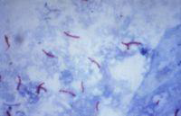
Positive Elephant
Notify regulator
Notify personnel
Notify other facilities
Confirm positive
Sequencing
Sensitivity
Medications
Notes:
Notify regulatory personnel such as the state public health veterinarian, this could also include USDA inspector, state veterinarian, local public health official
Double check the positive with a stored banked sample if available. Request additional sequencing of the isolate. Get sensitivity of the isolate. If your lab can’t do this, send it to National Veterinary Services Laboratory (NVSL). Many medications used for treatment have been bulk drugs. There are various concerns with this including delay in obtaining, loss of potency. This loss of potency can be evaluated by analyzing it with a potency assay

Slide 39
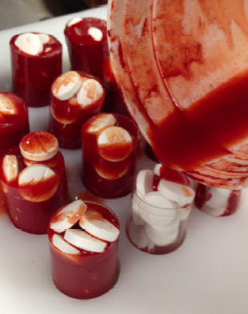
Treatment
Isoniazid, Rifampin, Pyrazinamide, and Ethambutol typically used
Isoniazid and Rifampin (or fluroquinolone) in all treatments
Isoniazid is drug to have in all protocols
Tolerance issues
Resistance issues
4 drug regimen for 6-12 months
Oral or rectal
Notes:
There is a fine line in treating these animals and adverse effects.
Isoniazid is the drug that is responsible for the rapid killing of actively dividing M tuberculosis organisms. Pyrazinamide is used in conjunction to prevent development of resistance to isoniazid. Rifampin kills latent or inactive M. tuberculosis organisms and resolves cavitary lesions. Levofloxacin (fluroquinolone) can be used in place or in addition to rifampin. Ethambutol is similar to pyrazinamide
You should test elephants weekly for 2 months for trunk wash plus a qPCR if available. You can also do triple trunk wash tests each week for the first 2-3 months of treatment. After treatment, an elephant should be tested quarterly during the year. The qPCR test is performed on the trunk wash.

Slide 40
Free-ranging wildlife Bovine tuberculosis reservoirs
White tailed deer in Michigan
Badgers in Great Britain
Feral pigs in Europe
Brush tailed possums in New Zealand
Buffalo in South Africa

Slide 41
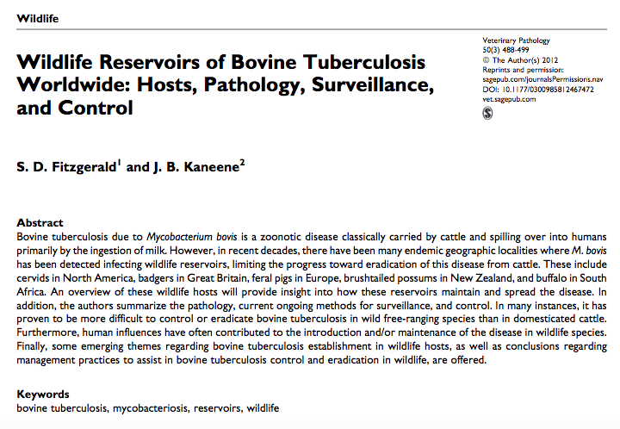

Slide 42
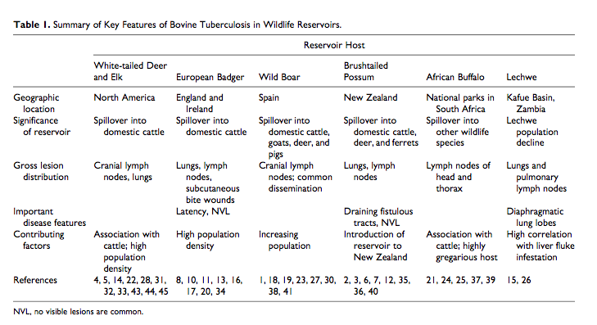

Slide 43
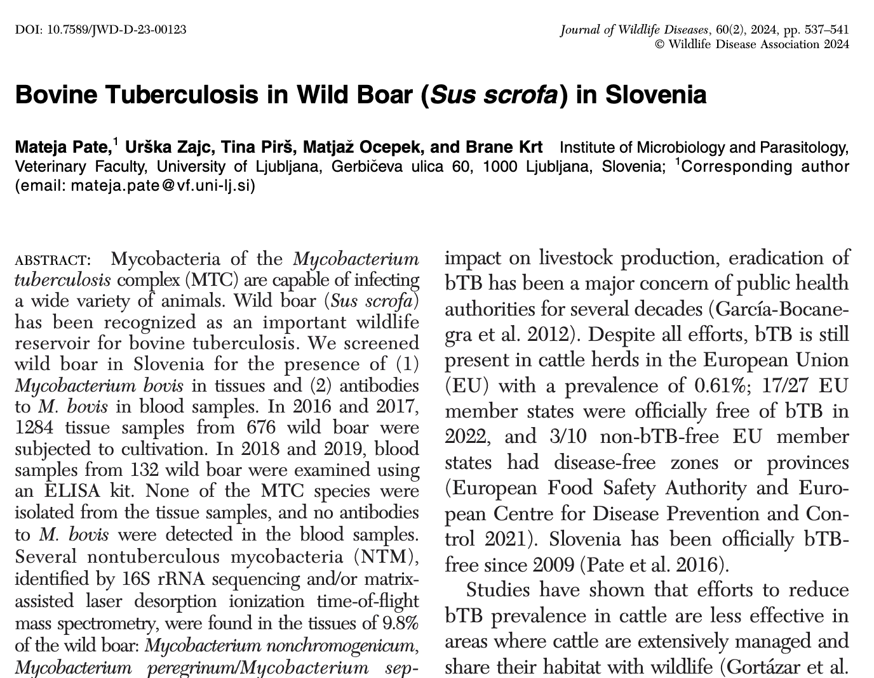
Bovine tuberculosis and Wild Boar

Slide 44
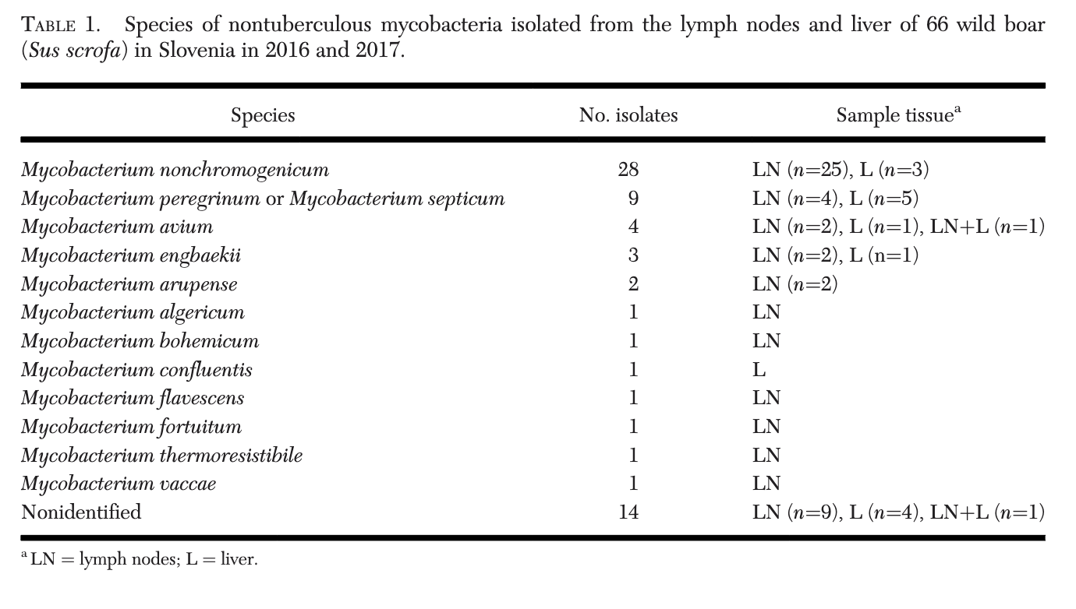
Bovine tuberculosis and Wild Boar

Slide 45
Question
In a recent paper evaluating for the presence of Mycobacterium bovis in wild boar (Sus scrofa) in Slovenia, which of the following testing methods were employed and which is also considered an indirect testing method?
A. Acid fast staining
B. M. bovis ELISA
C. Tissue PCR, rRNA sequencing
D. Tuberculin skin test of the ear
E. Mass spectrometry

Slide 46
Answer
In a recent paper evaluating for the presence of Mycobacterium bovis in wild boar (Sus scrofa) in Slovenia, which of the following testing methods were employed and which is also considered an indirect testing method?
A. Acid fast staining
B. M. bovis ELISA
C. Tissue PCR, rRNA sequencing
D. Tuberculin skin test of the ear
E. Mass spectrometry
Notes:
Answer: B. ELISA – serology is considered an indirect testing method, was utilized in this paper with the benefit of being rapid, simple, inexpensive in wildlife.
Explanation:
A direct test confirms the actual presence of a Mycobacterial organism, whereas an indirect test demonstrates exposure.
A. Acid fast staining is considered direct. AF staining was not used for blood smears in the study (making this an unlikely boards question, but rather a study question), also typically described to have low SN/SP.
C. Tissue PCR + sequencing utilized in this paper but considered direct
D. Tuberculin skin tests in swine are done on the ear rather than the caudal fold in bovids. This was not performed in this study, but is also considered an indirect method.
E. Mass spec utilized in this paper but considered direct due to identification of ribosomal proteins from the cultured mycobacterial colonies.
Note: mycobacterial culture had to be performed prior to PCR, sequencing, and mass spec, and is considered a direct method, I did not include that as an answer since it is lumped in the methods as a precursor to other diagnostics.

Slide 47

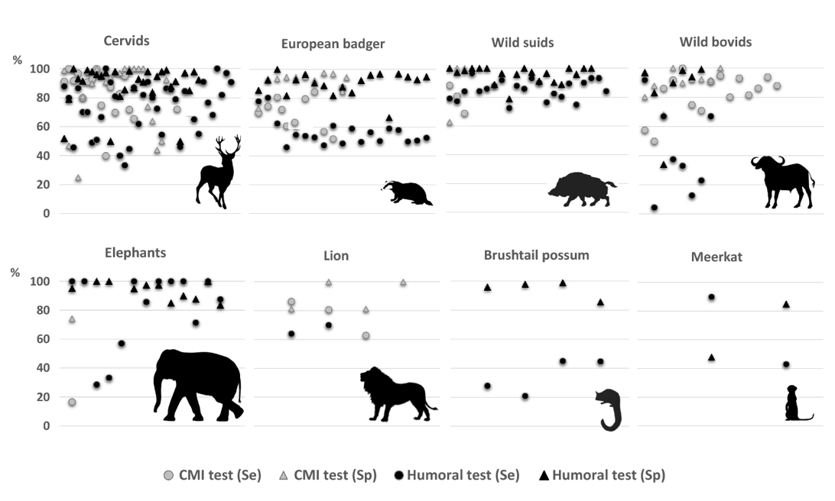
Diagnosis of Tuberculosis in wildlife

Slide 48
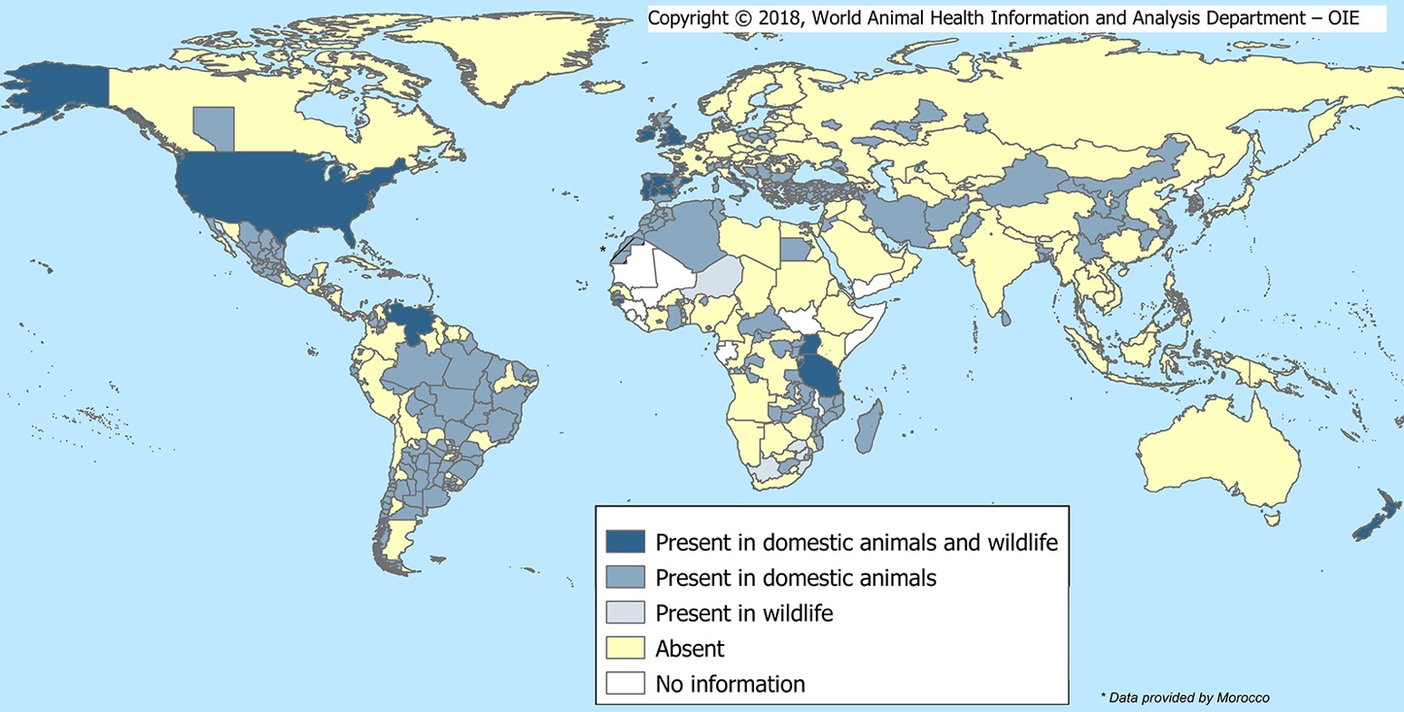
Mycobacteria bovis

Slide 49
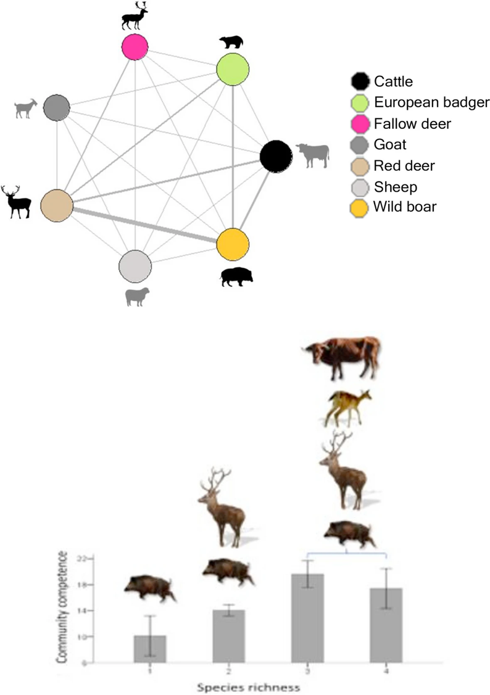
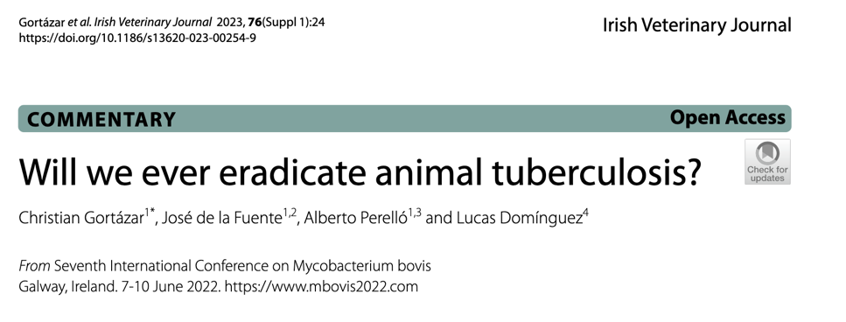

Slide 50
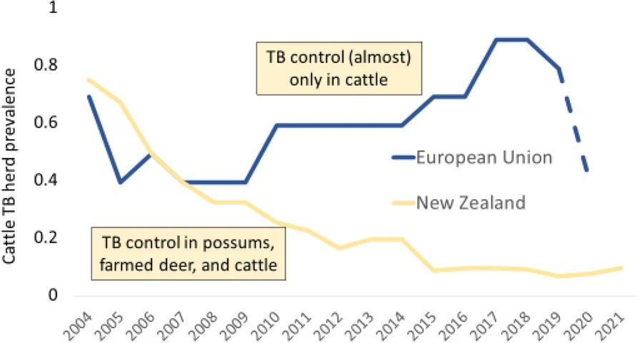

Slide 51
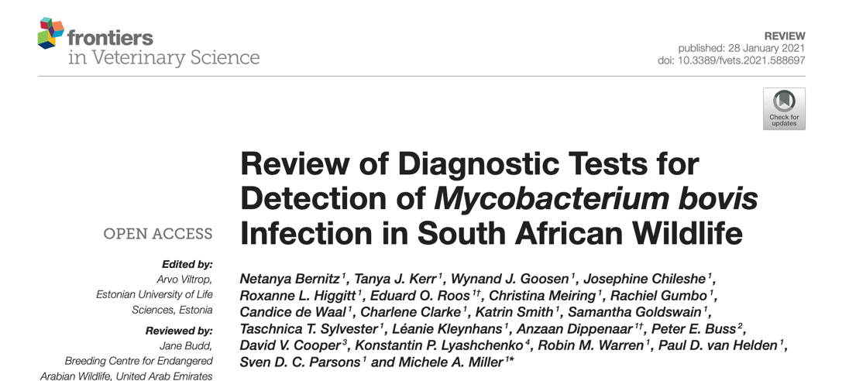
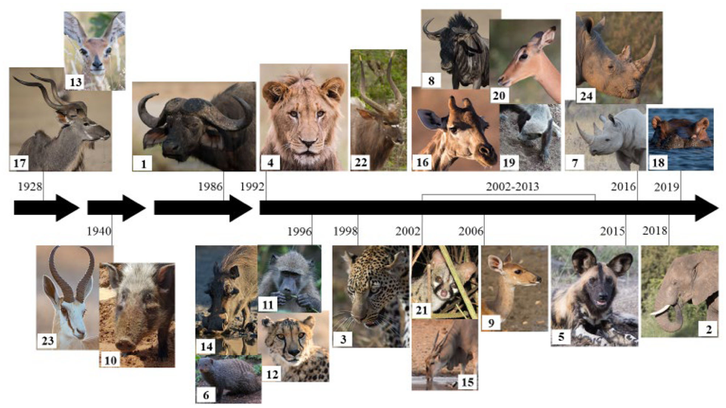
M. bovis in South Africa – Index Cases

Slide 52
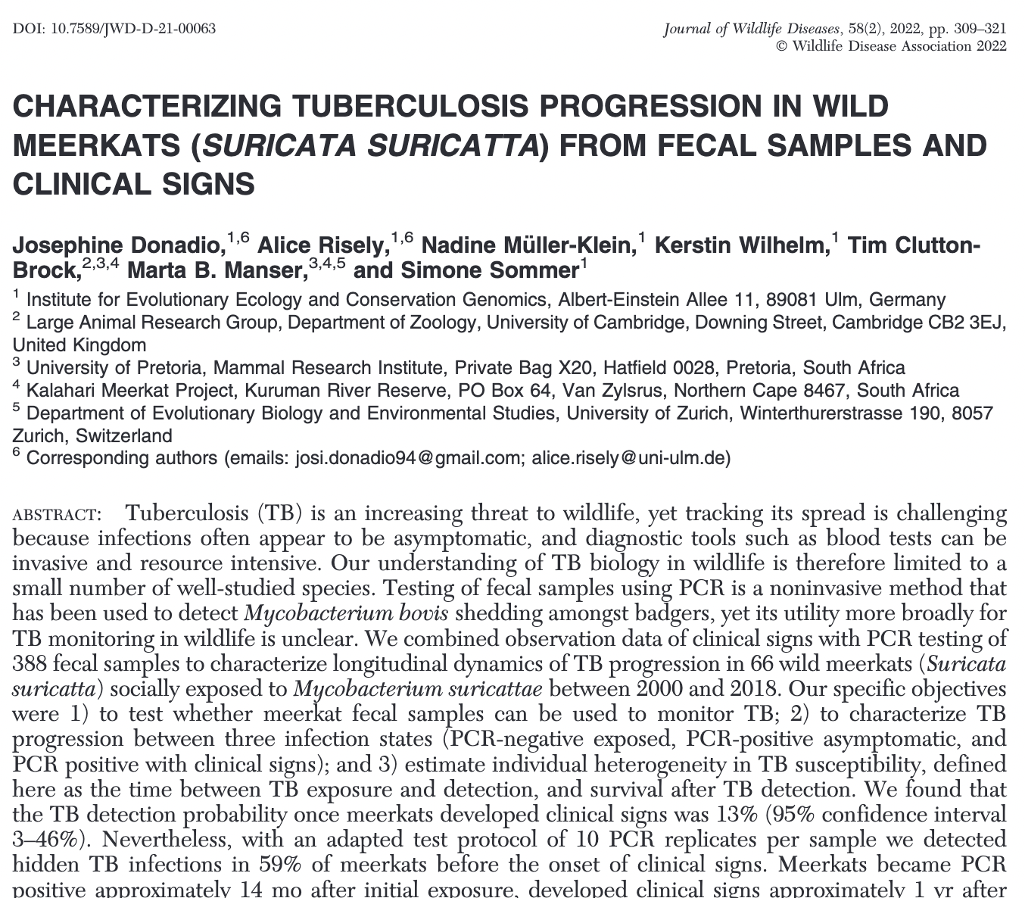

Slide 53
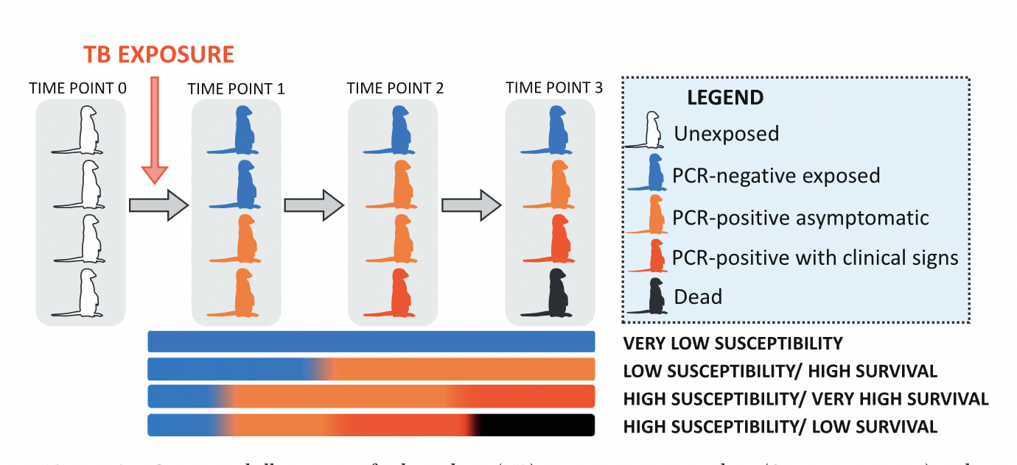
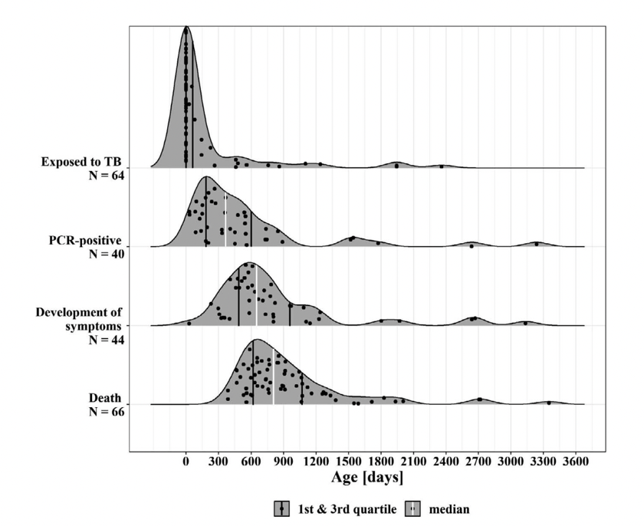
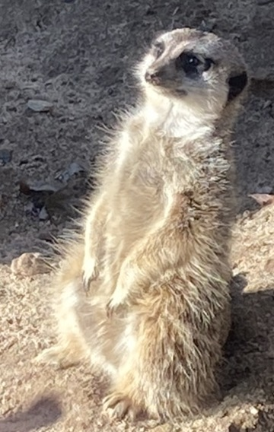

Slide 54

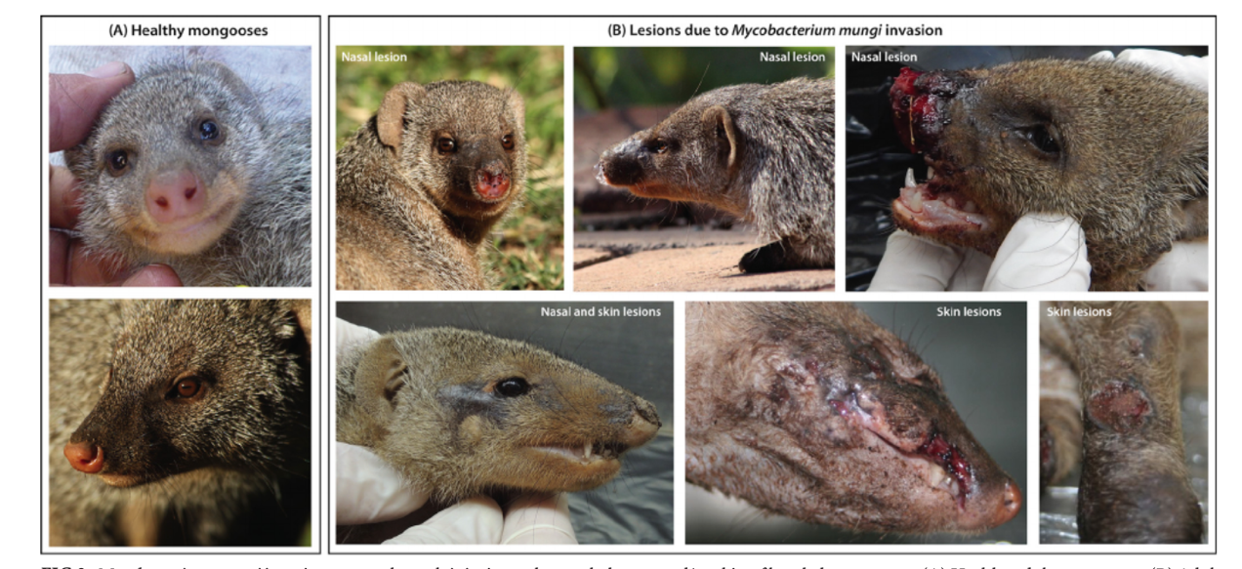
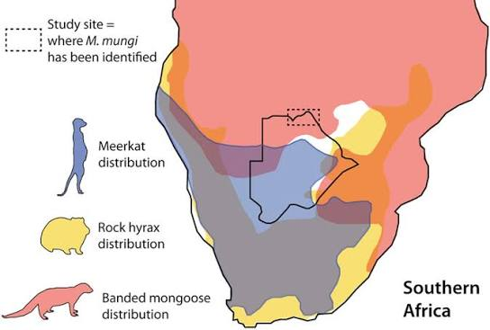
Tuberculosis Complex
In Banded Mongoose

Slide 55
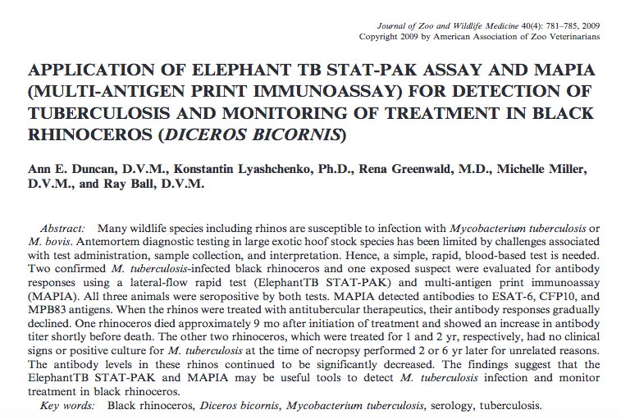
Rhinoceros Tuberculosis testing
Notes:
65% of institutions did not tuberculosis test their rhinoceros. Intradermal skin testing, variable results, a rhino found dead, these results may work Elephant MAPIA and STAT-PAK, other paper by Michelle Whitehead summary (Miller et al) showed that rhino tested positive after skin test, so may have been boosted by skin test antigen and seropositive for 12 years afterward

Slide 56
Camelids
M. bovis and M. tuberculosis
M. microti South American camelids
Combination testing (antibody and Interferon Gamma Release Assay)
TB test in axilla (< 2.0 mm increase – negative; 2-4 mm increase = suspect; >4.0mm = positive)
Notes:
Bovigam does work to detect camelid interferon gamma; serologic or interferon gamma tests alone do not have a sensitivity greater than 70%, but in combination, it is better. Camelids can present with a change in behavior, anorexia, cachexia, respiratory distress, coughing, or sudden death or euthanasia for declining body condition

Slide 57
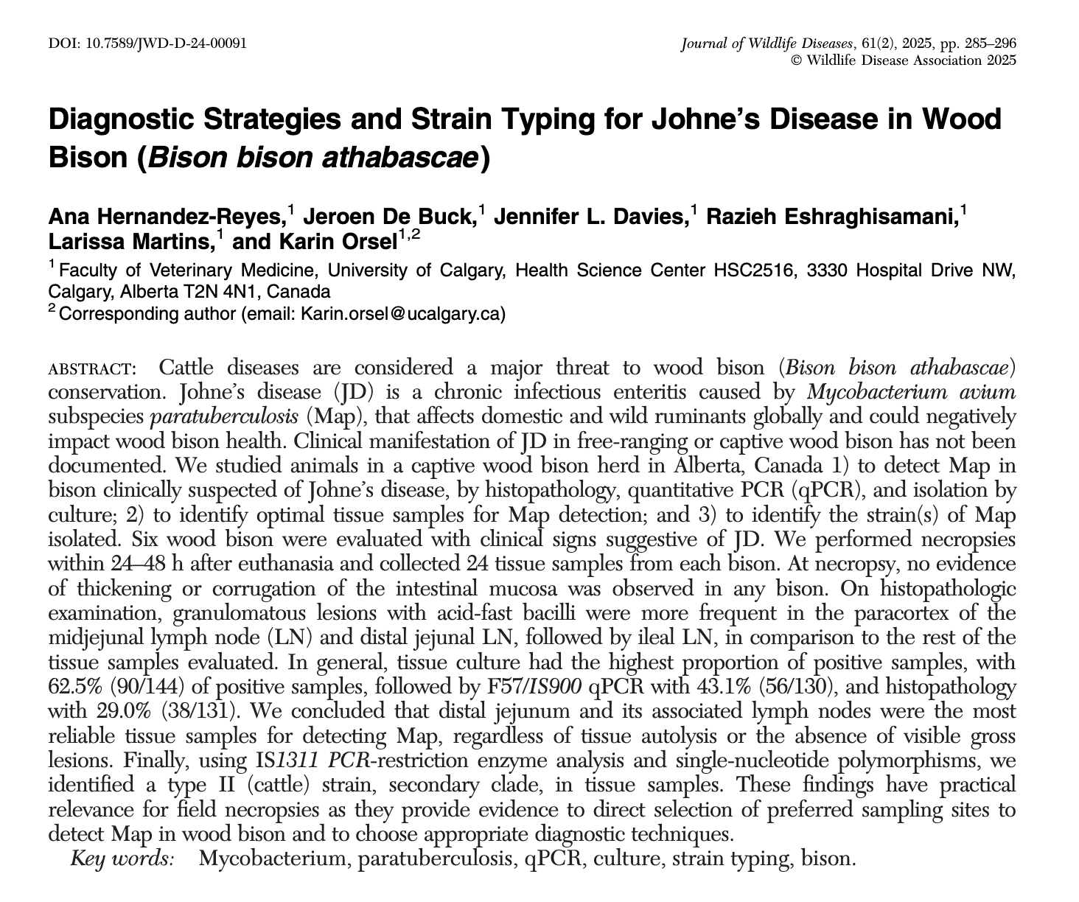
Johne’s Disease in Bison
Day
Notes:
Day

Slide 58
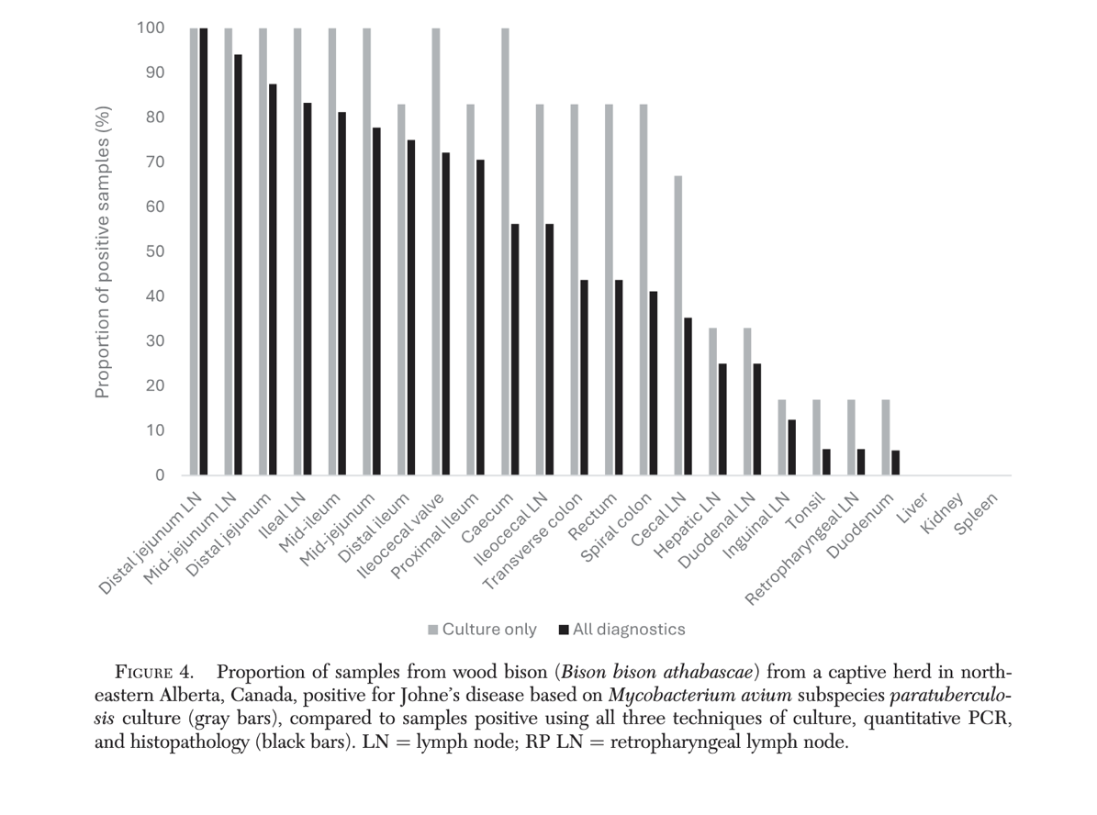
Johne’s Disease in Bison

Slide 59
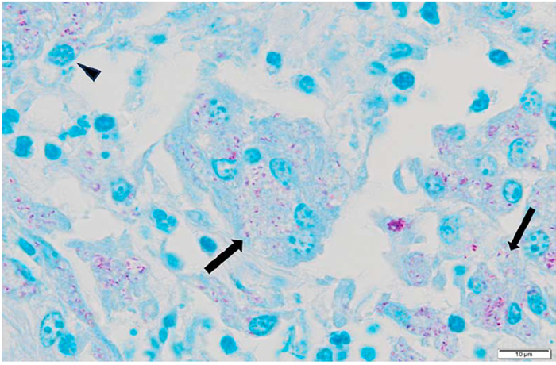
Question
The following histopathology was obtained from a wood bison
(Bison bison athabascae) with diarrhea. If you were testing
another animal in this herd, what sample should you obtain
and what method of testing should you use for the highest
likelihood of obtaining a positive result?

Slide 60
Answer
This is Mycobacterium avium subsp. paratuberculosis (Johne’s disease) in a wood bison. Culture of the distal jejunal lymph node has been associated with the highest percentage of positive results in this species, regardless of autolysis. qPCR can also be used despite autolysis, though this method had a lower percentage of positive results than culture (43.1% compared to 62.5%).

Slide 61
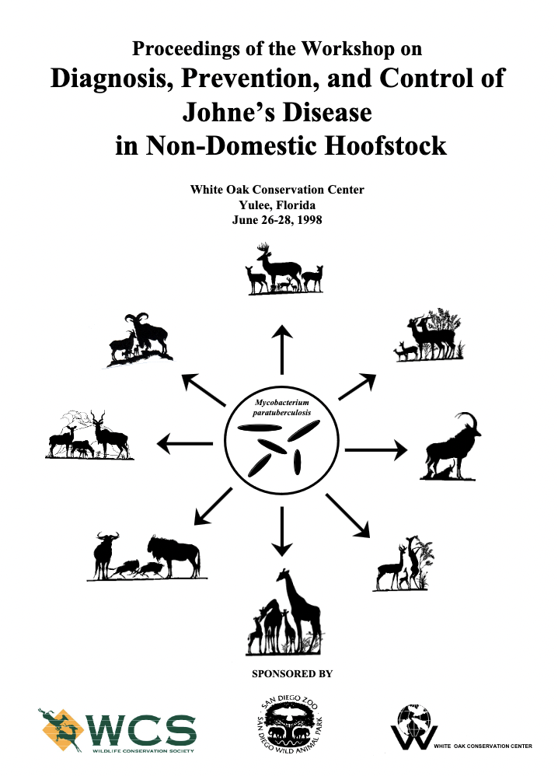
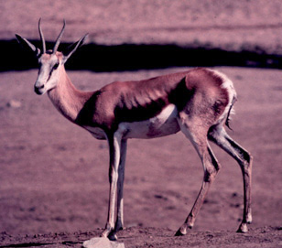
https://johnes.org/other-animals/zoo-ruminants/
Notes:
Based on the 2007 Dairy NAHMS study, about 68 percent of U.S. dairy herds have at least one cow that tests positive for Johne’s with herd prevalence approaching 100% in large dairy herds. Because few herds have instituted biosecurity programs, infection continues to spread. https://www.aphis.usda.gov/aphis/ourfocus/animalhealth/nvap/NVAP-Reference-Guide/Control-and-Eradication/Johnes-Disease
Animals exposed at a young age and develop clinical signs 2+ years of age

Slide 62
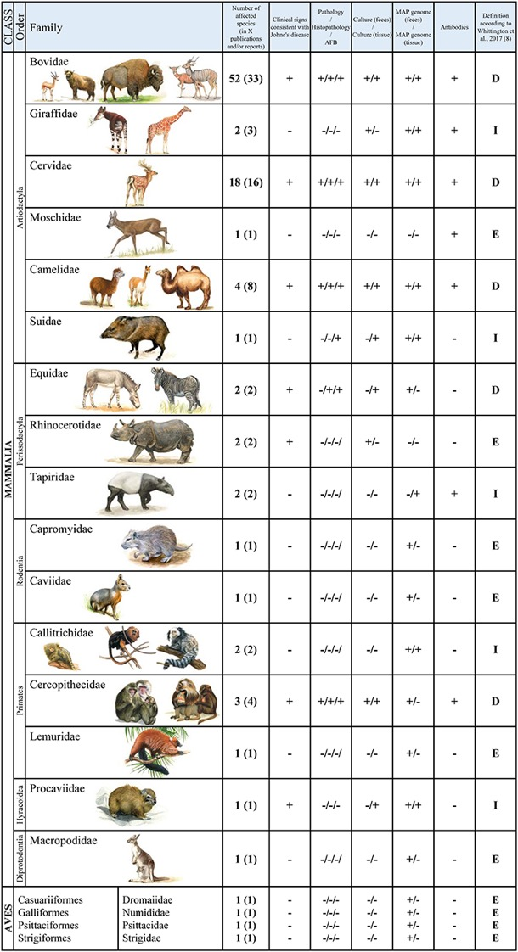
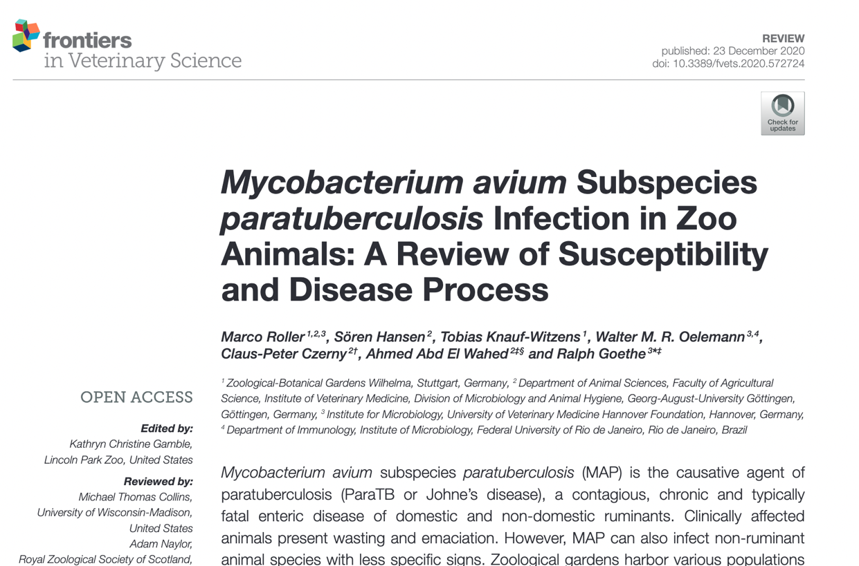
M. Avium ssp paratuberculosis

Slide 63
Johne’s Disease
Stage I – silent, subclinical, nondetectable
Stage II: Subclinical shedders
Stage III: Clinical Johne’s Disease
Stage IV: Emaciated animals with fluid diarrhea
Notes:
Infected by feces, milk or colostrum; Stage 1 is in calves, heifers, young animals under 2, fecal cultures and serology won’t detect; Stage 2 heifers or older animals, appear healthy but shedding, may or may not progress to stage 3; Stage 3 advanced infection and clinical signs associated with stress, acute or intermittent diarrhea, weight loss, decreased milk production, recover and relapse; Stage 4 terminal stage, extremely thin and develop bottle jaw

Slide 64
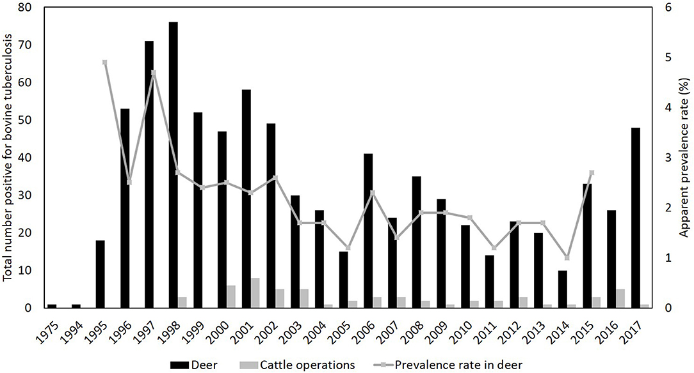
Cervids
https://www.frontiersin.org/files/Articles/411895/fvets-05-00301-HTML/image_m/fvets-05-00301-g002.jpg

Slide 65


Cervids, etc. Mycobacteria

Slide 66
Carnivores
Reservoir or spill over host
Badgers, lions, others
M. mungi (banded mongoose)
Diagnose – BAL but may not be respiratory
2008 CVC Kansas Proceedings
Notes:
badgers, black bears (7), bobcats, coyotes (18), feral cats, feral dogs, gray fox, mink, opossum (2), otters, porcupine, raccoons (8), red fox (3), skunks, snowshoe hare, and weasel. The majority of the infected wildlife has come from 12 northeastern Lower Peninsula counties in Michigan
Diagnosis by BAL, upper respiratory mucosal sampling (but tend to not be the respiratory form),

Slide 67


Veterinary Micrbiology 177
(2015) 252-260
Notes:
Lions do not appear to maintain the infection, they can have respiratory, GI, or other lesions. Diagnosis – gold standard is culture from organs, BAL but this can produce significant false negative results (only 6% of 134 lions test in Kruger had this). Antemortem you could use ELISA/EIA antibody tests for M bovis and M. avium, but there really aren’t more specific antemortem diagnoses. Serological tests tend to not be very sensitive until the animal has advanced tuberculosis. The intradermal skin test was used to identify 86.5% of lions (52%) with M. bovis but had to use 0.2 ml of tuberculin per site and did comparative avian at the same time, but 13.5% of the animals were falsely negative. The results were read in 72 hours.

Slide 68

Notes:
STAT-PAK and DPP have a very high test specificity

Slide 69

Pinnipeds
Mycobacteria pinnipedii
Seals, sea lions, dolphins
Diagnosis – culture, stains, PCR on BAL, CT, serology
Dual-path platform > STAT PAK
One positive….
Notes:
Due to these animals having exposure to many environmental waterborne mycobacteria, one positive on a test should initiate further testing.

Slide 70
Tapirs
Ground exposure may increase baseline immune response to testing (antigen)
Diagnosis – BAL, culture, PCR, STAT PAK, ELISA, skin testing (comparative avian and bovine)
MAPIA and RT
M. tuberculosis
Notes:
MAPIA test appeared to work for M tb, M bovis and maybe M pinnipedii

Slide 71

Notes:
Treated for 11 months, minimal side effects

Slide 72

Mycobacterial Infections in Sea Turtles

Slide 73
Question
Which of the following statements is true regarding nontuberculous mycobacterial infections in cold-stunned Kemp’s ridley sea turtles (Lepidochelys kempii)?
A. Mycobacterium chelonae was the most commonly identified NTM species in the study, and pulmonary disease was the most common clinical manifestation.
B. Mycobacterium syngnathidarum was the most commonly identified NTM species in the study, and pulmonary disease was the most common clinical manifestation.
C. Fluoroquinolone monotherapy is the recommended treatment for M. chelonae infection in Kemp’s ridley sea turtles
D. For all turtles with NTM infection, antimicrobial selection was guided by susceptibility testing, and all were successfully treated and released.
E. NTM infections were treated on average for 1 month duration with a combination of antimicrobials and an antifungal

Slide 74
Answer
Which of the following statements is true regarding nontuberculous mycobacterial infections in cold-stunned Kemp’s ridley sea turtles (Lepidochelys kempii)?
A. Mycobacterium chelonae was the most commonly identified NTM species in the study, and pulmonary disease was the most common clinical manifestation.
B. Mycobacterium syngnathidarum was the most commonly identified NTM species in the study, and pulmonary disease was the most common clinical manifestation.
C. Fluoroquinolone monotherapy is the recommended treatment for M. chelonae infection in Kemp’s ridley sea turtles
D. For all turtles with NTM infection, antimicrobial selection was guided by susceptibility testing, and all were successfully treated and released.
E. NTM infections were treated on average for 1 month duration with a combination of antimicrobials and an antifungal

Slide 75


Notes:
Non-healing skin lesions, differentiate from lymphoma, proliferative ulcerative skin lesions, pneumonia, gall bladder emphysema

Slide 76

Leprosy and Armadillos
Nye
Notes:
Mycobacterium leprae

Slide 77

Armadillos Positive for Mycobacterium leprae

Slide 78
Question
A free-ranging Mexican long-nosed nine-banded armadillo (Dasypus mexicanus) from Missouri is screened for Mycobacterium leprae using real-time PCR targeting the RLEP repetitive element. Liver tissue is PCR-negative. Which of these conclusions is most accurate?
A. The negative liver PCR result does not exclude M. leprae infection because different tissues from the same animal may yield differing PCR results, and relying on a single tissue type may therefore result in false-negative animals and underestimation of population prevalence.
B. The negative liver PCR result makes current M. leprae infection unlikely because the liver is a preferred site of bacterial growth in armadillos; therefore, additional tissue testing would be expected to have minimal diagnostic benefit.
C. The negative liver PCR result does not exclude M. leprae infection because bacterial DNA may be distributed unevenly among tissues; however, spleen PCR would be expected to have sufficiently high sensitivity that a negative spleen result would effectively exclude infection.
D. The negative liver PCR result is most consistent with prior rather than active infection because tissue PCR primarily identifies advanced disseminated disease, whereas earlier or resolved infections would be expected to be identified only through serologic testing for PGL-1 or LID-1 antibodies.

Slide 79
Answer
A free-ranging Mexican long-nosed nine-banded armadillo (Dasypus mexicanus) from Missouri is screened for Mycobacterium leprae using real-time PCR targeting the RLEP repetitive element. Liver tissue is PCR-negative. Which of these conclusions is most accurate?
A. The negative liver PCR result does not exclude M. leprae infection because different tissues from the same animal may yield differing PCR results, and relying on a single tissue type may therefore result in false-negative animals and underestimation of population prevalence.
B. The negative liver PCR result makes current M. leprae infection unlikely because the liver is a preferred site of bacterial growth in armadillos; therefore, additional tissue testing would be expected to have minimal diagnostic benefit.
C. The negative liver PCR result does not exclude M. leprae infection because bacterial DNA may be distributed unevenly among tissues; however, spleen PCR would be expected to have sufficiently high sensitivity that a negative spleen result would effectively exclude infection.
D. The negative liver PCR result is most consistent with prior rather than active infection because tissue PCR primarily identifies advanced disseminated disease, whereas earlier or resolved infections would be expected to be identified only through serologic testing for PGL-1 or LID-1 antibodies.
Notes:
Correct answer: A
The study demonstrated differing PCR results between tissues from the same animal - the Greene County armadillo had a PCR-positive spleen but a PCR-negative liver. The authors mentioned that M. leprae may not be detected uniformly among tissues and that sampling only one tissue type could underestimate prevalence or produce false-negative results.
B - negative liver PCR can occur in an infected animal (though liver is a preferred site for M. leprae growth
C - single-organ testing alone (including spleen) is not enough to rule out infection
D - study didn’t show that PCR-negative animals represent prior or resolved infection

Slide 80

Questions?

Slide 81
References
Fowler 8, Fowler 7, Fowler 6
http://www.usaha.org/upload/Committee/InfectiousCattleBison/TB-in-camelids.pdf
http://www.dpz.eu/fileadmin/content/Infektionspathologie/Bilder/Dokumente/SCHROEDER%20TB%20FORMAT%20Cop_Korr.pdf
2017 Recommendations for the diagnosis, treatment, and management of tuberculosis (Mycobacterium tuberculosis) in elephants in human care
http://www.dpz.eu/fileadmin/content/Infektionspathologie/Bilder/Dokumente/LECU%20TuberculosisFORMAT%20COP_Korr.pdf

