Slide 1
Selected Emerging Aquatic Animal Diseases
Craig A. Harms, DVM, PhD, DACZM, DECZM (ZHM)
CBS 817, 27 August 2026

Slide 2
What is an Emerging Disease?
CDC NIOSH Definition:
  Emerging infectious diseases are those whose incidence in humans has increased in the past 2 decades or threaten to increase in the near future.
Medicinenet.com
  An infectious disease that has newly appeared in a population or that has been known for some time but is rapidly increasing in incidence or geographic range
Moutou & Pastoret. 2015. Defining an emerging disease. Rev Sci Tech Off int Epiz 34: 41-44, DOI: 10.20506/rst.34.1.2344.
  Defining emerging disease not straightforward.
  “Real” emergence of brand new disease, geographic emergence in area not previously affected, emergence in species formerly not considered affected, increase in knowledge or awareness of a particular disease
  Human activities frequently play a role in emergence

Slide 3
What is an Emerging disease?
”Emerging Disease” or “Emergence” or “Novel” or “Update” appears in the title of the paper or chapter
It is published in the journal Emerging Infectious Diseases
It’s cool and new and catches the attention of clinicians and researchers
It’s in this week’s New York Times
It’s too recent to appear on this year’s ACZM exam
  (but maybe next year’s)

Slide 4
Yanong R. 2023. Fish Medicine updates. In Fowler 10.
Megalocytivivirus, DNA virus in Iridoviridae
  Infectious Spleen & Kidney Necrosis Virus
Betanodavirus, RNA virus in Nodaviridae, CNS
Picornaviruses, RNA virus, clownfish, bluegill
Tilapia Lake Virus, orthomyxo-like RNA virus
Erysipelothrix spp., E. rhusiopathiae, E. piscisicarius
Fusasporis stethaprioni, microsporidian, tetras
Dr. Day and
Dr. Greenfield-Feig

Slide 5
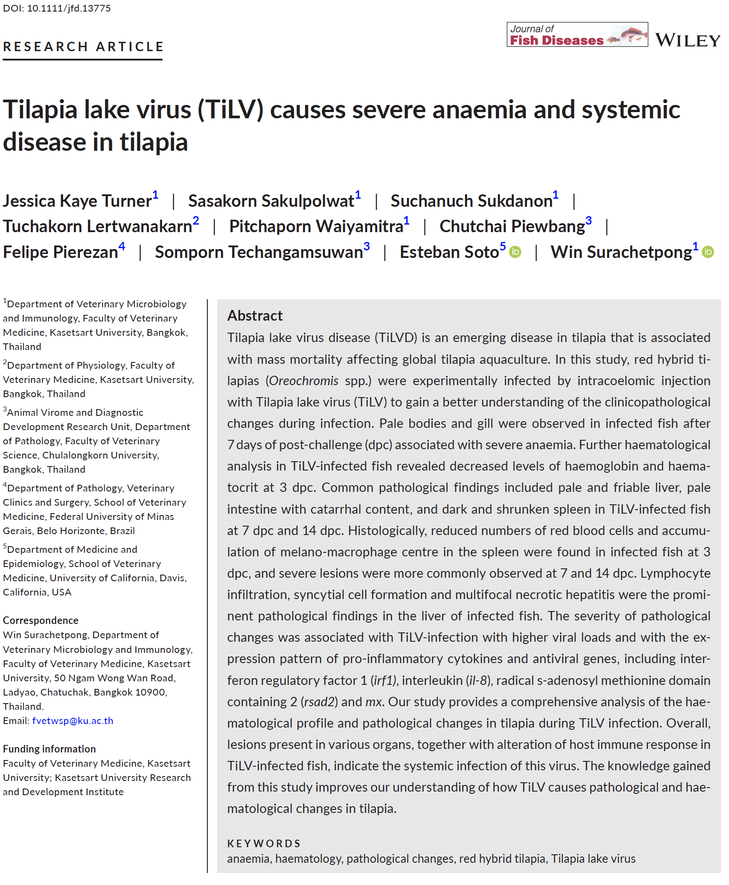
Tilapia lake virus
Dr. Day
Turner et al. 2023. Tilapia lake virus (TiLV) causes severe anaemia and systemic disease in tilapia. J Fish Dis46:643-651. DOI: 10.1111/jfd.13775

Slide 6
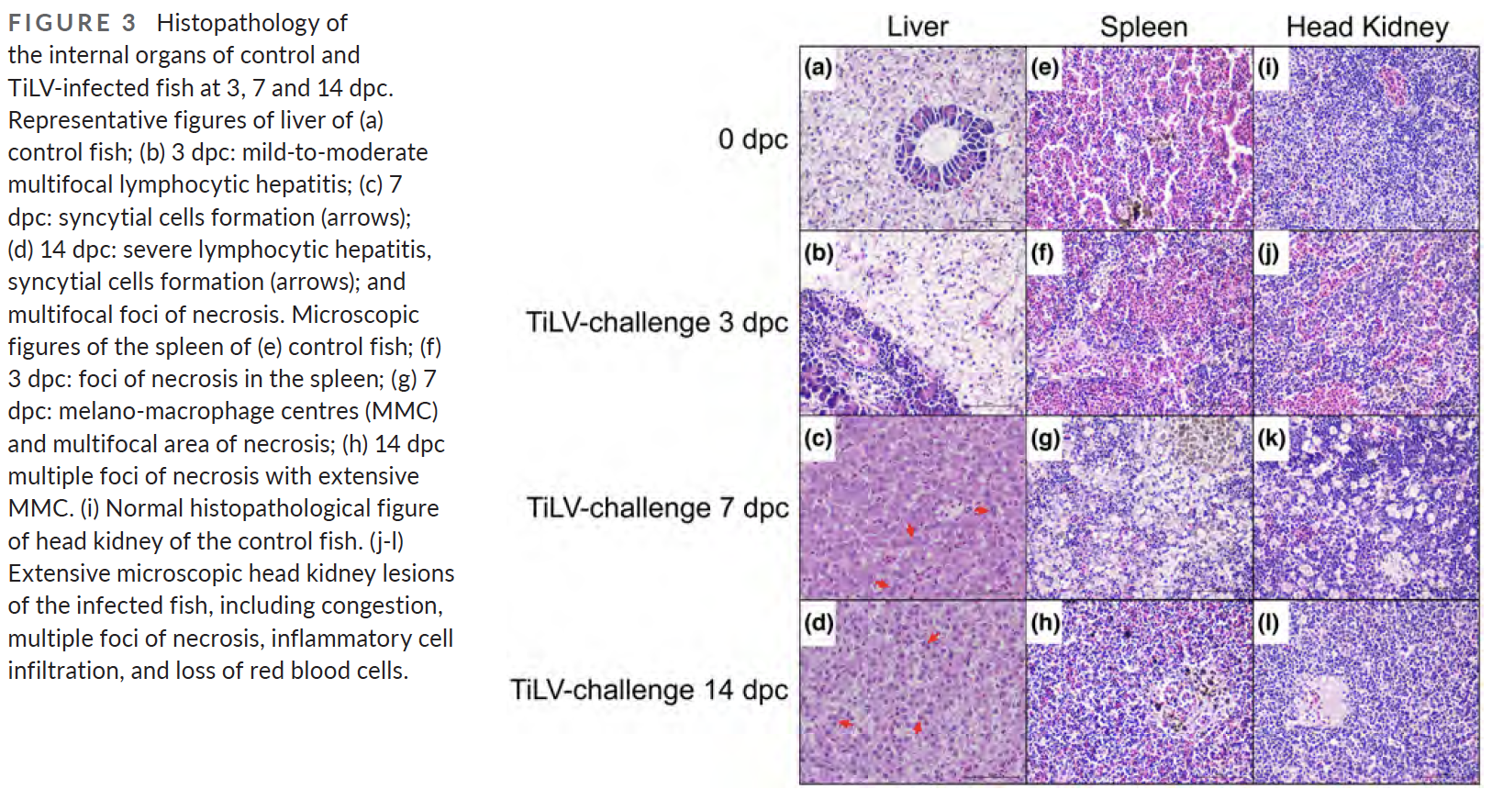
Turner et al. 2023

Slide 7
A tilapia (Oreochromis sp.) presented for emaciation and lethargy. The fish was euthanized and diagnosed with Tilapia Lake Virus (TiLV) via PCR. What type of inclusion bodies do you expect to see on histology?
Eosinophilic intracytoplasmic inclusion bodies
Basophilic intracytoplasmic inclusion bodies
Eosinophilic intranuclear inclusion bodies
Basophilic intranuclear inclusion bodies
Eosinophilic intracytoplasmic and intranuclear inclusion bodies

Slide 8
A tilapia (Oreochromis sp.) presented for emaciation and lethargy. The fish was euthanized and diagnosed with Tilapia Lake Virus (TiLV) via PCR. What type of inclusion bodies do you expect to see on histology?
Eosinophilic intracytoplasmic inclusion bodies
Basophilic intracytoplasmic inclusion bodies
Eosinophilic intranuclear inclusion bodies
Basophilic intranuclear inclusion bodies
Eosinophilic intracytoplasmic and intranuclear inclusion bodies

Slide 9
Yanong R. 2023. Fish Medicine updates. In Fowler 10.
Megalocytivivirus, DNA virus in Iridoviridae
  Infectious Spleen & Kidney Necrosis Virus
Betanodavirus, RNA virus in Nodaviridae, CNS
Picornaviruses, RNA virus, clownfish, bluegill
Tilapia Lake Virus, orthomyxo-like RNA virus
Erysipelothrix spp., E. rhusiopathiae, E. piscisicarius
Fusasporis stethaprioni, microsporidian, tetras
Dr. Day and
Dr. Greenfield-Feig

Slide 10
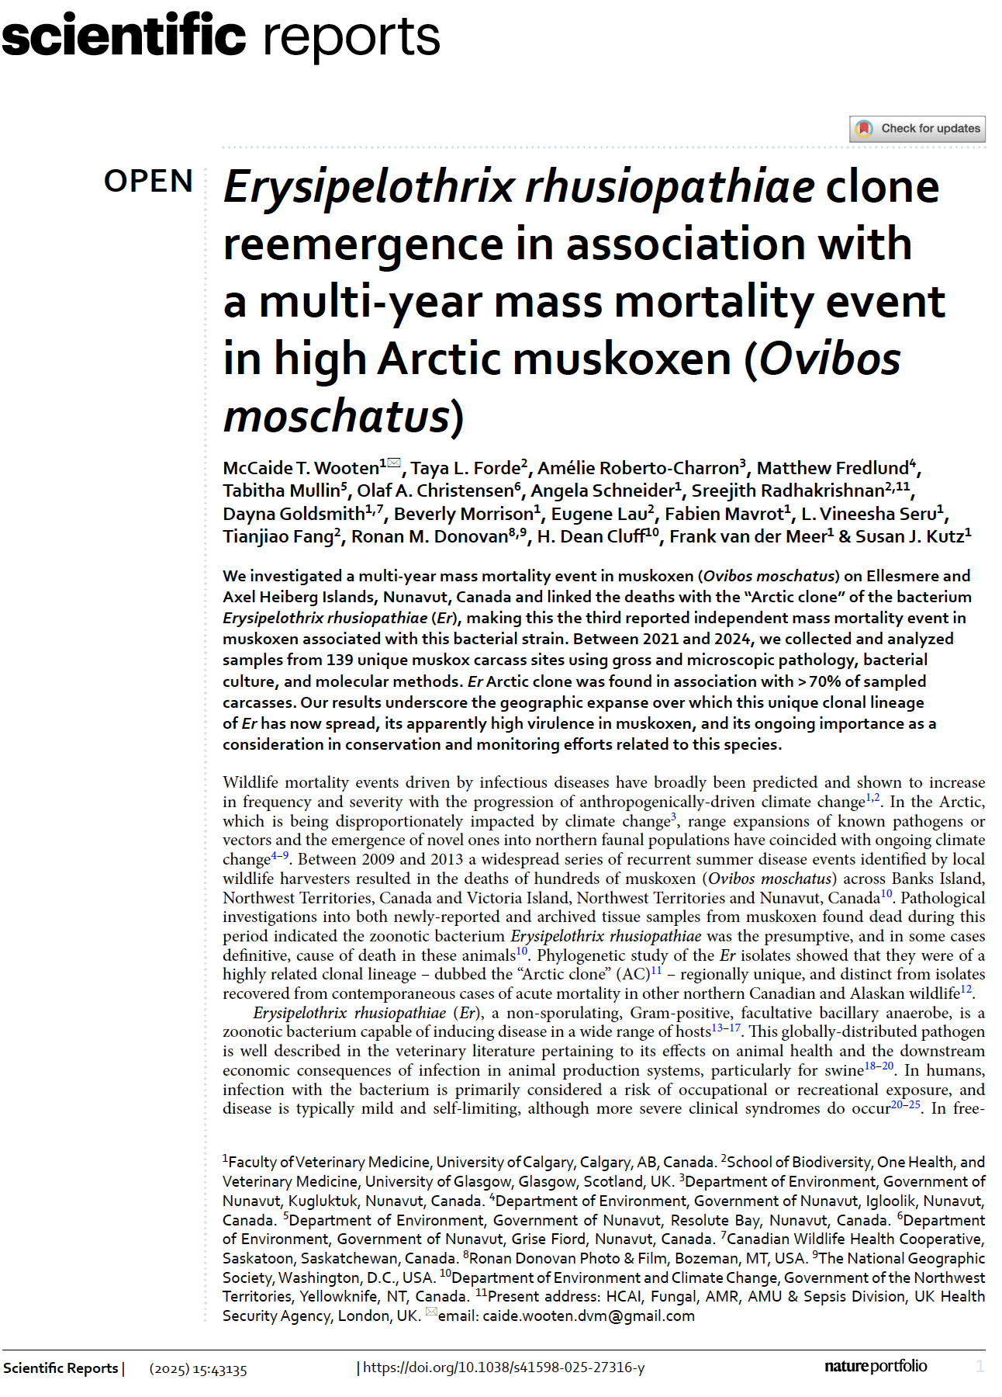
Wooten et al. 2025

Slide 11
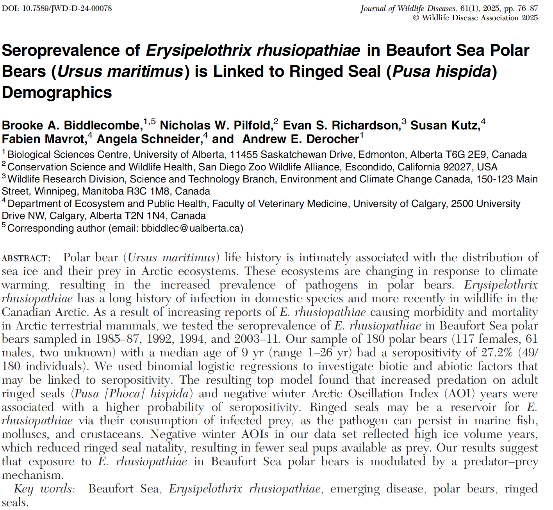
Biddlecombe et al. 2025.
Dr. Greenfield-Feig
Biddlecombe et al. 2025. Seroprevalence of Erysipelothrix rhusiopathiae in Beaufort Sea polar bears (Ursus maritimus) is linked to ringed seal (Pusa hispida) demographics. J Wildl Dis 61:76-87. DOI: 10.7589/JWD-D-24-00078

Slide 12
In a study evaluating the seroprevalence of Erysipelothrix rhusiopathiae in Beaufort Sea polar bears, which of the following is correct?
There was little to no seropositivity in the study population of polar bears
Female polar bears were more likely to be seropositive than males
There was a significant decrease in seropositivity over time
There was higher seropositivity in bears that predated on juvenile seals
Years with high volumes of sea ice resulted in lower seropositivity

Slide 13
In a study evaluating the seroprevalence of Erysipelothrix rhusiopathiae in Beaufort Sea polar bears, which of the following is correct?
There was little to no seropositivity in the study population of polar bears
Female polar bears were more likely to be seropositive than males
There was a significant decrease in seropositivity over time
There was higher seropositivity in bears that predated on juvenile seals
Years with high volumes of sea ice resulted in lower seropositivity
Answer: C – There was a decrease in seropositivity over time (possibly due to predation of young seals which increased as ice was declining, years with higher ice resulted in higher seropositivity since bears ate more adults); A – 27% seropositivity; B – Males were more likely to be seropositive; D – higher seropositivity in bears that ate adult seals; E – years with high sea ice resulted in higher seropositivity

Slide 14
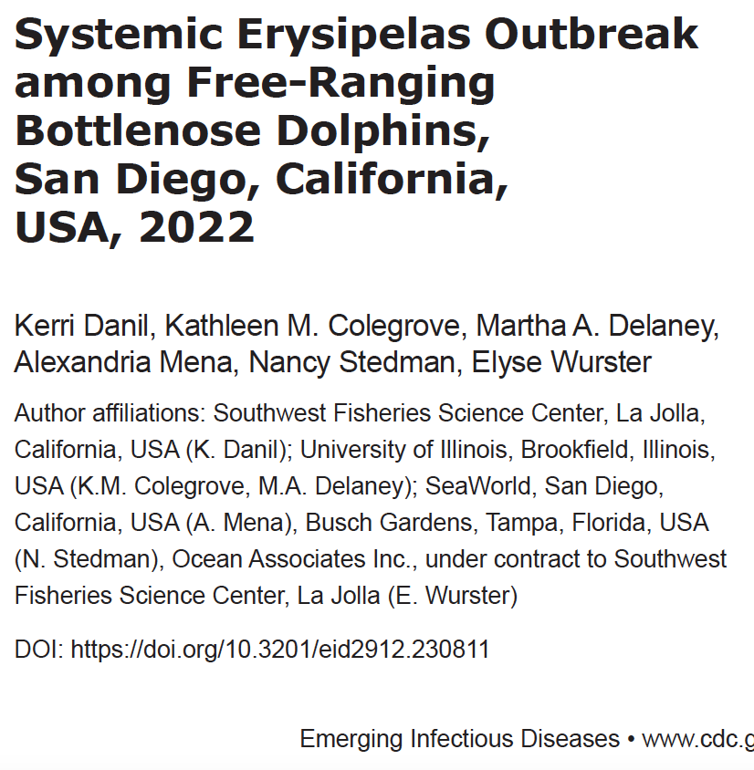
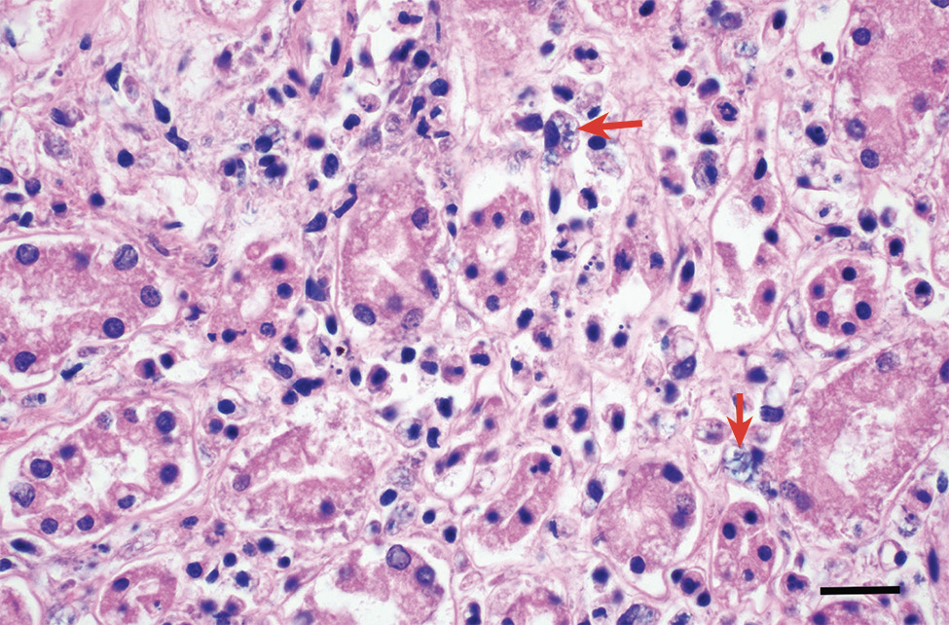
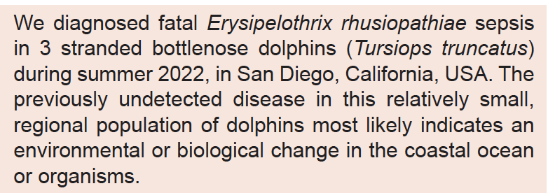
Erysipelas in free-ranging dolphins
Dr. Greenfield-Feig

Slide 15
In a study evaluating the seroprevalence of Erysipelothrix rhusiopathiae in Beaufort Sea polar bears, which of the following is correct?
There was little to no seropositivity in the study population of polar bears
Female polar bears were more likely to be seropositive than males
There was a significant decrease in seropositivity over time
There was higher seropositivity in bears that predated on juvenile seals
Years with high volumes of sea ice resulted in lower seropositivity
Answer: C – There was a decrease in seropositivity over time (possibly due to predation of young seals which increased as ice was declining, years with higher ice resulted in higher seropositivity since bears ate more adults); A – 27% seropositivity; B – Males were more likely to be seropositive; D – higher seropositivity in bears that ate adult seals; E – years with high sea ice resulted in higher seropositivity

Slide 16
In a study evaluating the seroprevalence of Erysipelothrix rhusiopathiae in Beaufort Sea polar bears, which of the following is correct?
There was little to no seropositivity in the study population of polar bears
Female polar bears were more likely to be seropositive than males
There was a significant decrease in seropositivity over time
There was higher seropositivity in bears that predated on juvenile seals
Years with high volumes of sea ice resulted in lower seropositivity
Answer: C – There was a decrease in seropositivity over time (possibly due to predation of young seals which increased as ice was declining, years with higher ice resulted in higher seropositivity since bears ate more adults); A – 27% seropositivity; B – Males were more likely to be seropositive; D – higher seropositivity in bears that ate adult seals; E – years with high sea ice resulted in higher seropositivity
Danil et al. 2023. Systemic erysipelas outbreak among free-ranging bottlenose dolphins, San Diego, California, USA, 2022. Emerg Infec Dis 29:2561-2563. DOI: https://doi.org/10.3201/eid2912.230811

Slide 17
A dolphin strands on the coast of California, and multiorgan inflammation, necrotizing adrenalitis and nephritis and intracellular bacteria are identified on histopathology. The following image is from the specimen.
What is a likely differential?
What is the method of transmission?
What are the expected clinical signs in an alive animal?

Slide 18
A dolphin strands on the coast of California, and multiorgan inflammation, necrotizing adrenalitis and nephritis and intracellular bacteria are identified on histopathology. The following image is from the specimen.
What is a likely differential?
What is the method of transmission?
What are the expected clinical signs in an alive animal?
Answer: Erysipelothrix rhusiopathiae; transmission: contact through damaged skin or mucous membranes, bacteria in feces/urine/saliva, via insects as fomites; acute fatal septicemia, chronic cutaneous lesions

Slide 19
Emerging Diseases in Marine Mammals
Bossart GD, Duignan PJ. 2018. Emerging viruses in marine mammals. CAB Rev 13:052
Papillomaviruses – several, but especially 4 in Florida manatee (TmPV1-4) and cetacean genital papillomas
Morbilliviruses – PDV, CeMV
Influenza Viruses
Polyomaviruses
Togaviridae and Flaviviridae
Herpesviruses – many, but OtHV-1/urogenital carcinoma most severe
Poxviruses
Adenoviruses
Coronaviruses – Seal CoV, BWCoV, BdCoV
Caliciviruses

Slide 20
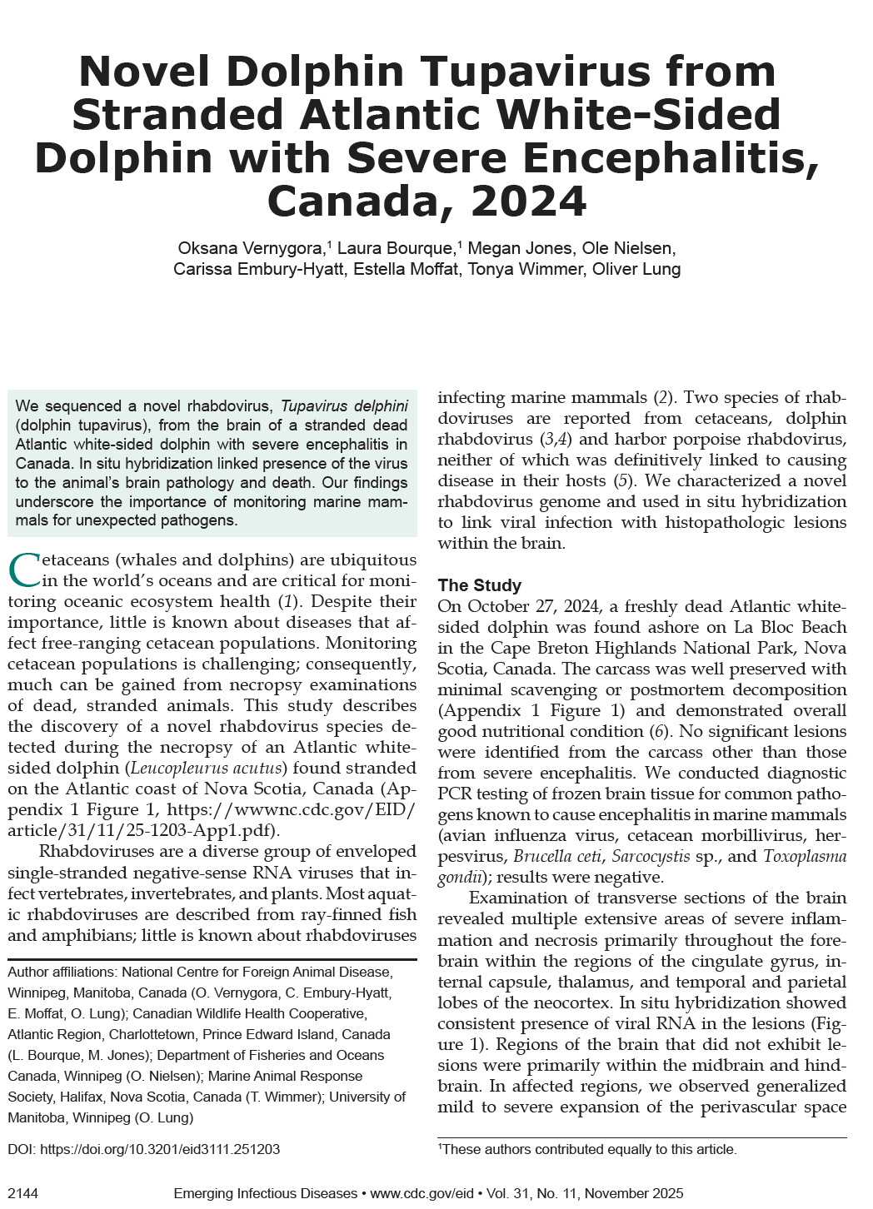
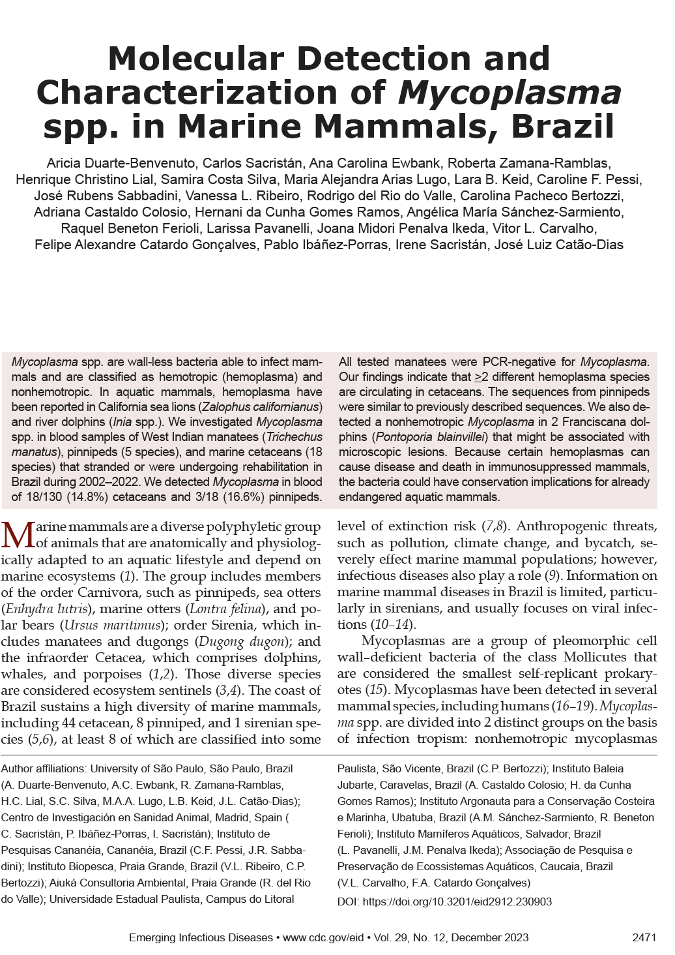
Other Emerging Diseases in marine mammals

Slide 21
Influenzaviruses
RNA Viruses
Influenza A – widespread in wild aquatic birds (especially Anseriformes and Charadriiformes), can infect other hosts including mammals and become host-adapted
Influenza B and C viruses – primarily humans; Influenza D viruses – primarily livestock
  Greater detail in a graphic to follow later….
Influenza A viruses classified by variable surface antigens H (hemagglutinin, H1-H18) and N (neuraminidase, N1-N11). H and N antigens can join in any combination with co-infections (antigenic shift), and influenzaviruses also mutate frequently (antigenic drift)
H5 and H7 strains are of primary concern in poultry, and are classified as LPAI or HPAI, depending on clinical effects and genetic features.
National Veterinary Accreditation Program Module 18: Avian Influenza and Newcastle Disease: https://nvap.aphis.usda.gov/AIEND/index.htm
https://www.aphis.usda.gov/aphis/ourfocus/animalhealth/animal-disease-information/avian/avian-influenza/hpai-2022/2022-hpai-mammals

Slide 22
Select Agents
Biological agents and toxins that have the potential to pose a severe threat to public, animal or plant health, or to animal or plant products. Examples include anthrax, smallpox, FMDV, ricin.
USDA and HHS CDC
68 agents, some listed by one or the other or both agencies
HPAI is listed by USDA (LPAIs not listed), not by CDC
If detected, special handling required for live animals, carcasses, samples

Slide 23
Influenza in Seals
Influenza-A mortality events in harbor seals, mainly New England
  H7N7, H4N5, H4N6, H3N3, first described in late 1970s
  H3N3 in 1991/92 and 2011/12; H3N8 in 2011
  H10N7 NE Europe in 2014/15
One influenza B isolate from a seal with respiratory signs, and seropositivity in various locations consistent with spillover from humans
H1N1 in free-ranging elephant seals 2010 – asymptomatic. Goldstein et al. 2013. PLoSOne
Weakness, incoordination, dyspnea, conjunctivitis, occasional frothy nasal discharge, cervical SQ emphysema, mortalities
Influenza A viruses in phocids antigenically related to avian influenza strains, but USUALLY nonpathogenic to poultry
Mycoplasma co-infection can occur
Zoonotic (mainly conjunctivitis)

Slide 24
Marine Mammal Unusual Mortality Events https://www.fisheries.noaa.gov/national/marine-mammal-protection/marine-mammal-unusual-mortality-events
Criteria for determining an unusual mortality event:
A marked increase in the magnitude or a marked change in the nature of morbidity, mortality, or strandings when compared with prior records.
A temporal change in morbidity, mortality, or strandings is occurring.
A spatial change in morbidity, mortality, or strandings is occurring.
The species, age, or sex composition of the affected animals is different than that of animals that are normally affected.
Affected animals exhibit similar or unusual pathologic findings, behavior patterns, clinical signs, or general physical condition (e.g., blubber thickness).
Potentially significant morbidity, mortality, or stranding is observed in species, stocks, or populations that are particularly vulnerable (e.g., listed as depleted, threatened, or endangered or declining). For example, stranding of three or four right whales may be cause for great concern whereas stranding of a similar number of fin whales may not.
Morbidity is observed concurrent with or as part of an unexplained continual decline of a marine mammal population, stock, or species.
Any of these criteria may indicate an unusual mortality event.

Slide 25
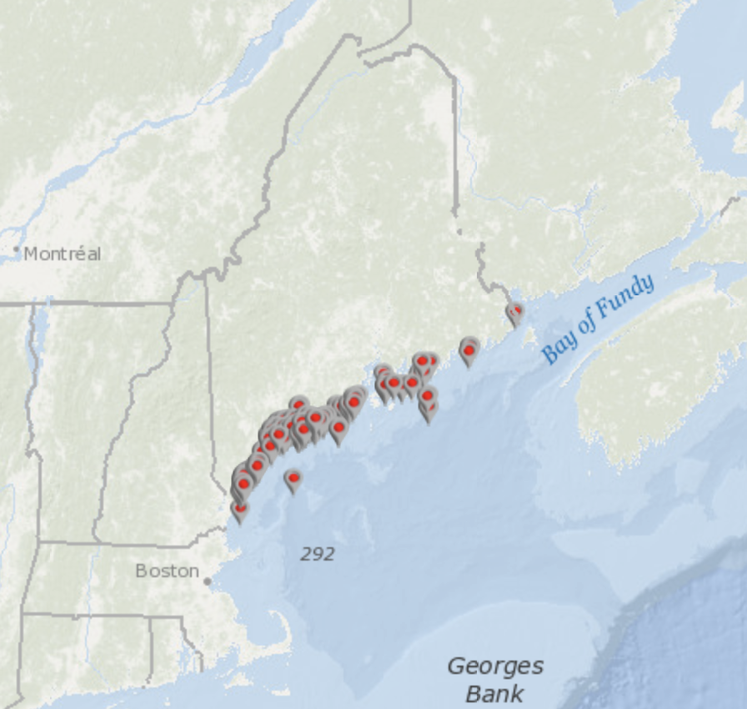
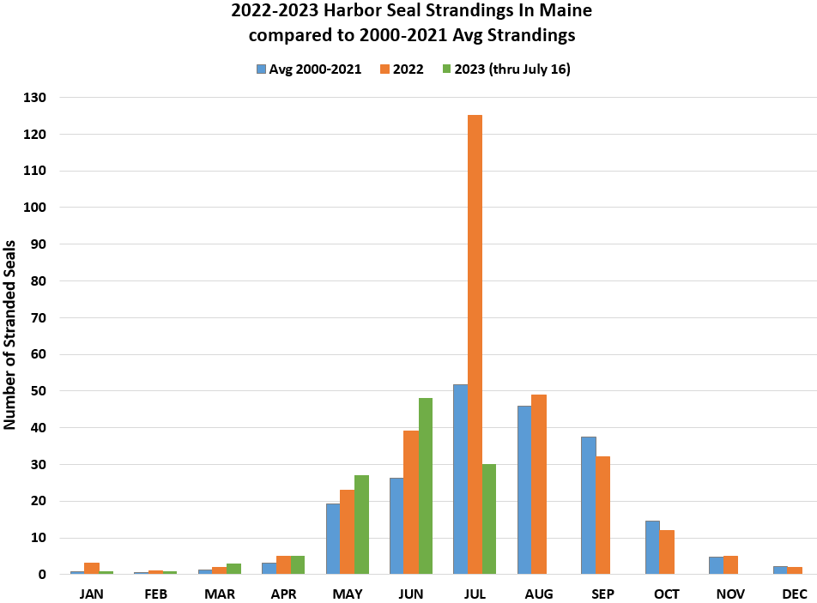
Highly pathogenic avian influenza (HPAI) virus unusual mortality event in Seals in Maine, 2022
(note: There was a concurrent event in Quebec, and a few HPAI seal mortalities in Washington state)

Slide 26
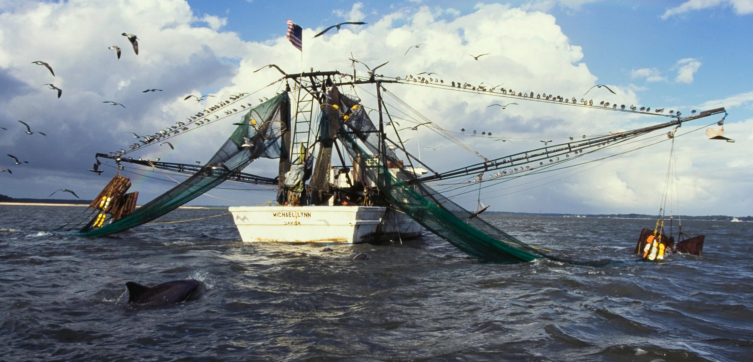
How could a dolphin be exposed to seabird feces????
(scientists are baffled)

Slide 27

HPAI UME in New England Seals
Emerging Infectious Diseases • www.cdc.gov/eid •
Vol. 29, No. 4, April 2023

Slide 28
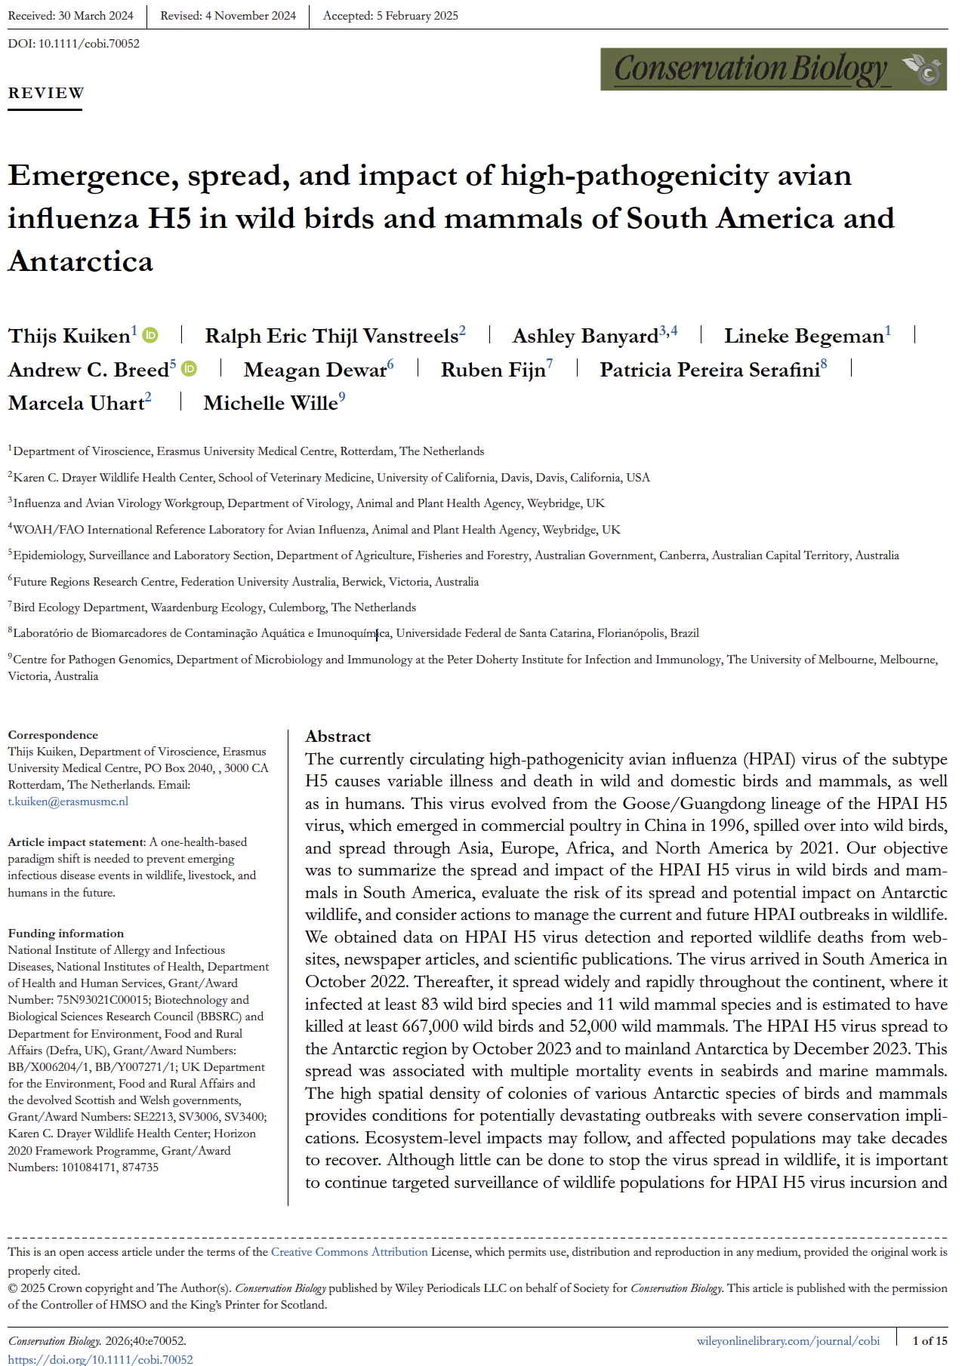
Spread to South America and Southern Hemisphere
Kuiken et al. 2025. Emergence, spread and impact of high-pathogenicity avian influenza H5 in wild birds and mammals of South America and Antarctica. Cons Biol 40:e70052, https://doi.org/10.1111/cobi.70052
Dr. Roeder

Slide 29
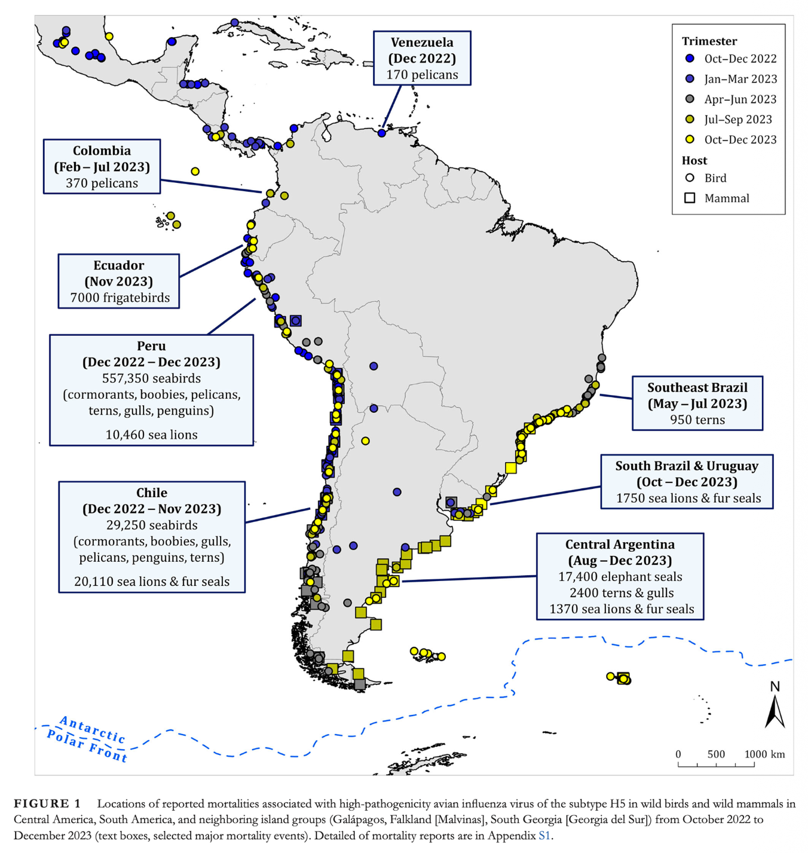
HPAI spread Through South American Marine Animals
Kuiken et al. 2025.

Slide 30
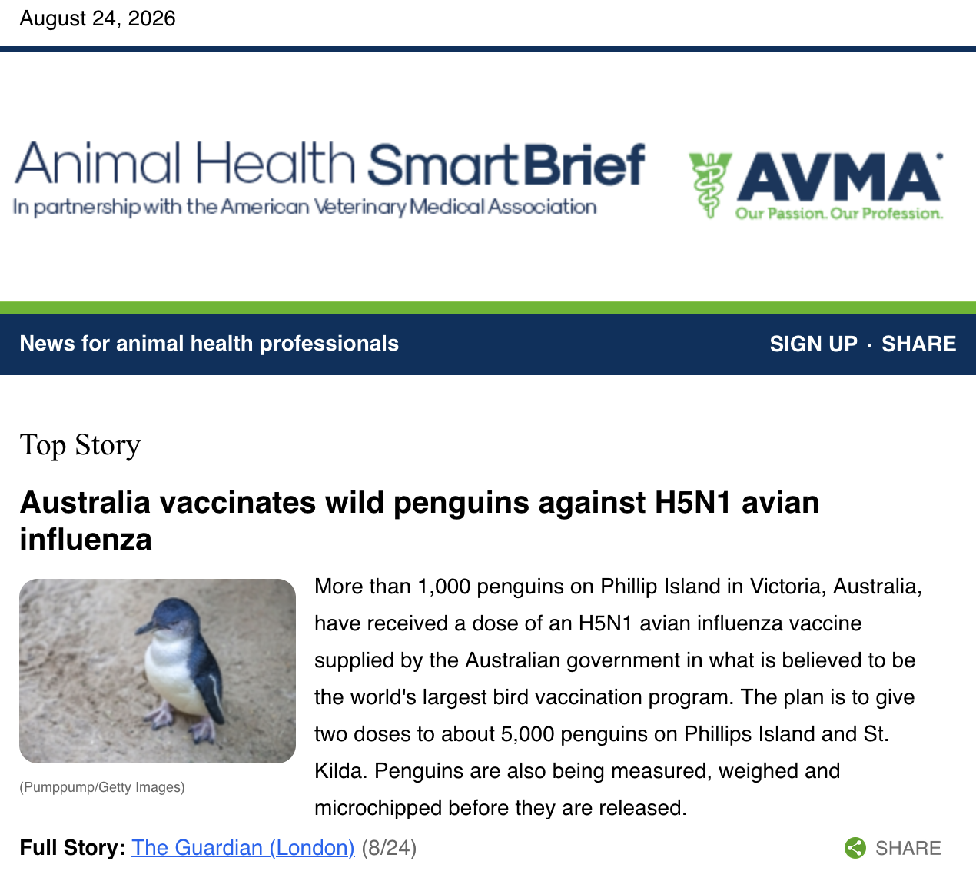
Little Penguin Vaccination program
Eudyptula minor

Slide 31
Of the following avian orders, which includes the typically non-migratory resident species that were most heavily decimated in mass mortality events associated with high pathogenicity avian influenza subtype H5 in Peru and Chile in 2022 – 2023?
Pelecaniformes
Charadriiformes
Suliformes
Procellariformes
Sphenisciformes

Slide 32
Of the following avian orders, which includes the typically non-migratory resident species that were most heavily decimated in mass mortality events associated with high pathogenicity avian influenza subtype H5 in Peru and Chile in 2022 – 2023?
Pelecaniformes - Pelicans, hamerkop, shoebill, herons, ibises, spoonbills
Charadriiformes - Plovers, gulls, sandpipers
Suliformes - Gannets, boobies, cormorants, frigatebirds, anhingas
Procellariformes - Albatrosses, petrels, shearwaters, storm petrels
Sphenisciformes - Penguins

Slide 33
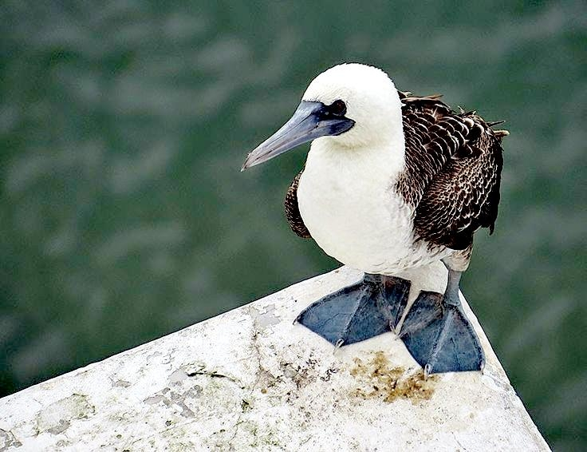
Of the following avian orders, which includes the typically non-migratory resident species that were most heavily decimated in mass mortality events associated with high pathogenicity avian influenza subtype H5 in Peru and Chile in 2022 – 2023?
Pelecaniformes
Charadriiformes
Suliformes – cormorants and Peruvian boobies
Procellariformes
Sphenisciformes

Slide 34
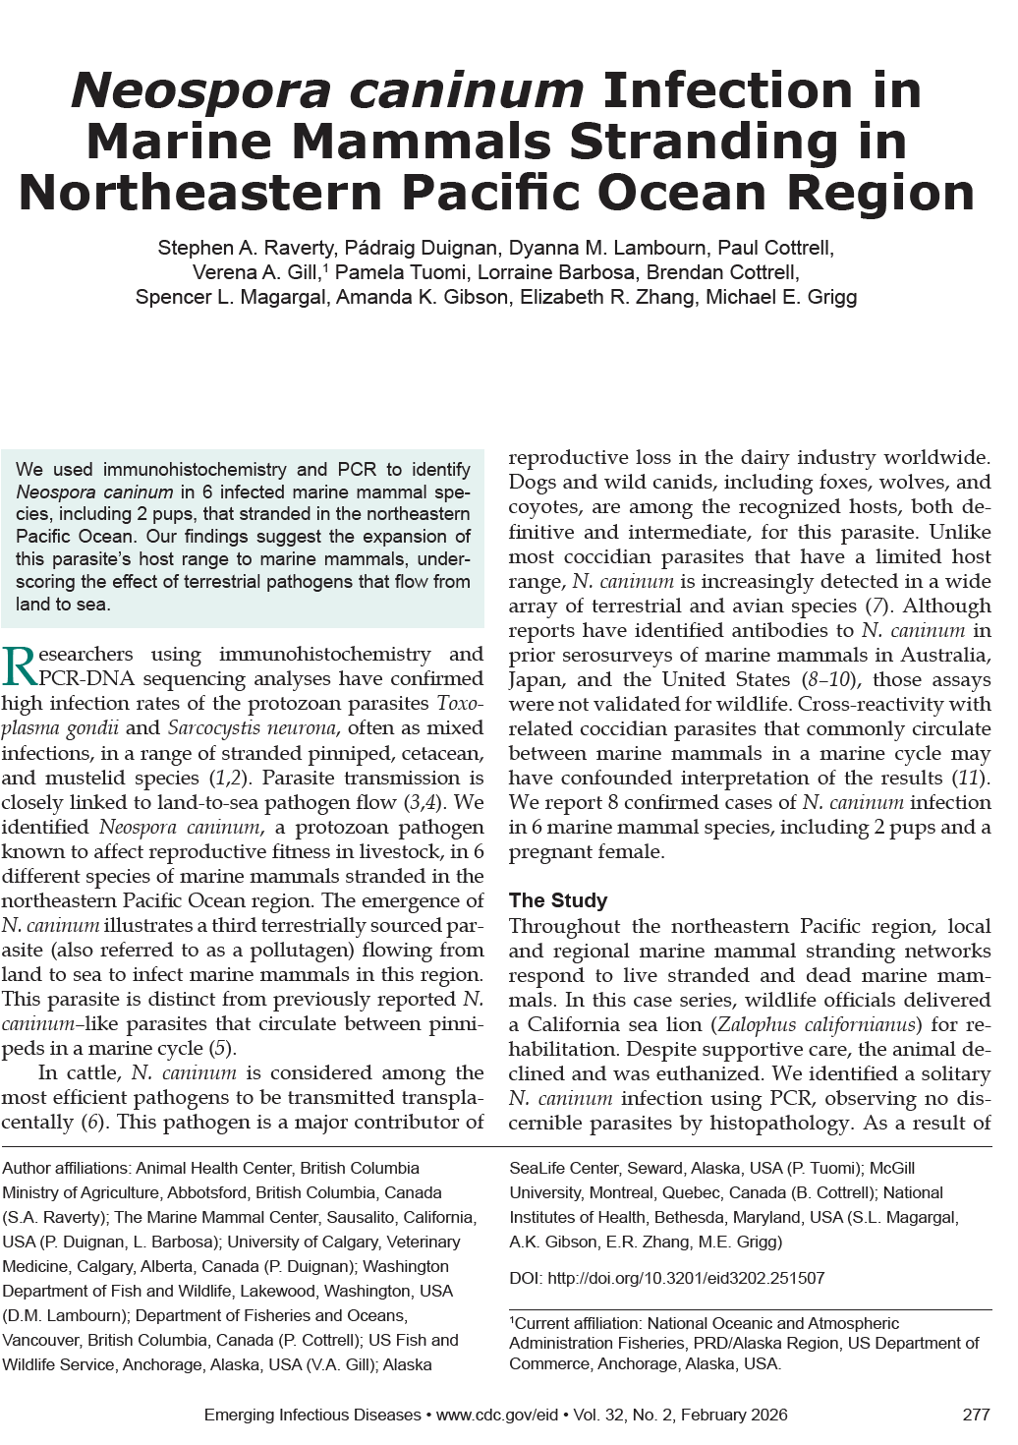
Neospora caninum
Dr. Chung
Raverty et al. 2026. Neospora caninum infection in marine mammals stranding in Northeastern Pacific Ocean region. Emerg Infec Dis 32:277-280. DOI: http://doi.org/10.3201/eid3202.251507

Slide 35
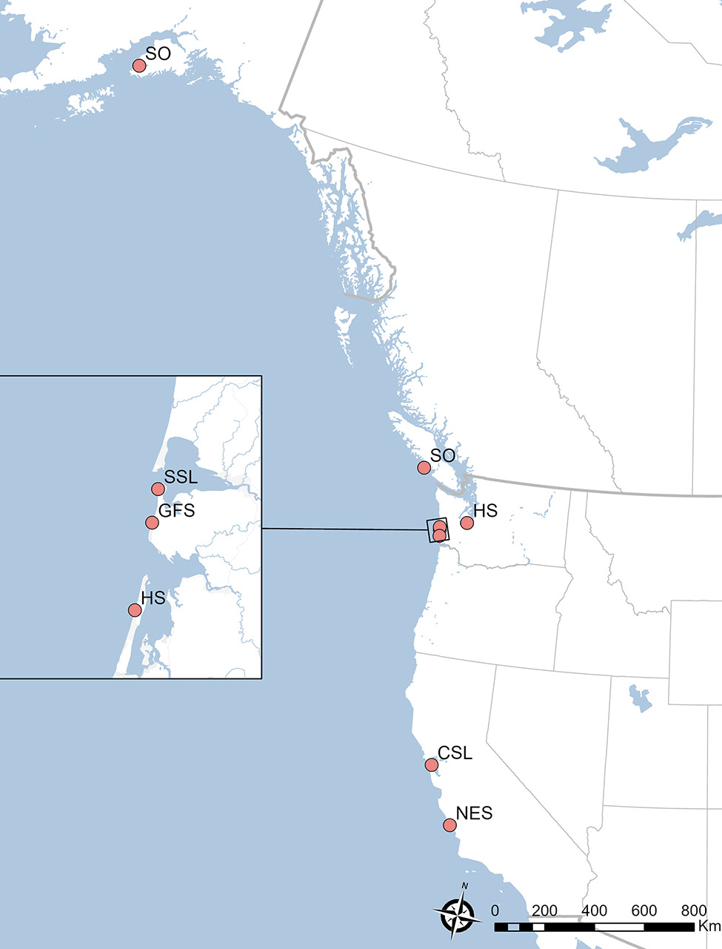
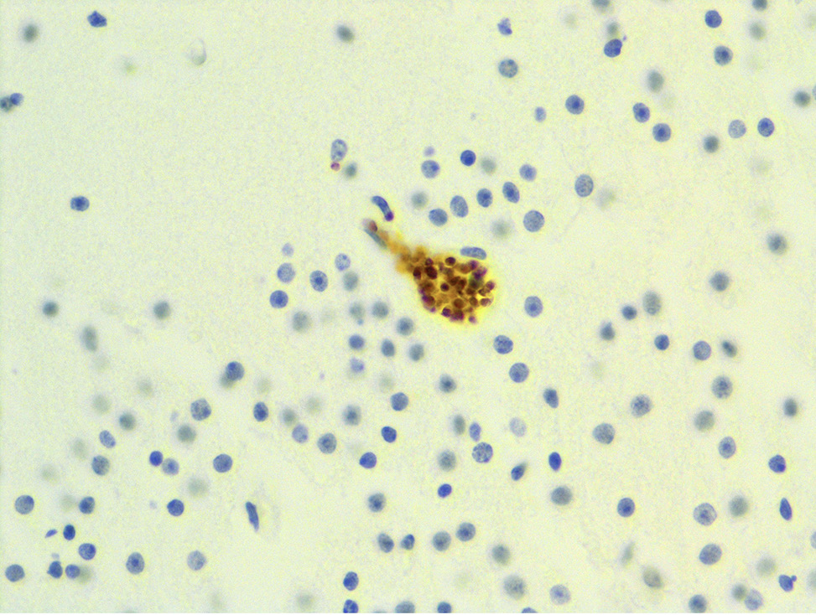
NeosporA caninum
Raverty et al. 20-26

Slide 36
Which of the following BEST describes the significance of the detection of Neospora caninum in marine mammals in the northeastern Pacific Ocean?
A. N. caninum is an important cause of fatal neurologic disease in marine mammals.
B. Marine mammals are likely the primary reservoir for N. caninum in the Pacific Ocean.
C. PCR detection of N. caninum in marine mammals provides evidence of pollutagen transmission.
D. N. caninum is transmitted primarily between marine mammals through direct contact.
E. Coinfection with other protozoal parasites indicates that N. caninum is not capable of infecting marine mammals.

Slide 37
Which of the following BEST describes the significance of the detection of Neospora caninum in marine mammals in the northeastern Pacific Ocean?
A. N. caninum is an important cause of fatal neurologic disease in marine mammals.
B. Marine mammals are likely the primary reservoir for N. caninum in the Pacific Ocean.
C. PCR detection of N. caninum in marine mammals provides evidence of pollutagen transmission.
D. N. caninum is transmitted primarily between marine mammals through direct contact.
E. Coinfection with other protozoal parasites indicates that N. caninum is not capable of infecting marine mammals.

Slide 38
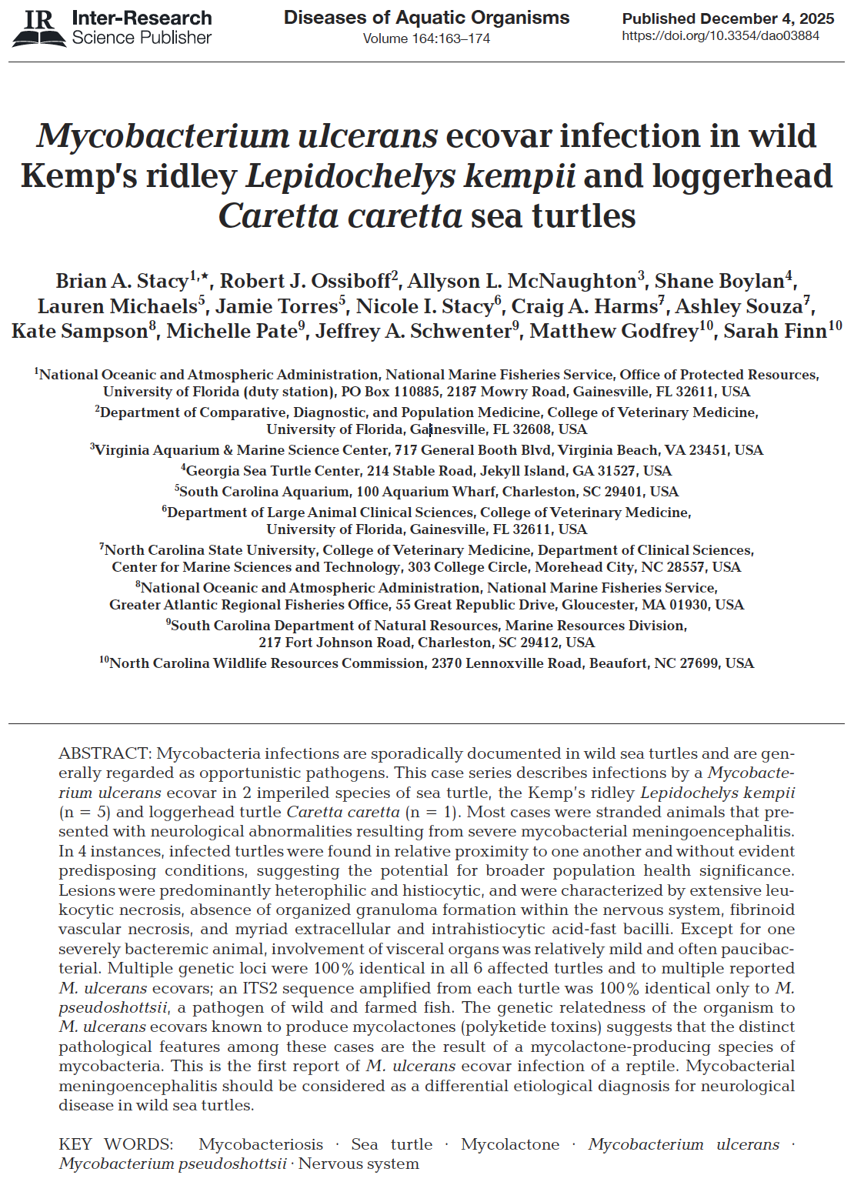
Mycobacterium ulcerans ecovar in wild sea turtles
Dr. Nye
Stacy et al. 2025. Mycobacterium ulcerans ecovar infection in wild Kemp's ridley Lepidochelys kempii and loggerhead Caretta caretta sea turtles. Dis Aquat Org 165:163-174. https://doi.org/10.3354/dao03884

Slide 39
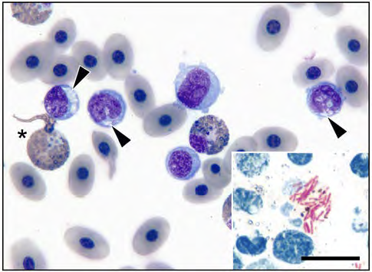
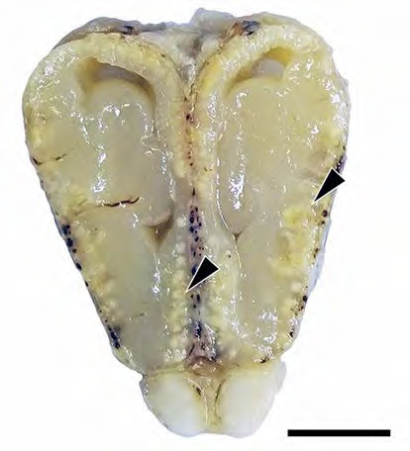
Mycobacterium ulcerans ecovar in wild sea turtles
Stacy et al. 2025
Previously reported sea turtle mycobacteria: M. chelonae, M. haemophilum, M. gordonae, M. avium, M. sygnathidarum.
M. pseudoshottsii/ striped bass

Slide 40
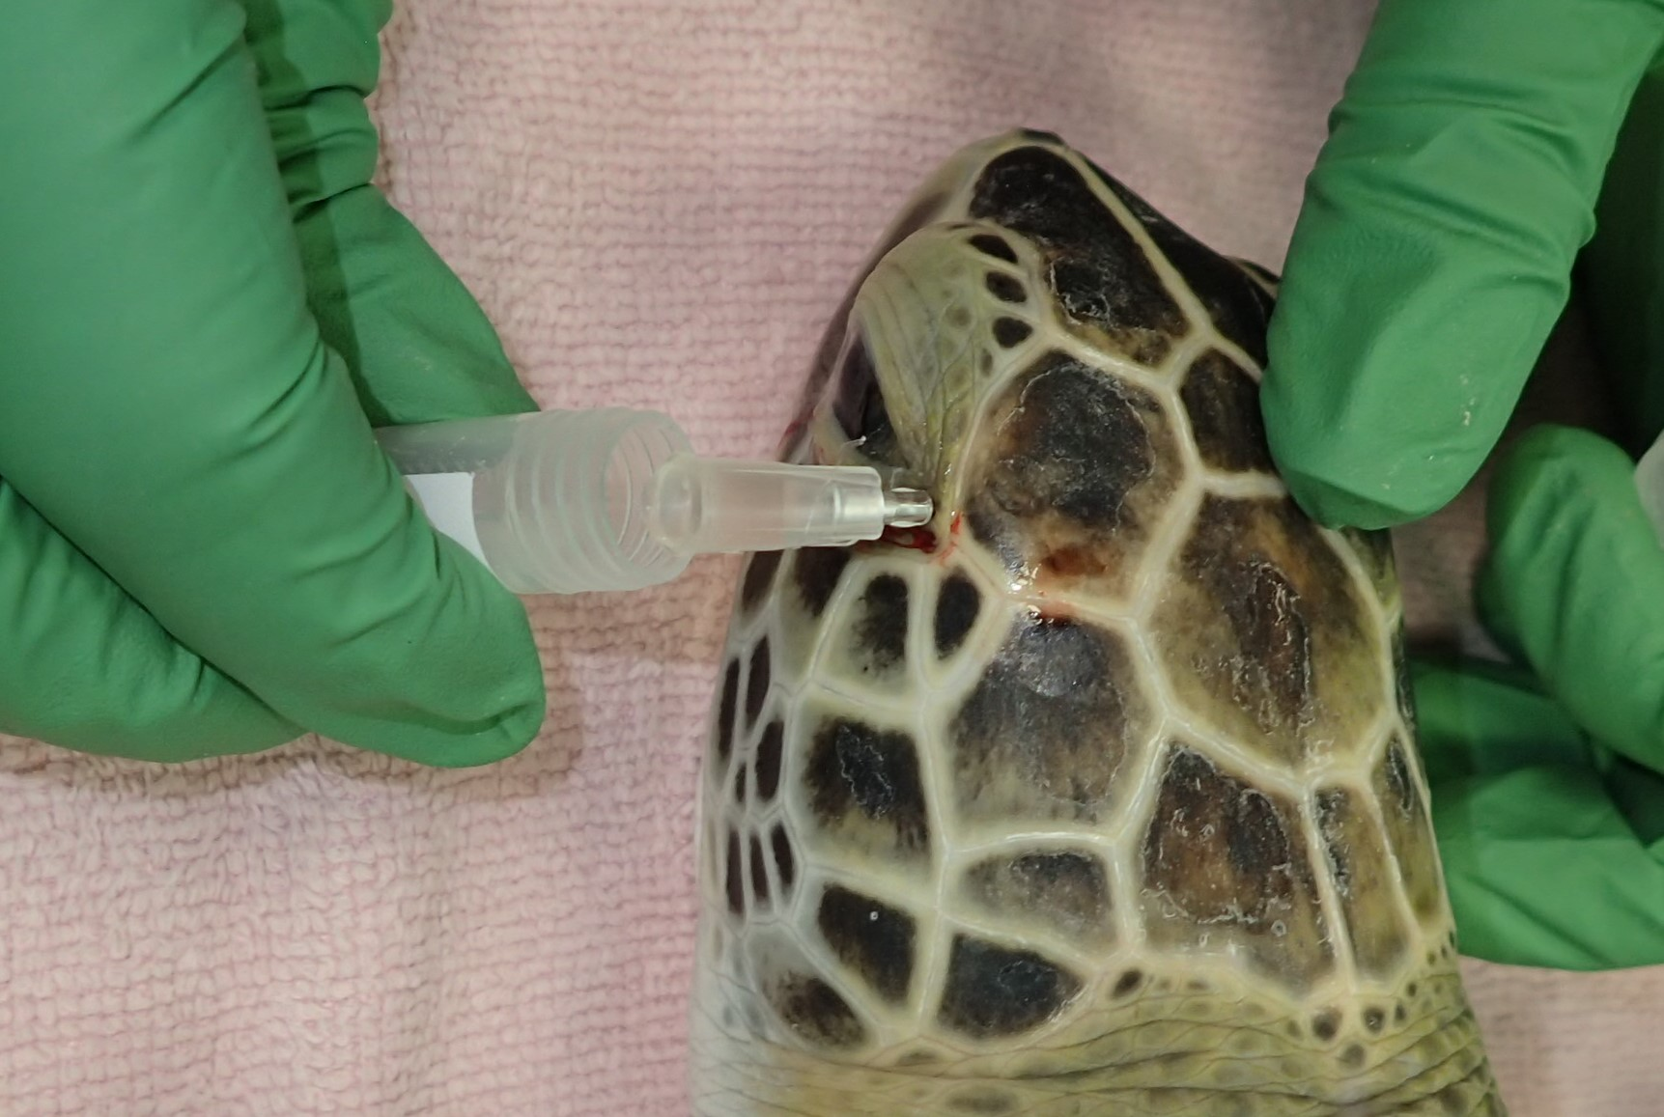
Transorbital CSF Tap in Green turtles
Souza et al. in prep

Slide 41
In sea turtles, which histopathologic finding was associated with the immune-modulatory and cytotoxic effects of mycolactone, and served as a key feature distinguishing these infections from typical mycobacteriosis found in reptiles?
A. Predominance of eosinophilic granulocytes within lesions
B. Extensive dystrophic mineralization of necrotic debris
C. Lack of organized granuloma formation
D. Formation of thick fibrous capsules surrounding lesions
E. Absence of acid-fast bacilli despite heavy inflammation

Slide 42
In sea turtles, which histopathologic finding was associated with the immune-modulatory and cytotoxic effects of mycolactone, and served as a key feature distinguishing these infections from typical mycobacteriosis found in reptiles?
A. Predominance of eosinophilic granulocytes within lesions
B. Extensive dystrophic mineralization of necrotic debris
C. Lack of organized granuloma formation
D. Formation of thick fibrous capsules surrounding lesions
E. Absence of acid-fast bacilli despite heavy inflammation
Mycolactone is a plasmid-encoded toxin produced by ecovars of M. ulcerans. Instead of forming organized granulomas like with typical reptilian mycobacteriosis, the affected turtles' lesions, especially in the CNS, consisted of dense, disorganized collections of necrotic leukocytes mixed with numerous acid-fast bacilli. This lack of organized granuloma formation was one of the most distinctive pathological features of these cases.

Slide 43
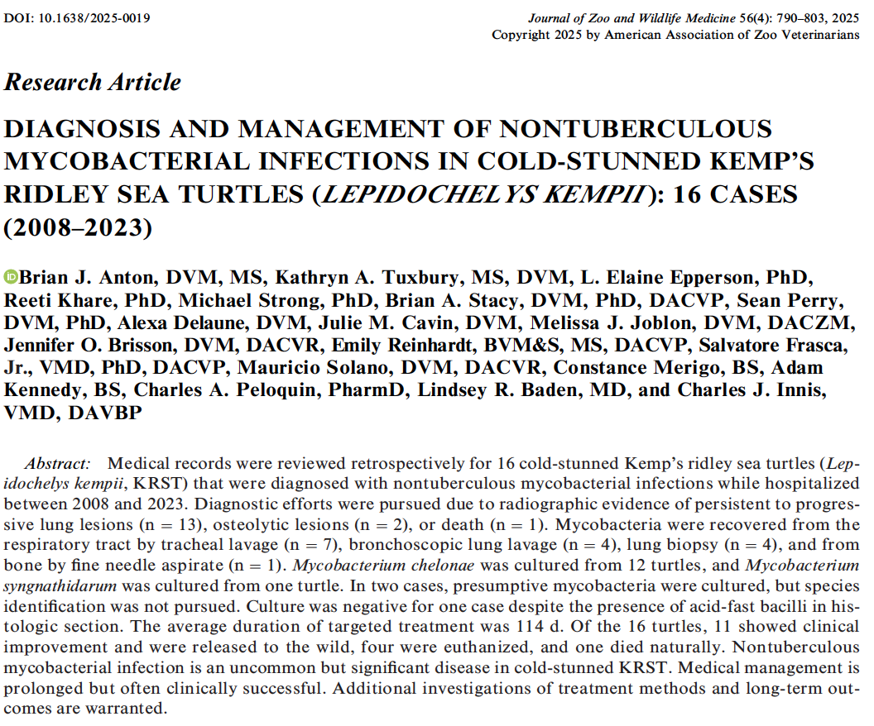
For contrast:
Different host species, different mycobacterium, further north

