Slide 1
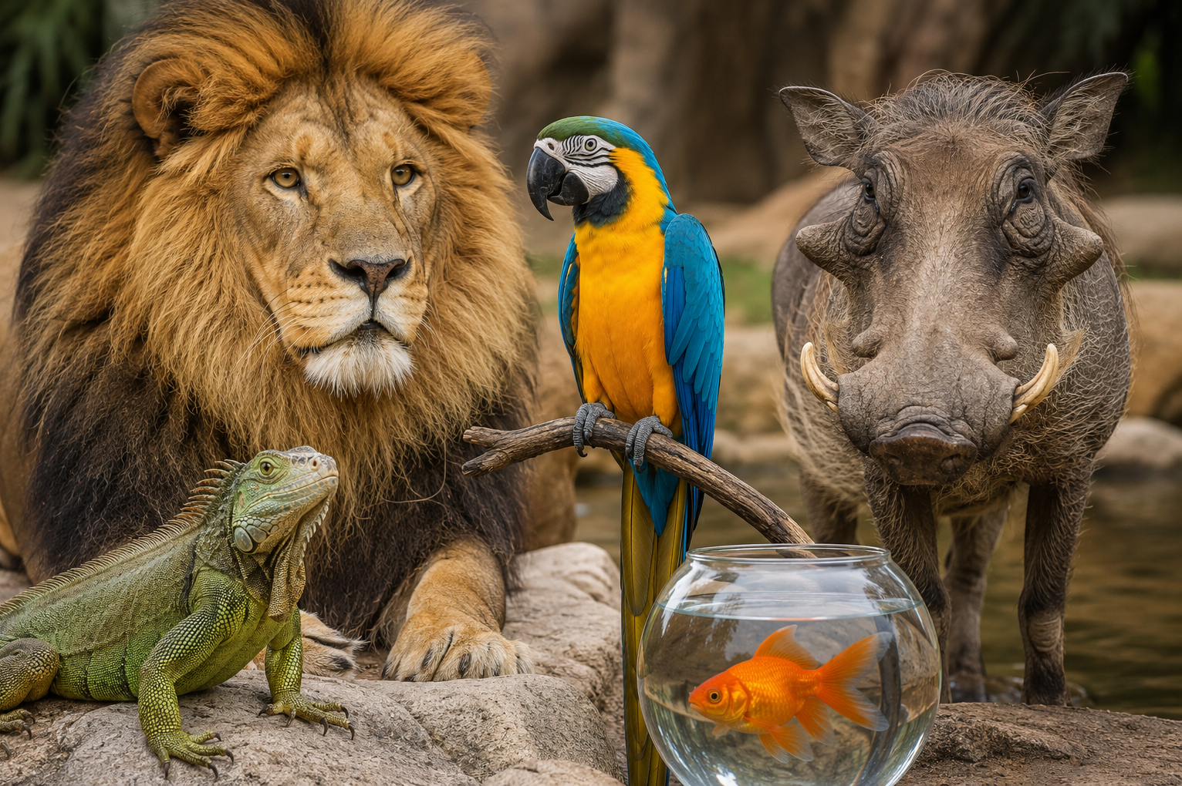
Welcome to CBS 817!
Advanced Zoo Topics
Fall 2026

Slide 2
Housekeeping items
Course website: https://emconnect.emc.ncsu.edu/
  Syllabus
  Schedule
  Lecture materials
  Resident guidelines
Moodle site – attendance, reading assignments, quizzes located HERE
Course objective: to prepare residents to take the ACZM board exam
  ACZM = American College of Zoological Medicine
  Taught at the resident level, but students are encouraged to actively participate!

Slide 3
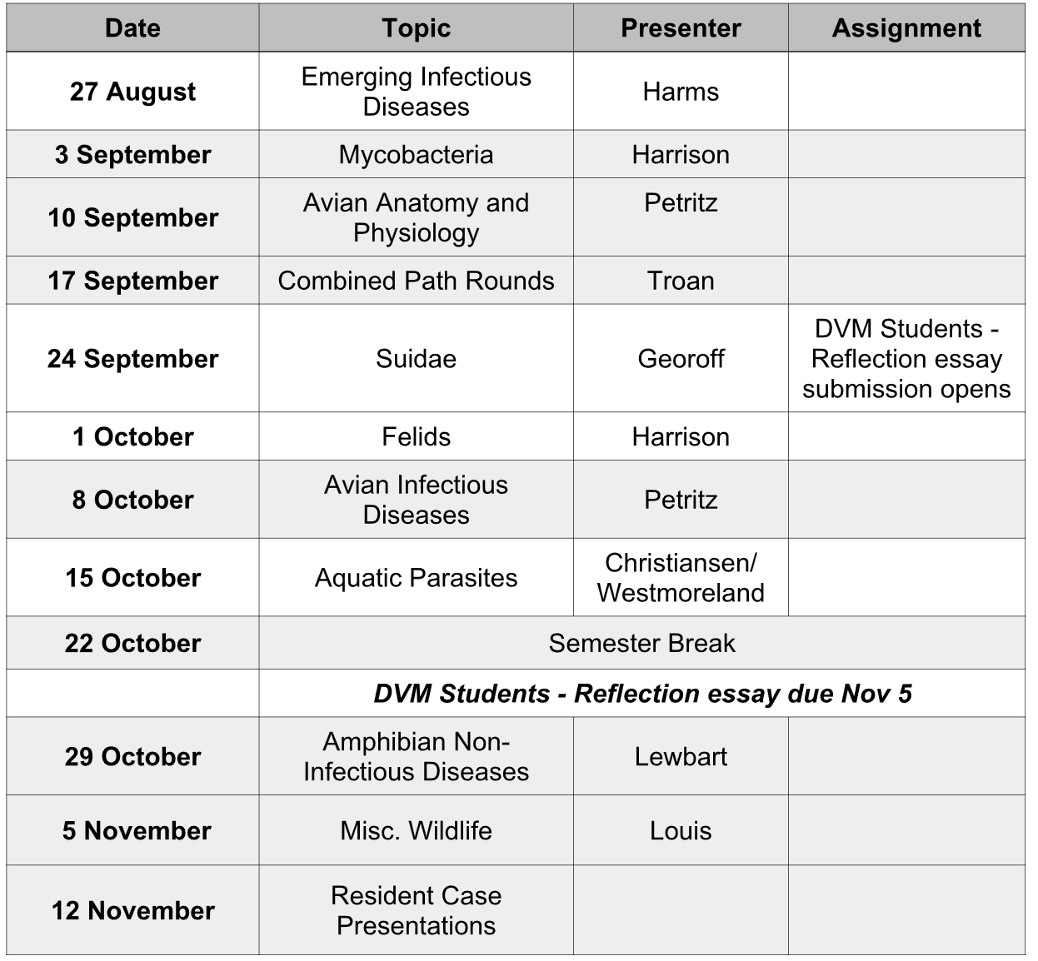
Schedule
11 classes
Held via IN PERSON and via Zoom
  Thursdays: 4-5pm
Asynchronous attendance for students is allowed from Drs. Harrison or Petritz
  Required to watch Zoom recordings if not able to attend live
Reptile parasites
Guest Lecturer: Dr. Meghan Louis

Slide 4
Class outline
Combination of journal review and topic lecture
  ACZM Residents review 2-3 of the assigned papers/book chapters for the week
      Student participation is still encouraged!
  We will review multiple choice questions written by presenter and residents about that topic or others
    For ACZM board exam preparation

Slide 5
Student Responsibilities
Satisfactory/Unsatisfactory grading
Attendance:
  A minimum of 10 classes must be attended to pass (asynchronously or synchronously)
  Attendance counts as taking the class quiz after being in class or watching the zoom video
Reflective essay: due November 5th
  Details in syllabus and on Moodle page

Slide 6
Student Responsibilities
Weekly reading assignments + brief QUIZ:
  Book chapter or review article reading assignment per lecture
    Located on Moodle site and on separate course webpage
  1-3 multiple choice questions per quiz/reading assignment
    Located on Moodle website – must read and complete ALL assignments to pass
  Quizzes are open book-open note, but please complete individually
  Quizzes open day of class (Thursday) and are due by the following Monday at 8am on Moodle
    These also count towards attendance

Slide 7
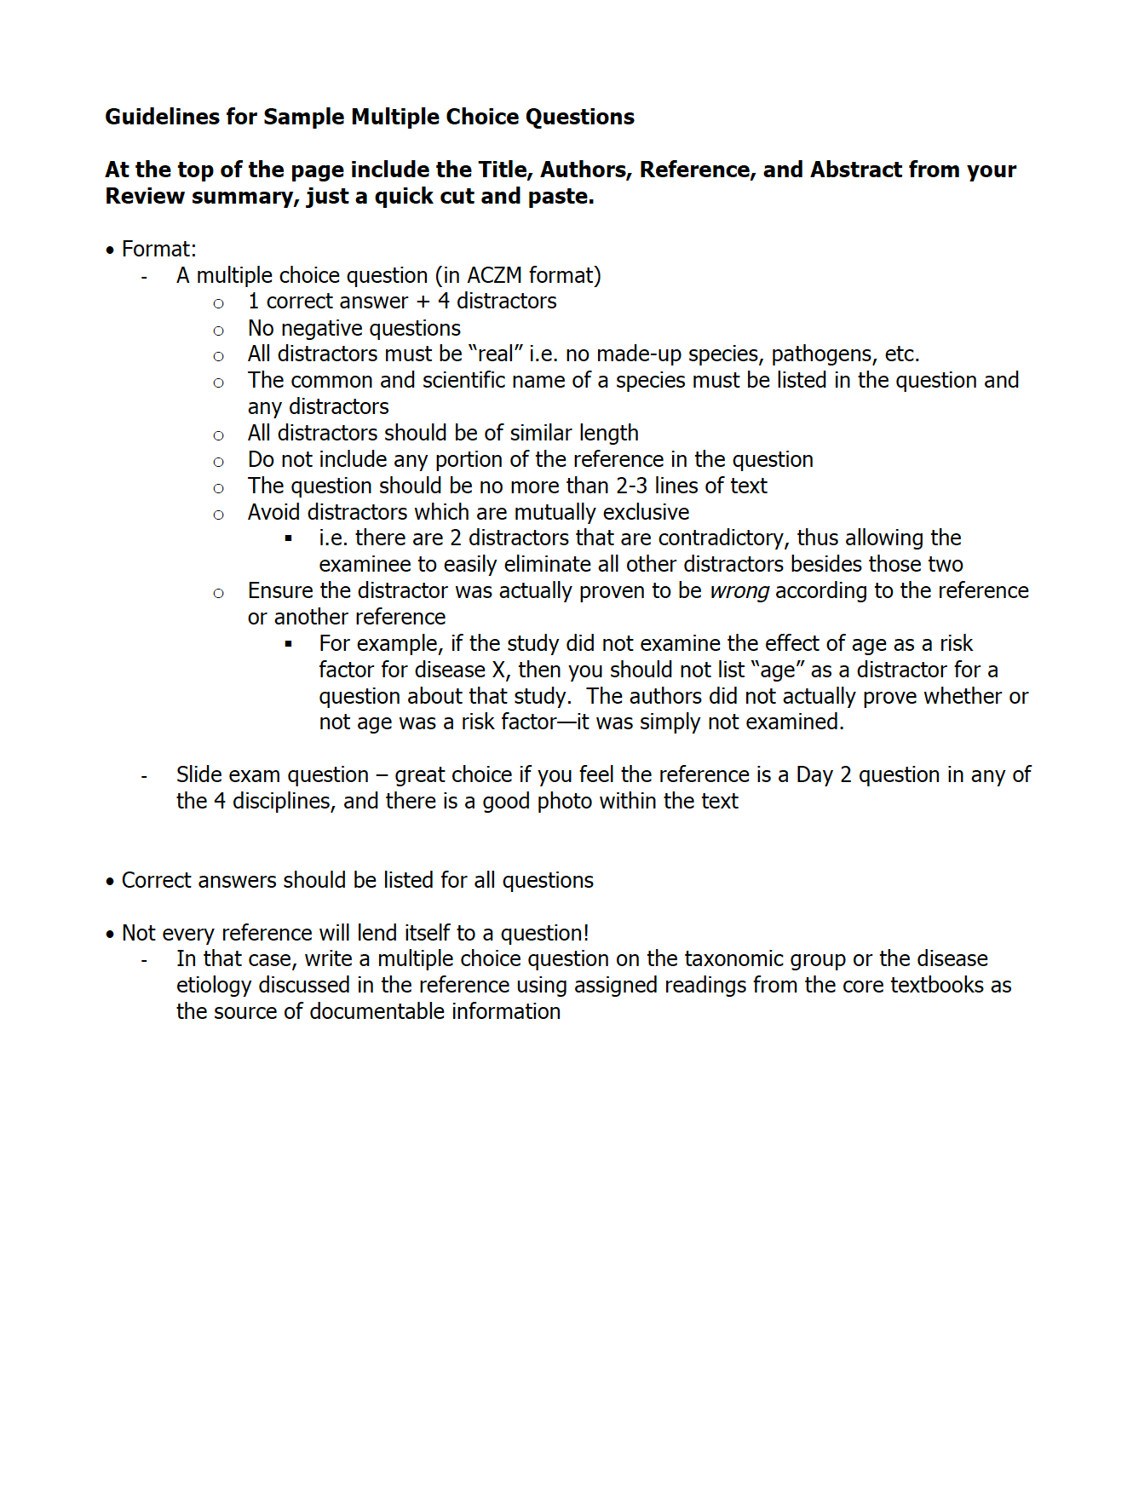
Resident Responsibilities
Email summaries and questions to Drs. Harrison + Petritz by Sunday evening
Please combine all summaries into ONE document and all questions into ONE (separate) document
Research presentations: 10 minutes
Case presentations: 10 minutes
NOTE: NO research presentations this semester

Slide 8
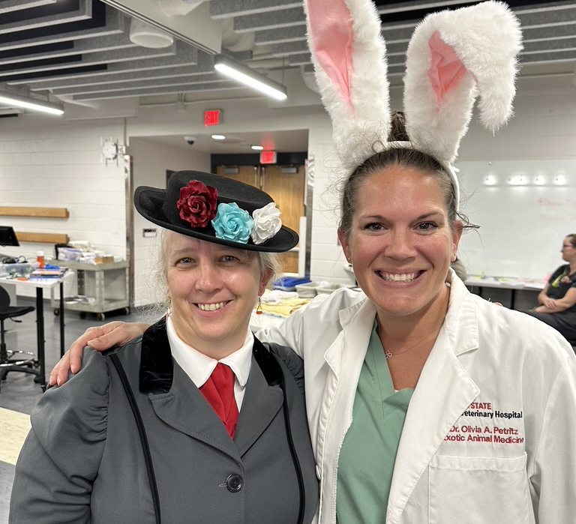
Questions?
Course Coordinators:
  Dr. Tara Harrison: tmharri7@ncsu.edu
    Website and Zoom coordinator
  Dr. Olivia Petritz: oapetrit@ncsu.edu
    Attendance and grading coordinator

