Slide 1
Wild Rodents
Tara Harrison

Slide 2
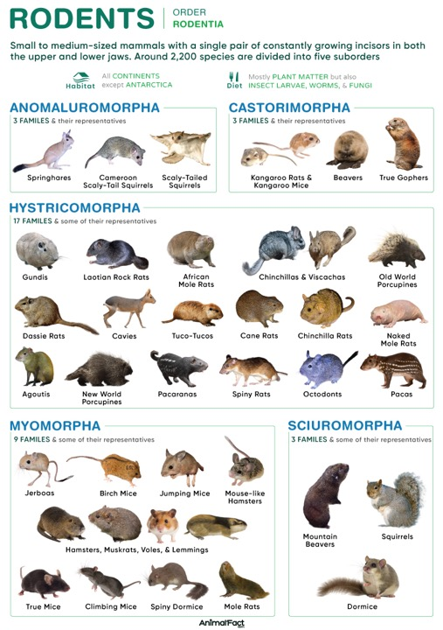
Rodents
Aprox. 2,200 species
5 suborders
34 families
481 genera
https://animalfact.com/rodents/
Notes:
Suborder: Anomaluromorpha (scaly tailed squirrels, springhare); Castorimorpha (2 super families - beavers, gophers, kangaroo mice); Hystricomorpha (rats, chinchillas, cavies, etc); Myomorpha (mice); Sciuromorpha (mountain beavers, squirrels, dormice)

Slide 3
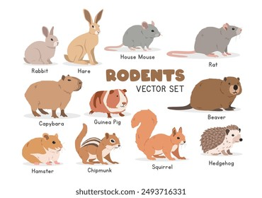
Rodents?

Slide 4
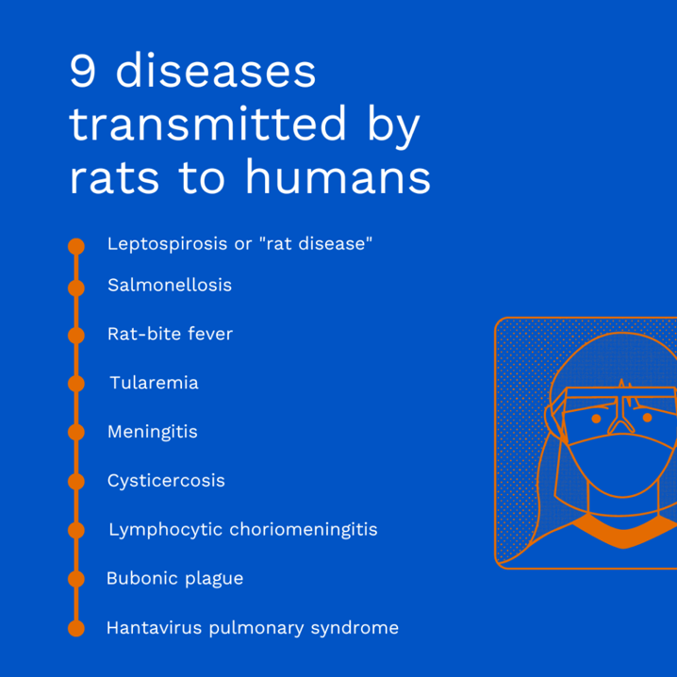
https://eliteextermination.com/en/news/rat-borne-diseases-children/

Slide 5
What Disney Princess’s mom died from the plague?

Slide 6
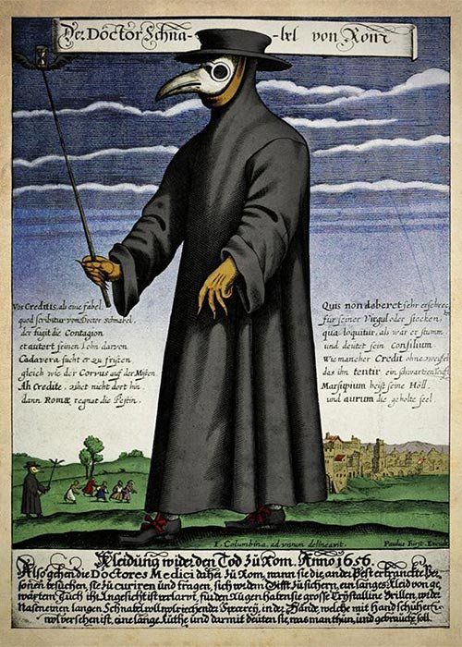
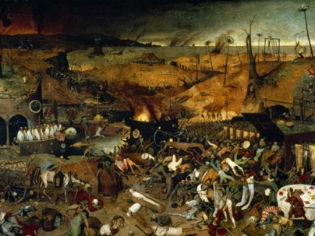
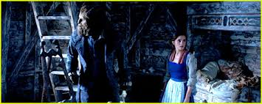
Plague
Black death
First identified in 1894 in Hong Kong
Evolved from Yersinia pseudotuberculosis
Still around, modern culture
https://www.barcelona-metropolitan.com/features/the-plague-years/

Slide 7
Plague Pandemics
First Pandemic (Justinian Plague, 541-750 AD)
  Estimated 50-60% of population lost
Second Pandemic (Black Death, 8th-14th century)
  Estimated 60-75 million people died
Third Pandemic (1855 – current day)

Slide 8
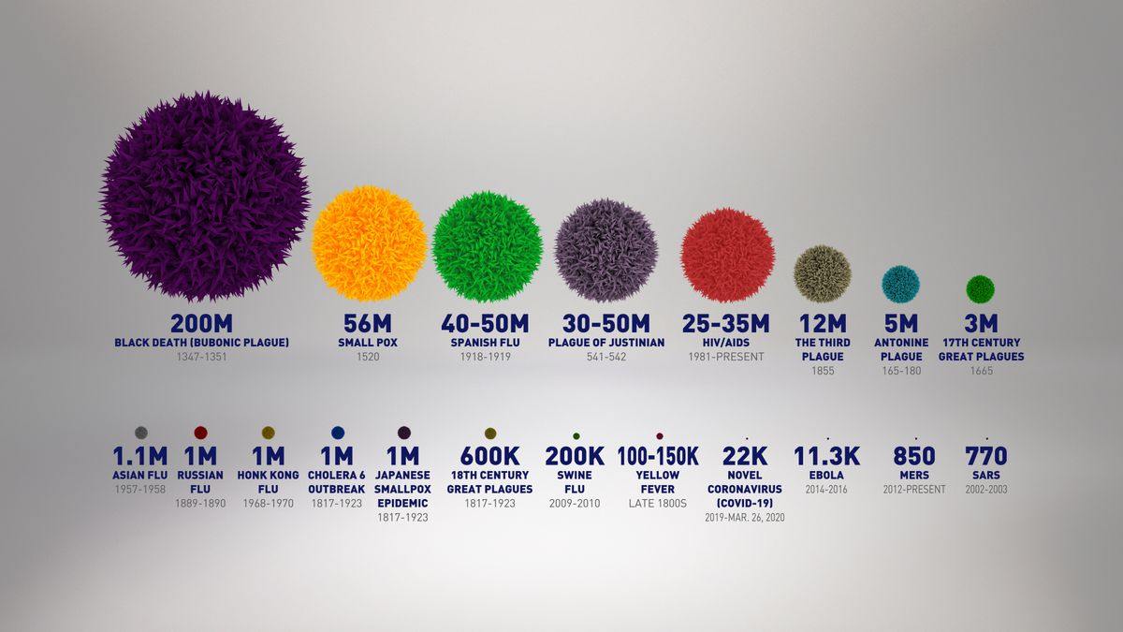
Now 7.1 million COVID deaths
https://www.alaskasnewssource.com/content/news/Pandemics-through-history-What-we-can-learn-and-how-it-relates-to-COVID-19-569147331.html

Slide 9
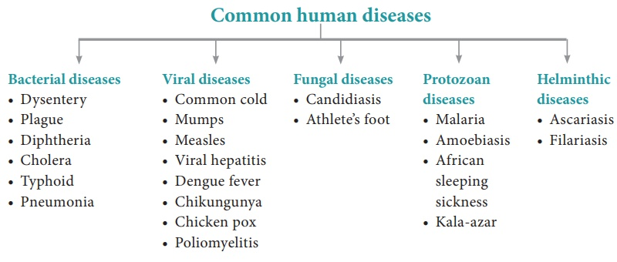
Common human diseases
http://www.brainkart.com/article/Common-diseases-in-human-beings_38087/

Slide 10
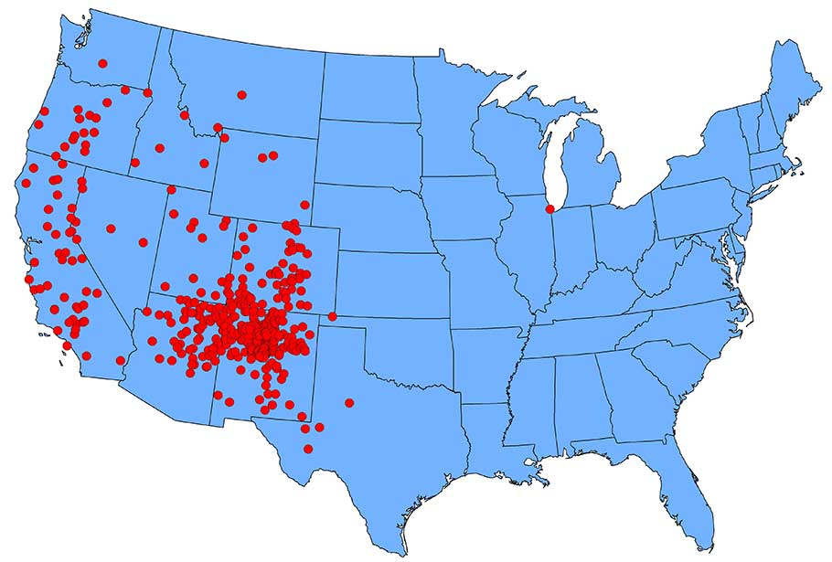
Plague
Still in the United States regularly
Mostly out west
4 corners (Utah, Arizona, New Mexico, Colorado)
https://www.cdc.gov/plague/maps/index.html

Slide 11
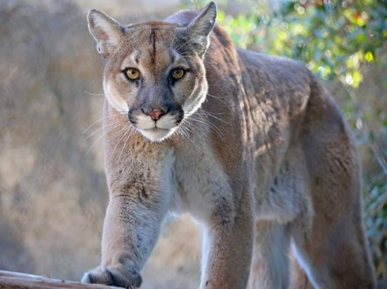
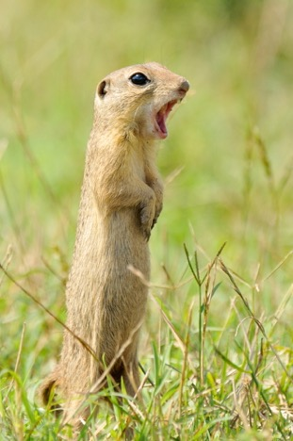
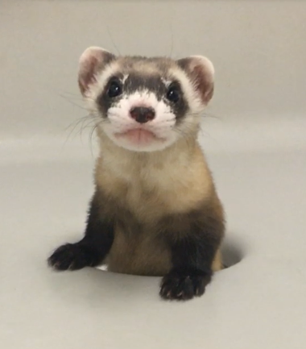
What animals are affected by plague?

Slide 12
Plague Susceptibility
Rabbits and hares occasionally
Cats very susceptible
Rare in goats, sheep, camels

Slide 13
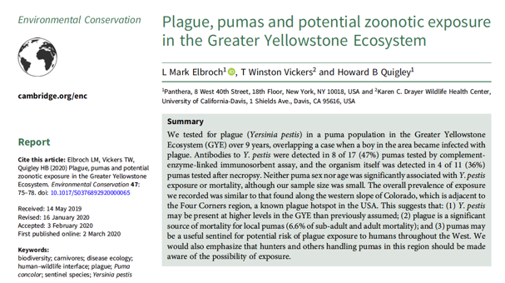
Pumas and Plague
47% pumas in area tested positive by C-ELISA and 36% after necropsy
6.6% cause of mortality
Higher soil salinity may cause persistence in environment

Slide 14

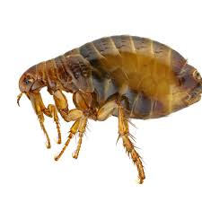
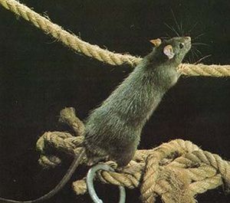
What animals spread plague?
Fleas
Rattus rattus (black rat)
In North America, rodents 100% susceptible to infection (90-100% mortality)
Raptors may spread
Carnivores (through fleas)

Slide 15
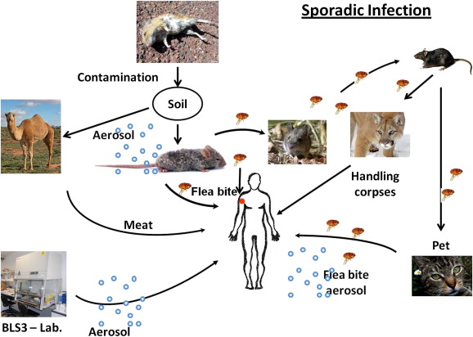
Cycle and Transmission
Summer
Arid/Semi-arid
Predominantly fleas
3 biovars
  orientalis,
  antigua (in Africa)
  mediaevalis (Black Death) one serotype/one phage type

Slide 16
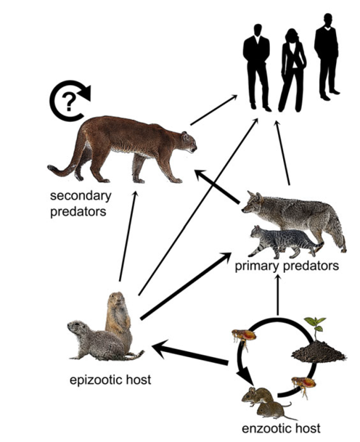
Transmission
Carnivores through predation on rodents
Accumulate through food chain
Flea transmission
Aerosols
Body fluids

Slide 17
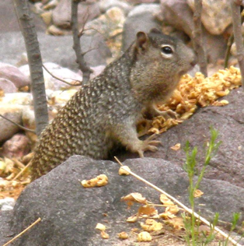
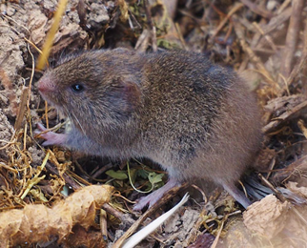
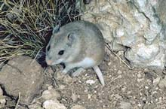
Enzootic or Maintenance Hosts
Microtus californicus – vole
Onychomys leucogaster – grasshopper mouse
Spermophilus variegatus – rock squirrel
J. Maugh
Smithsonian
Marc Trinks
Notes:
Grasshopper mouse - omnivore

Slide 18
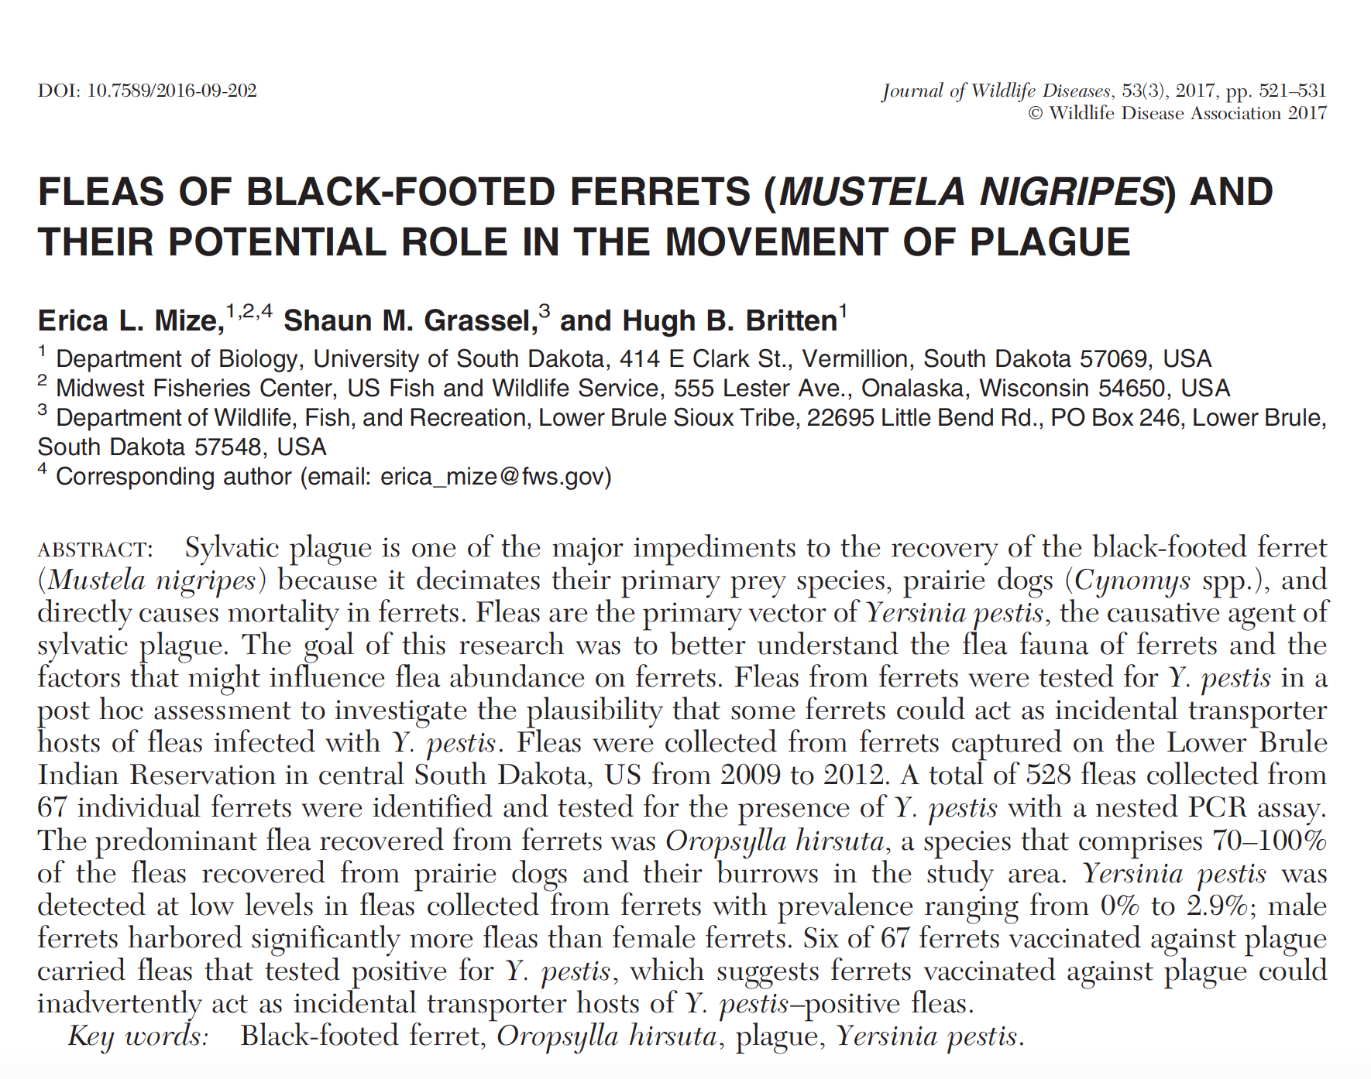
Notes:
Main threat to reintroducing black footed ferrets

Slide 19
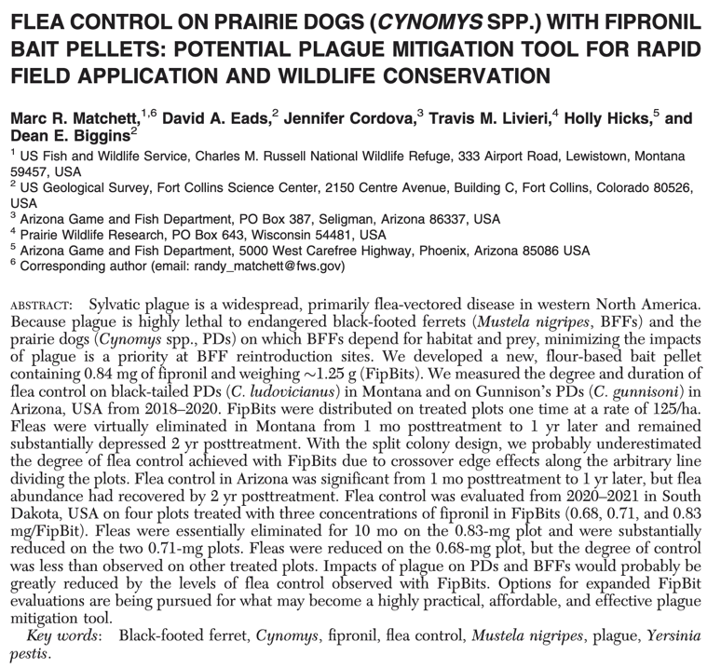
Martinelli

Slide 20
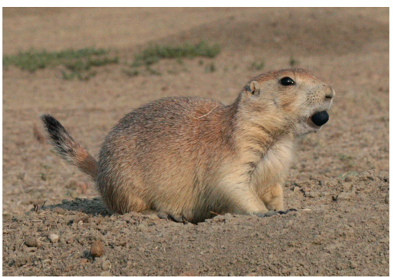
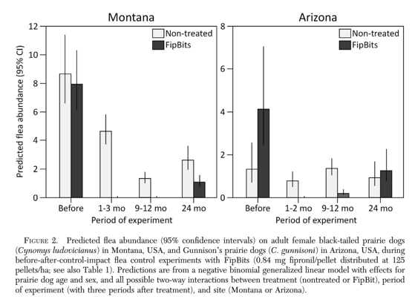

Slide 21
Question
Name a major advantage of FipBits (fipronil baits) over pesticides, such as deltamethrin, for flea control in free-ranging prairie dogs.

Slide 22
Answer
Less impact on non-target species

Slide 23
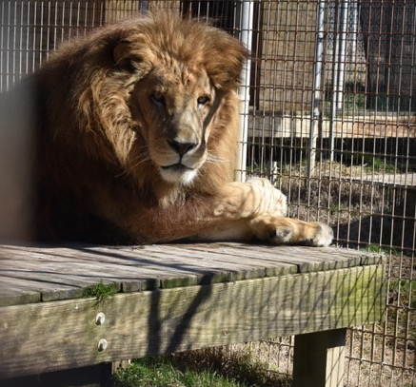
Clinical Signs
Rodents – subacute, mild, severe, and may have high fatality rates
Hemorrhagic buboes and splenomegaly, die in 3-5 days
Cats - abscesses, lymphadenopathy (submandibular and cervical LN), lethargy, fever, secondary pneumonia, mortality 50%

Slide 24
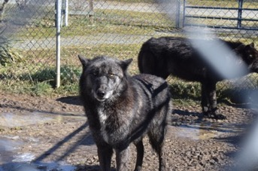
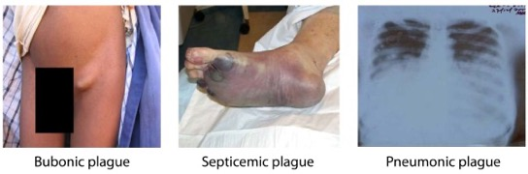
Clinical Signs
Dogs – only fever experimentally, may have lethargy, fever, dyspnea
Humans – signs in 2-6 days, fever, chills, headache, aches, vomiting, nausea, bubo (acutely swollen, painful lymph node), septicemia, gangrene (black death), coagulopathies, multiple organ failure
https://www.cdc.gov/plague/symptoms/index.html

Slide 25
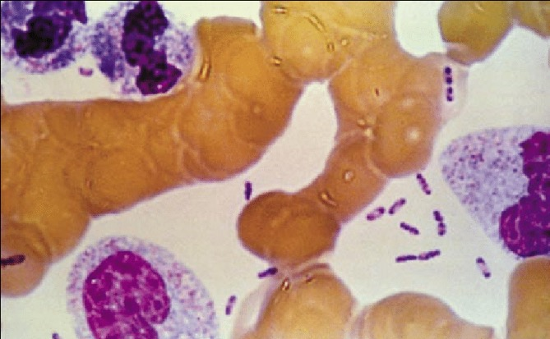
Diagnosis
Gram stain
Wright Giemsa
Bipolar-staining gram negative bacillus
Culture
PCR
Serology
https://www.researchgate.net/figure/Dark-stained-bipolar-ends-of-Yersinia-pestis-can-clearly-be-seen-in-this-Wrights-stain_fig4_7565384

Slide 26
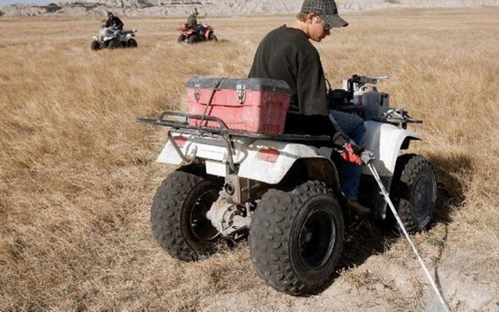
Prevention
Control flea vectors
Avoid rodents/exclude rodents
Flea prevention
https://www.mitchellrepublic.com/sports/2104687-Sylvatic-plague-hits-prairie-dogs-ferrets-in-Badlands

Slide 27
Treatment
Humans- gentamicin and fluroquinolones 10-14 days (https://www.cdc.gov/plague/healthcare/clinicians.html)
Veterinarians
  Aminoglycosides
  Fluroquinolones
  Tetracycline
  Isolate and take precautions for 48 hours post-treatment initiation

Slide 28
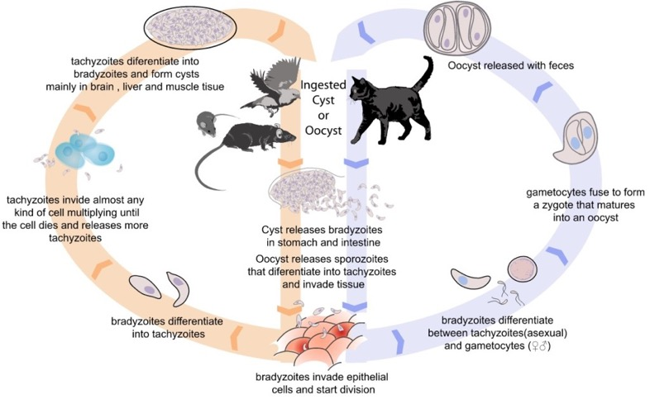
Toxoplasmosis
http://www.abcdcatsvets.org/toxoplasma-gondii-infection-2/

Slide 29

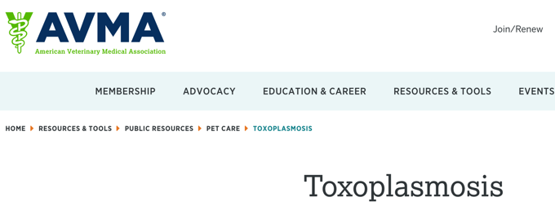
Where do I learn more about this?

Slide 30
Toxoplasmosis
Obligate intracellular coccidian parasite
Felids are natural hosts
Non-felines serve as intermediate hosts

Slide 31
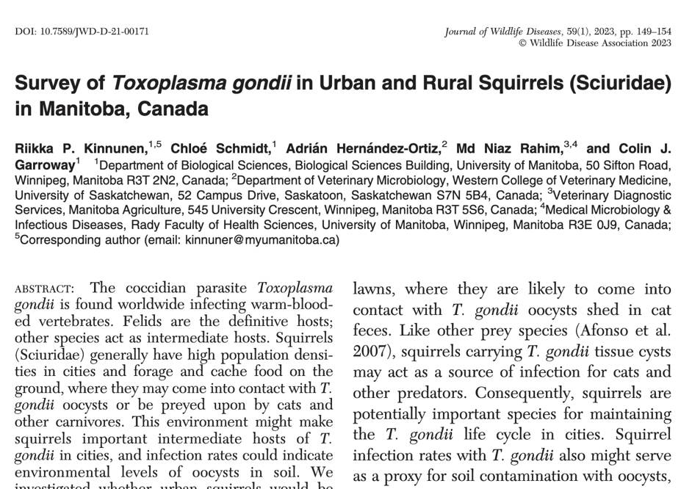
Stratton

Slide 32
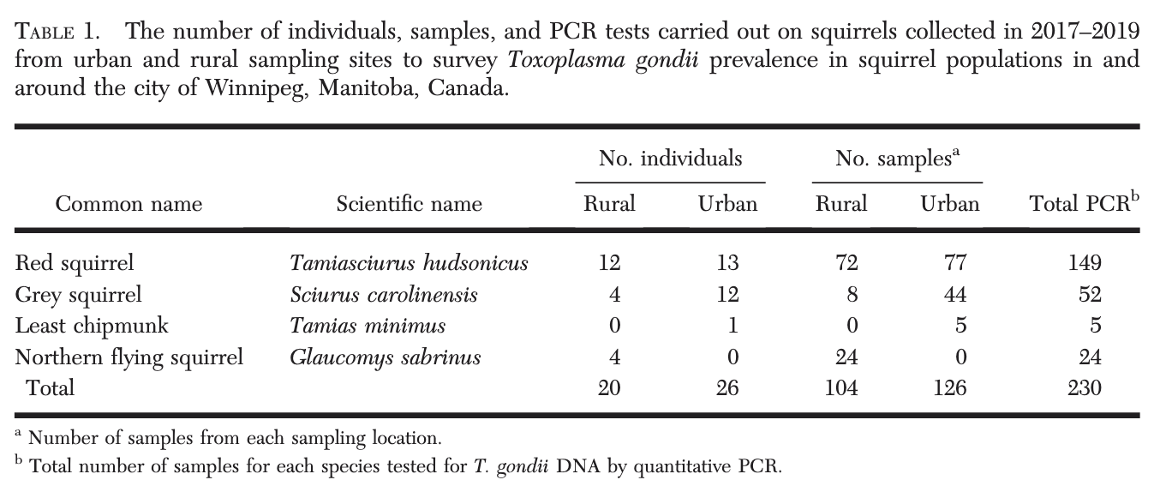

Slide 33
Question
Question: Which of the following species is uniquely susceptible to Toxoplasma gondii?
Otocolobus manul
Puma concolor
Felis margarita
Acinonyx jubatus
Lynx rufus

Slide 34
Answer
Question: Which of the following species is uniquely susceptible to Toxoplasma gondii?
Otocolobus manul
Puma concolor
Felis margarita
Acinonyx jubatus
Lynx rufus

Slide 35
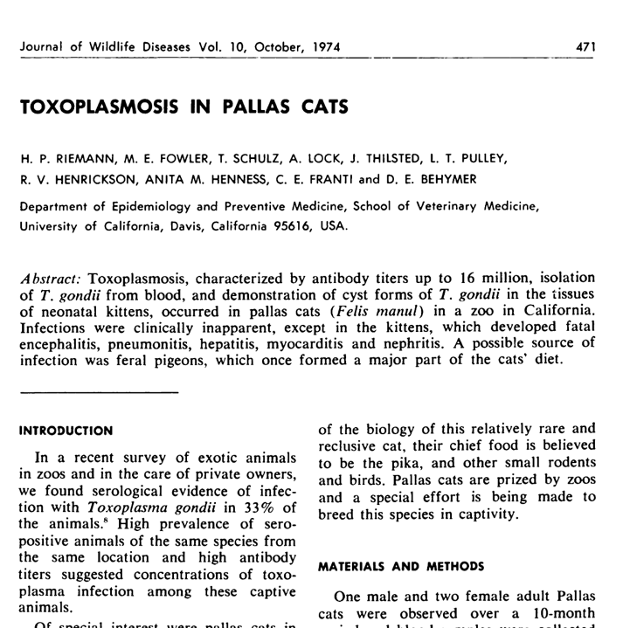
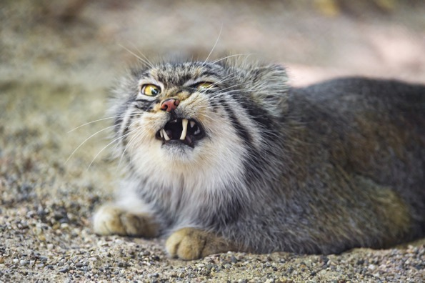
https://cn-animals.fandom.com/wiki/Pallas%27_Cat

Slide 36
Infectious Structures
Sporozoites in oocysts – in feces
Tachyzoites (the actively multiplying stage) – in tissue and milk
Bradyzoites (slowly multiplying stage) in tissue cysts – in tissues and milk

Slide 37
Transmission
Oocysts are in feces 3 days after infection
Oocysts released in feces for up to 20 days
Infectious outside the cat within 1-5 days
Contaminated uncooked meat, feed, drinks consumed then extra intestinal replication
Bradyzoites and sporozoites released and infect intestinal epithelium
Tachyzoites disseminate in blood and lymph and infect tissues and replicate
Some may die at this point (usually young, immunocompromised)
Older animals cell mediated immune response, maintain tissue cysts

Slide 38
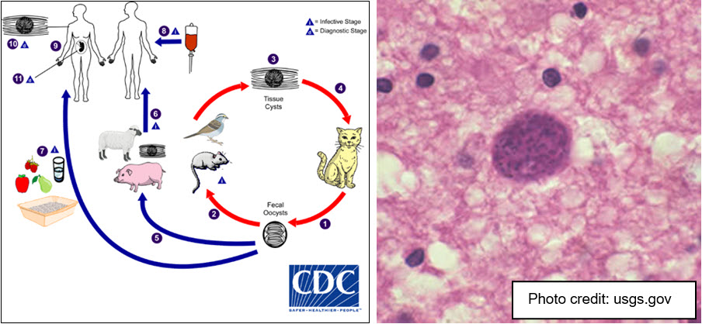

Slide 39
Transmission
Ingestion of infected oocysts in cat feces
Tissue cysts in infected meat
Transplacental transfer of tachyzoites

Slide 40
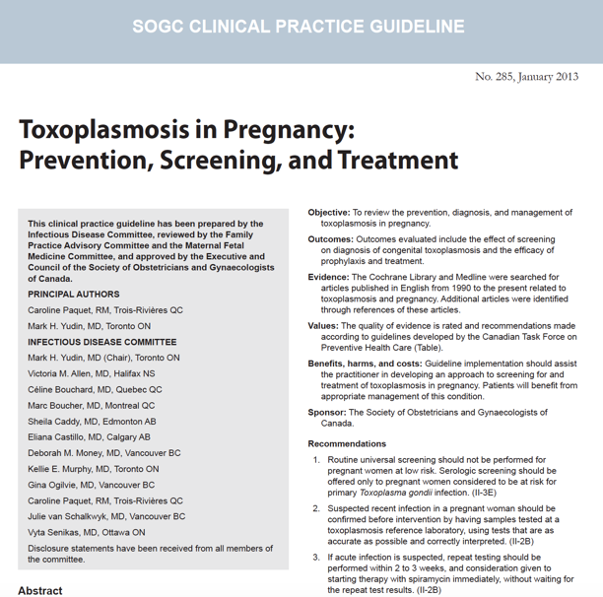
Clinical Signs
Tachyzoites responsible for tissue damage
Clinical signs depend on number of tachyzoites
Subclinical to fatal

Slide 41
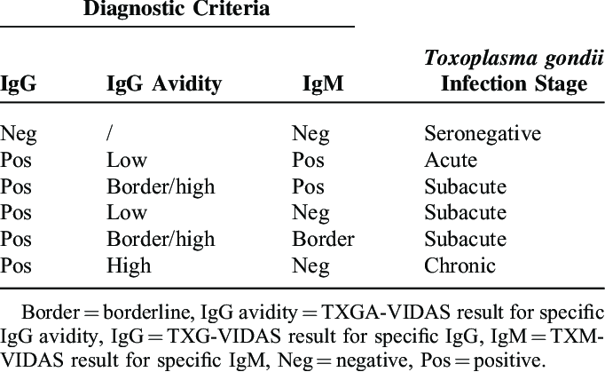
Diagnosis
Antemortem
  Indirect hemagglutination
  Indirect fluorescent antibody assay
  Latex agglutination test
  ELISA
  IgM antibodies >1:256
  IgG by 4th week and increased for years
https://www.researchgate.net/figure/Serological-Criteria-for-the-Determination-of-the-Toxoplasma-gondii-Infection-Stage-in_tbl1_297609601

Slide 42
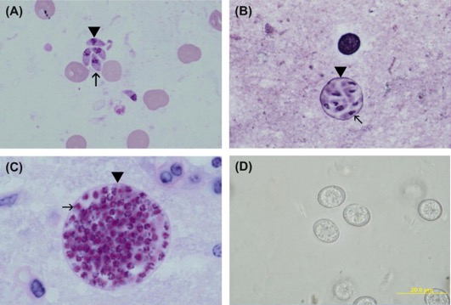
Diagnosis
Post-mortem
  Tachyzoites impression smears
  Histology
  Differentiate from Sarcocystis sp and Neospora caninum
https://www.sciencedirect.com/topics/biochemistry-genetics-and-molecular-biology/tachyzoite

Slide 43
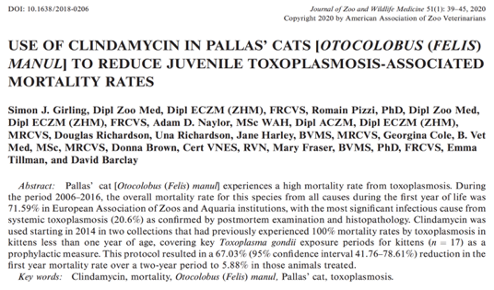
Pallas Cats
71.59% mortality from all causes in first year of life
20.6% died from Systemic Toxoplasmosis
Clindamycin treatment 67% reduction in first year mortality
Ultimate first year mortality became 5.88%
Treated pregnant female and kittens
Hepatic necrosis,
Terio Path book

Slide 44
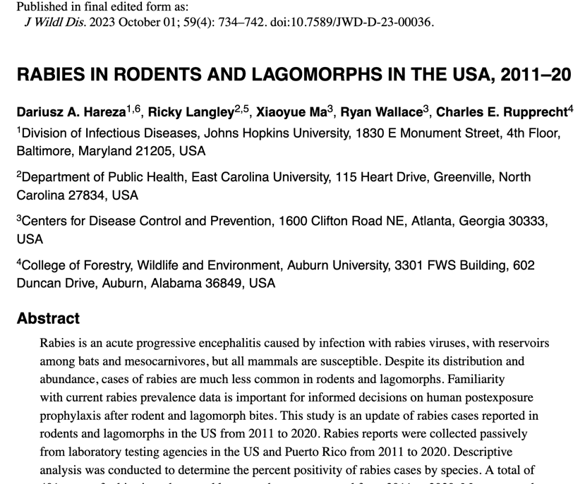
Roeder

Slide 45
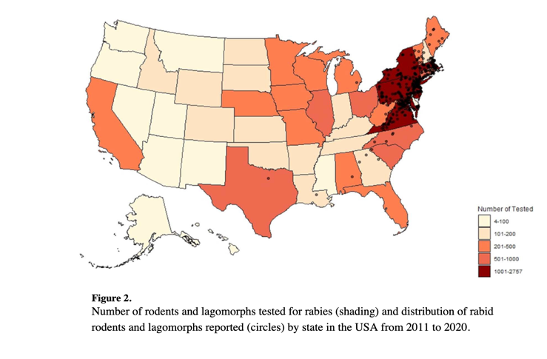
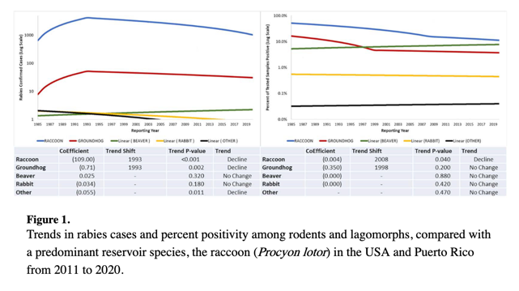
Rabies and Rodents

Slide 46
Question
Amongst rodents and lagomorphs, which species has been found to be most commonly associated with rabies in the United States?
Groundhogs (Marmota monax)
Eastern cottontail rabbits (Sylvilagus floridanus)
North American Beavers (Castor canadensis)
Eastern grey squirrels (Sciurus carolinensis)
Alaska marmots (Marmota broweri)

Slide 47
Answer
Amongst rodents and lagomorphs, which species has been found to be most commonly associated with rabies in the United States?
Groundhogs (Marmota monax)
Eastern cottontail rabbits (Sylvilagus floridanus)
North American Beavers (Castor canadensis)
Eastern grey squirrels (Sciurus carolinensis)
Alaska marmots (Marmota broweri)

Slide 48
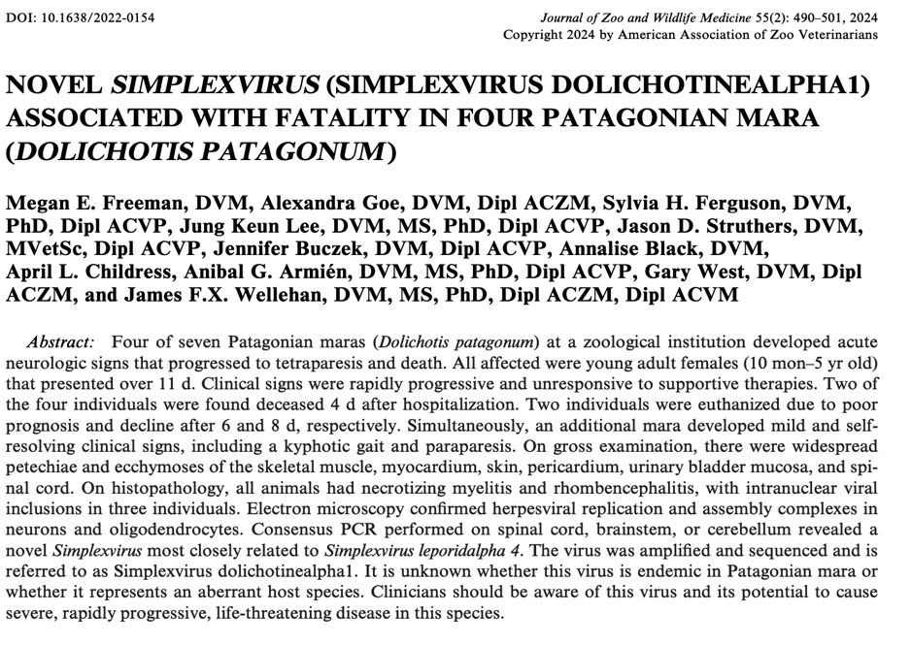
Day

Slide 49
Question
An adult female Patagonian mara (Dolichotis patagonum) presents to you with acute onset of a wide based stance, ataxia, depressed mentation, and hyperthermia. Which of the following diagnostic tests should you prioritize first to help obtain diagnosis in this animal?
Serum biochemistry panel
Complete hematology profile
PCR of nasal and oral swabs
Whole body radiographs
Trace mineral panel

Slide 50
Answer
An adult female Patagonian mara (Dolichotis patagonum) presents to you with acute onset of a wide based stance, ataxia, depressed mentation, and hyperthermia. Which of the following diagnostic tests should you prioritize first to help obtain diagnosis in this animal?
Serum biochemistry panel
Complete hematology profile
PCR of nasal and oral swabs
Whole body radiographs
Trace mineral panel
Notes:
Answer: A. This animal potentially has DolAHV1, though you should rule out rhabdomyolysis. Chemistry panel can help rule out rhabdomyolysis due to the absence of elevated muscle values, though PCR of CSF was suggested to diagnose DolAHV1. Antemortem diagnosis for DolAHV1 was difficult in a previous study, and nasal and oral swabs were negative on PCR. Blood work was unhelpful in obtaining a diagnosis, though one case did have a leukocytosis and neutrophilia on CBC (not seen in other cases). Herpesviruses are normally associated with leukopenia and lymphopenias. Whole body radiographs were unremarkable in all animals. Histopathology could be helpful in a deceased animal due to the presence of inclusion bodies, though these were rare and could be easily overlooked. A trace mineral panel was performed on liver one of the cases and was unremarkable.

Slide 51
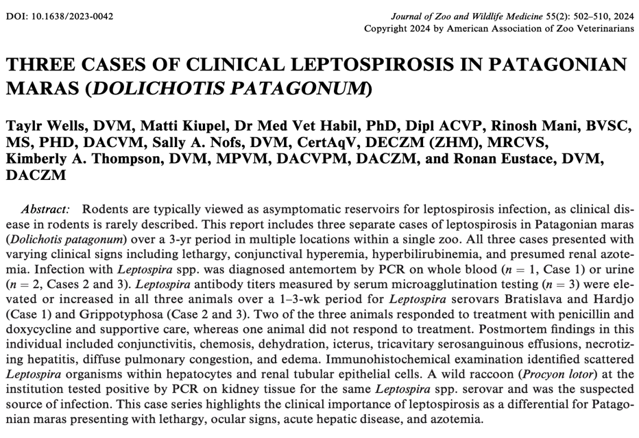
Greenfield-Feig

Slide 52
Question
A Patogonian mara at your zoo presents for lethargy, hyperemic conjunctiva, and inappetence. You find elevated kidney and liver values on bloodwork. What is the most likely differential (be specific)? What is the most likely transmission of disease?

Slide 53
Answer
Leptospirosis kirschneri serovar Grippotyphosa, most likely came from a racoon on zoo grounds

Slide 54
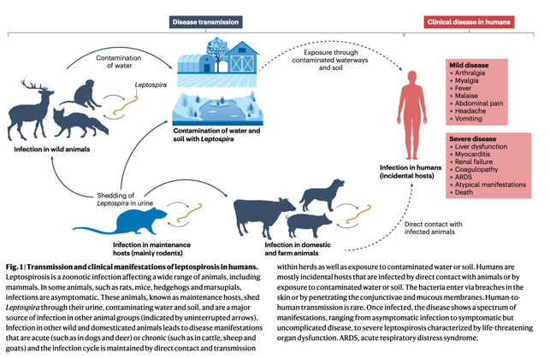
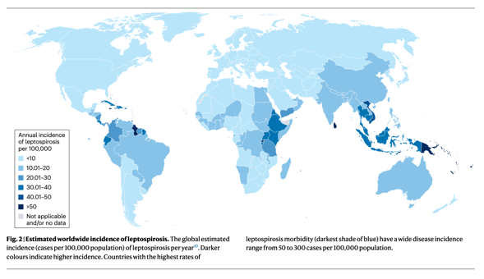
Leptospirosis
Rajapakse, S., Fernando, N., Dreyfus, A. et al. Leptospirosis. Nat Rev Dis Primers 11, 32 (2025). https://doi.org/10.1038/s41572-025-00614-5
Notes:
Despite being around for a long time there are still a lot of human deaths due to this (higher than dengue)

Slide 55
Leptospirosis Serovars
Serovar | Maintenance Host
Canicola | Dogs
Pomona | Raccoons, muskrats, skunks, voles
Hardjo | Cattle
Icterohaemorrhagiae | Rats
Bratislava | Pigs, mice (suspected), horses (suspected)

Slide 56
Leptospirosis
All mammals susceptible
Common in wildlife, more as the host
Re-emerging
Warm-moist environments
Maintenance host transmission – urine, placental fluids, milk
Incidental host infection – indirect
Diagnose – MAT test, PCR, immunohistochemistry
Notes:
Microscopic Agglutination Test – antibody agglutination test; PCR not validated; Immunohistochemistry in formalin fixed tissue

Slide 57
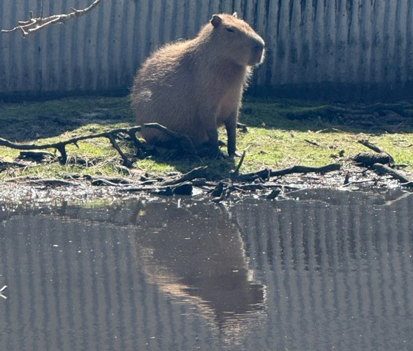
Questions?

