Slide 1
Raptors
Dr. Tara Harrison

Slide 2
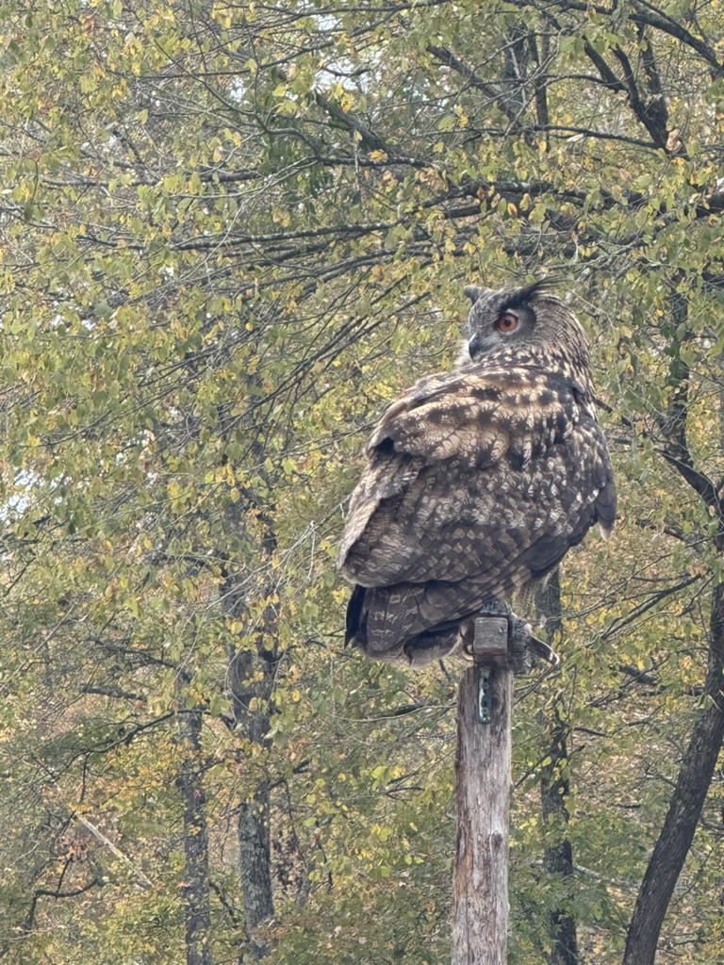

Raptors
Latin – to grasp or seize
Apex predator
Bioaccumulator of environmental toxins
Religious
Bounty
Notes:
Australia tribes - an owl holds a woman human’s spirit so all are left alone; 1600s bounty placed on raptors and got money when killed them

Slide 3
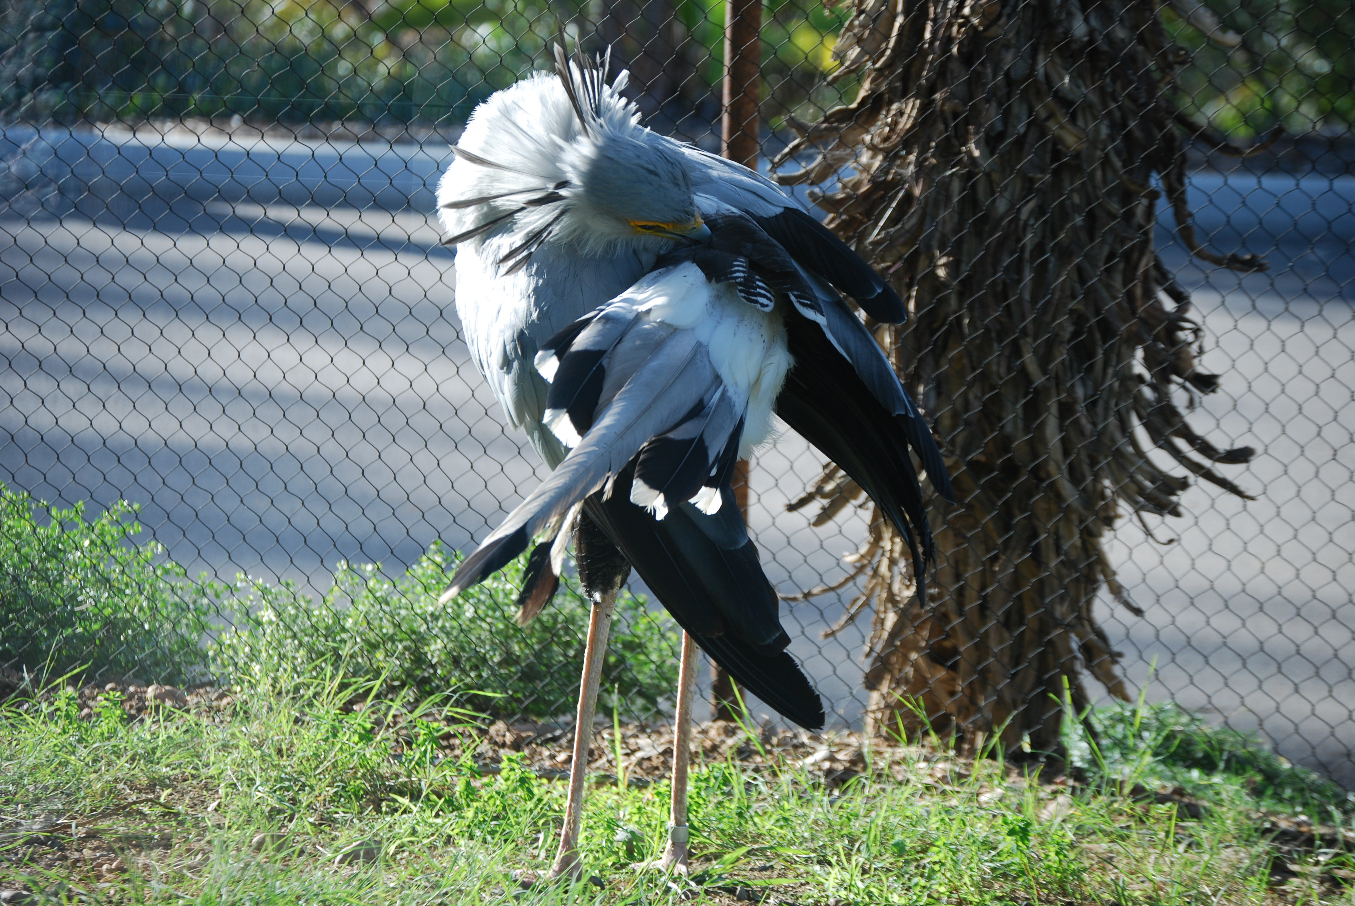
What is a raptor?
Bird of Prey
Eagle
Hawk
Falcon
Owl
Dinosaur

Slide 4
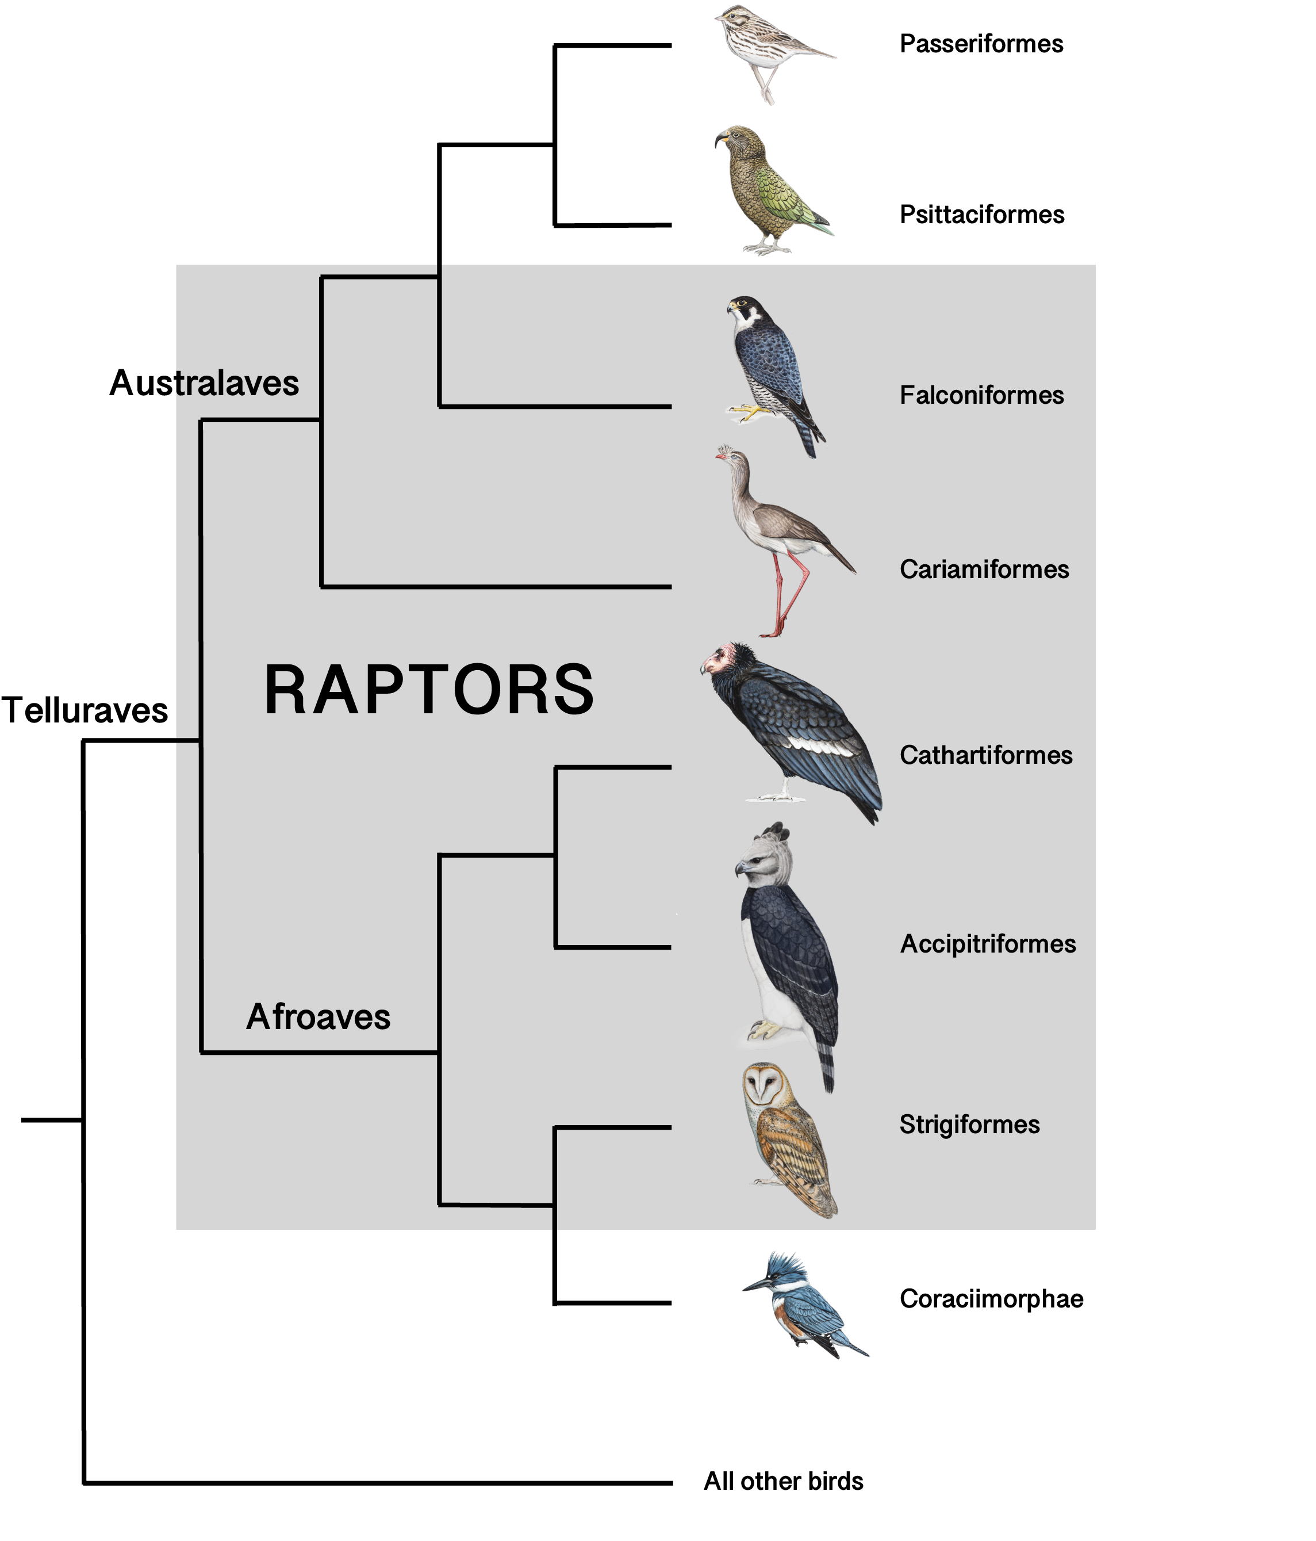
Types of Raptors
Strigiformes (owls)
Strigidae (most owls)
Tytonidae (barn owls)
Falconiformes (hawk-like)
Accipitridae (hawks, eagles, kites, harriers, Old World vultures)
Falconidae (falcons and caracaras)
Cathartidae (New World vultures)
Pandionidae (osprey)
Sagittriidae (secretary birds)
Cariamiformes ?
Red-legged and Black-legged Seriema

Slide 5
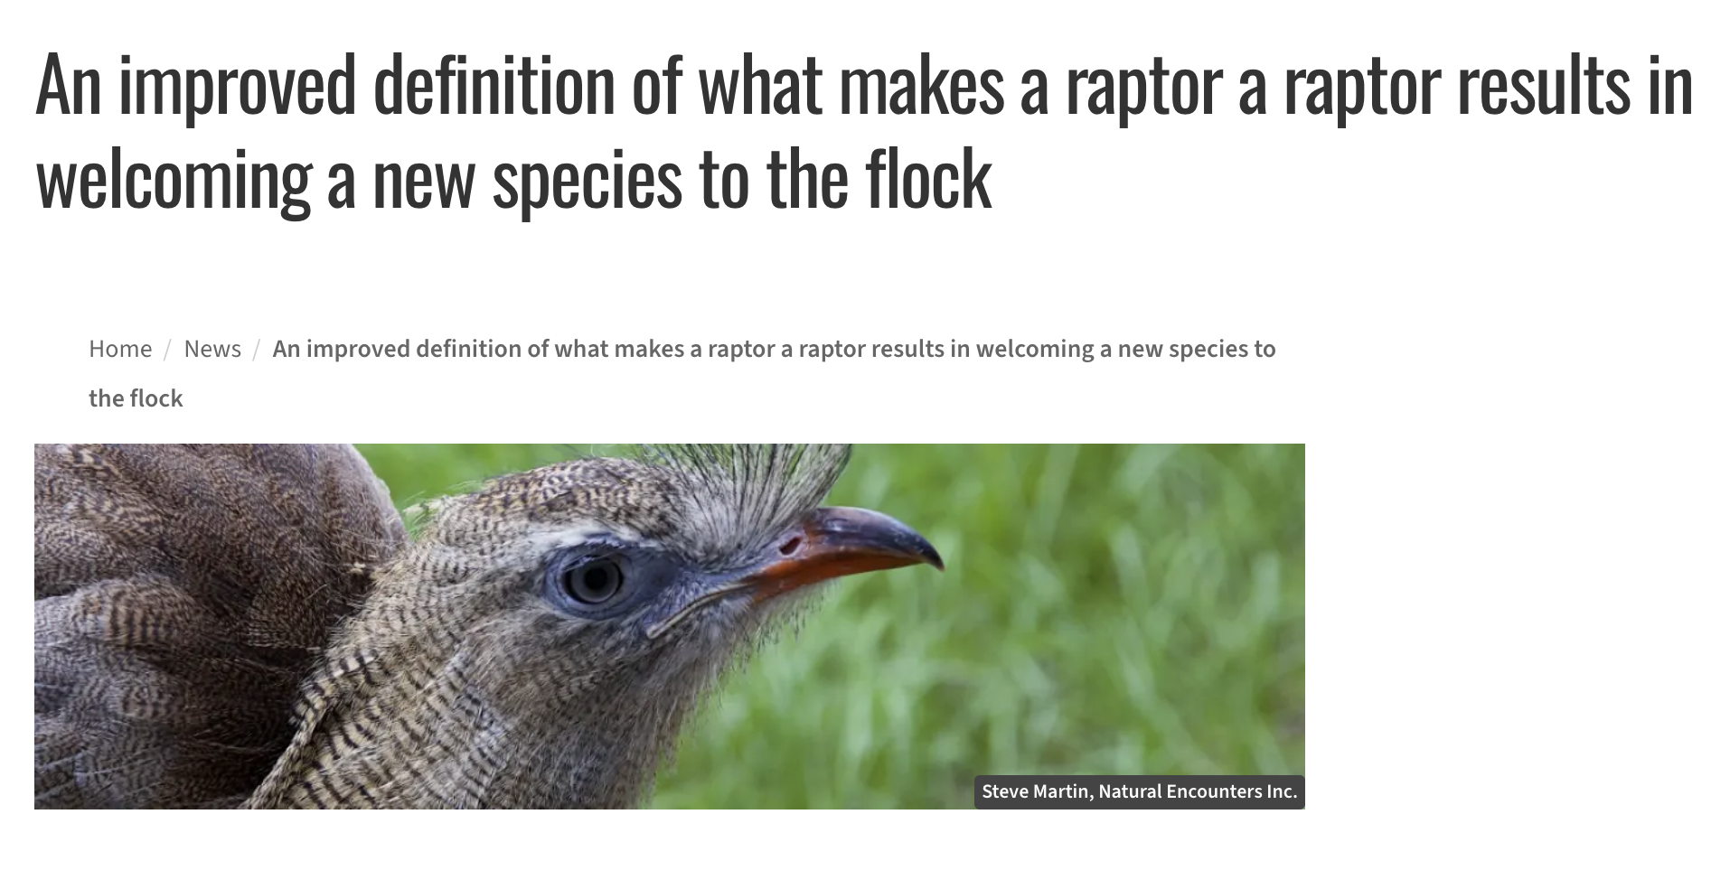
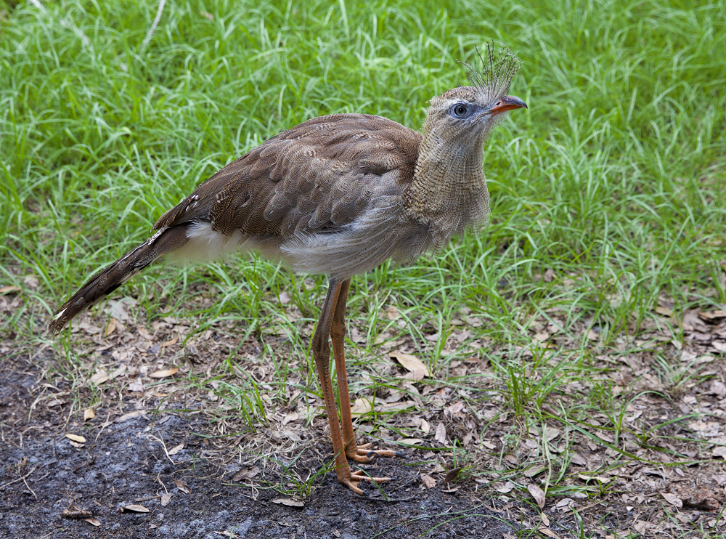
Article from 2019
https://peregrinefund.org/news-release/improved-definition-what-makes-raptor-raptor-results-welcoming-new-species-flock
Notes:
South American birds, they are related to the now extinct giant “terror birds” and they hunt and eat vertebrate prey. Live in the scrublands.

Slide 6
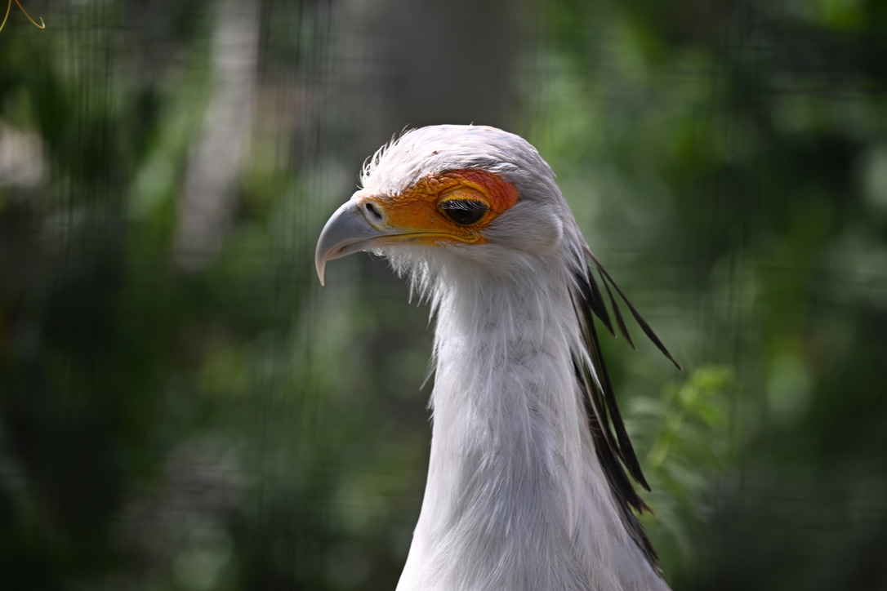
Name the Raptor
Notes:
Secretary bird

Slide 7
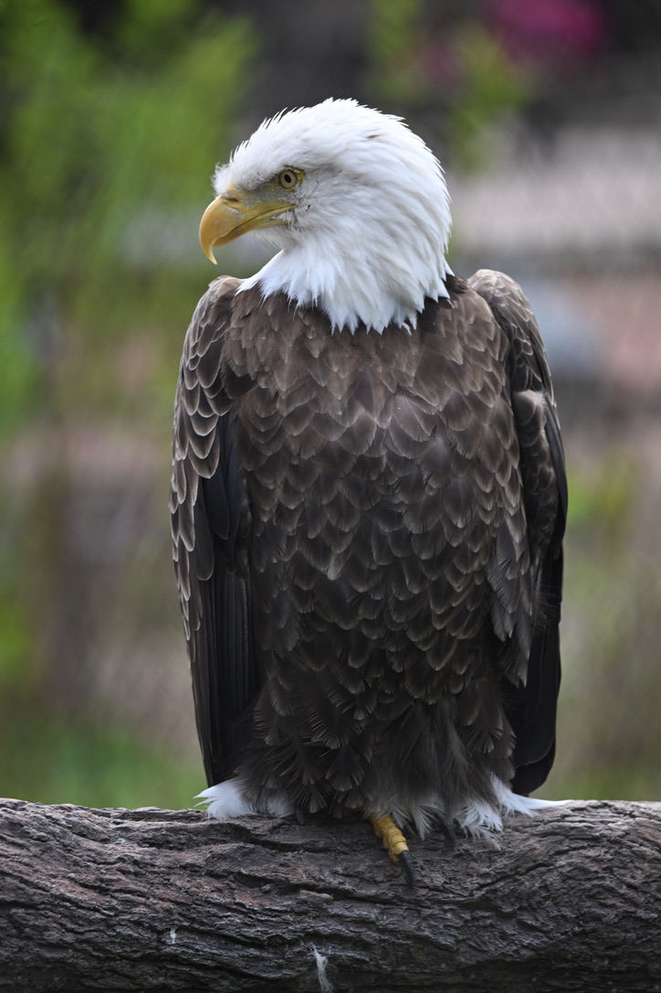
Name the Raptor
Notes:
Bald eagle, Haliaeetus leucocephalus

Slide 8
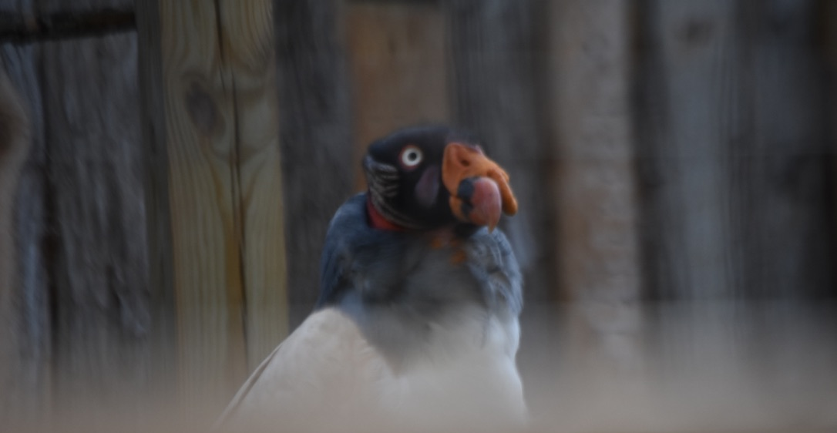
Name the Raptor
Notes:
King vulture

Slide 9
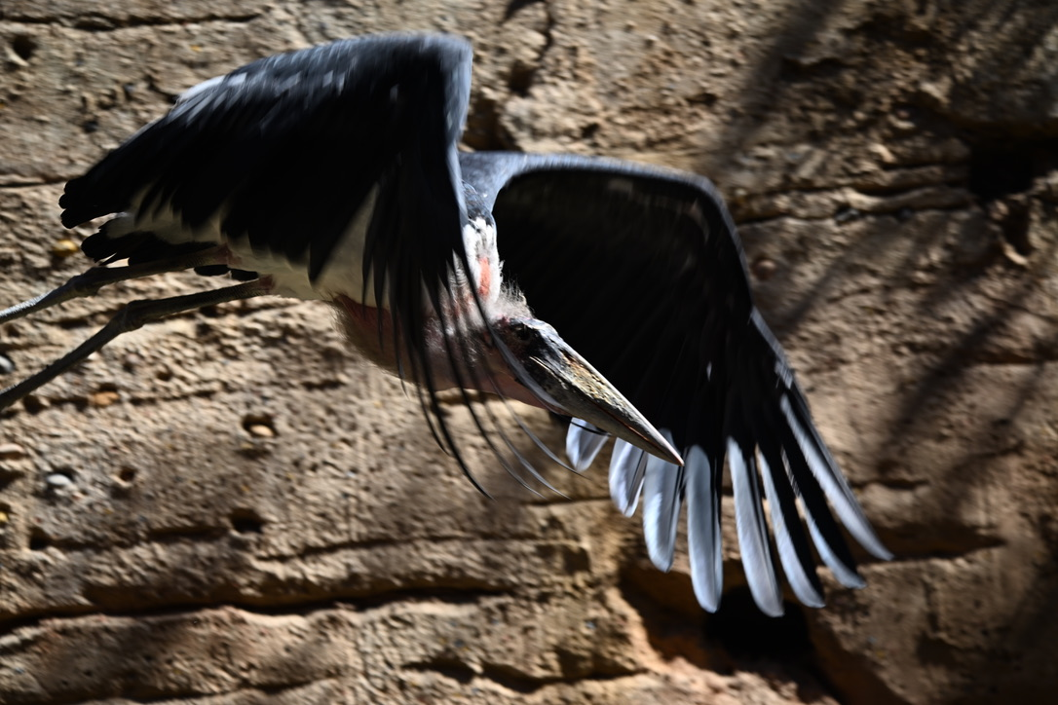
Name the Raptor
Notes:
Maribou stork

Slide 10
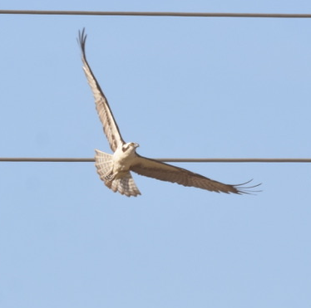
Name the Raptor
Notes:
Osprey

Slide 11
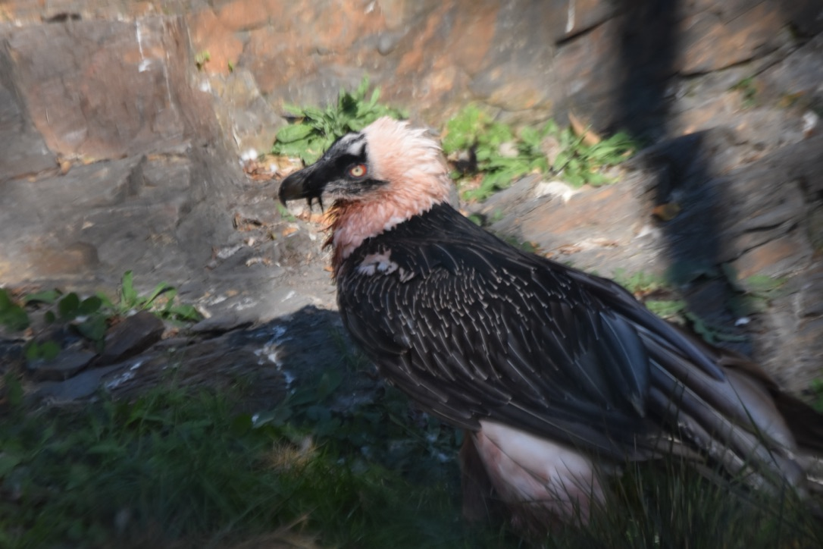
Name the Raptor
Notes:
Bearded vulture

Slide 12
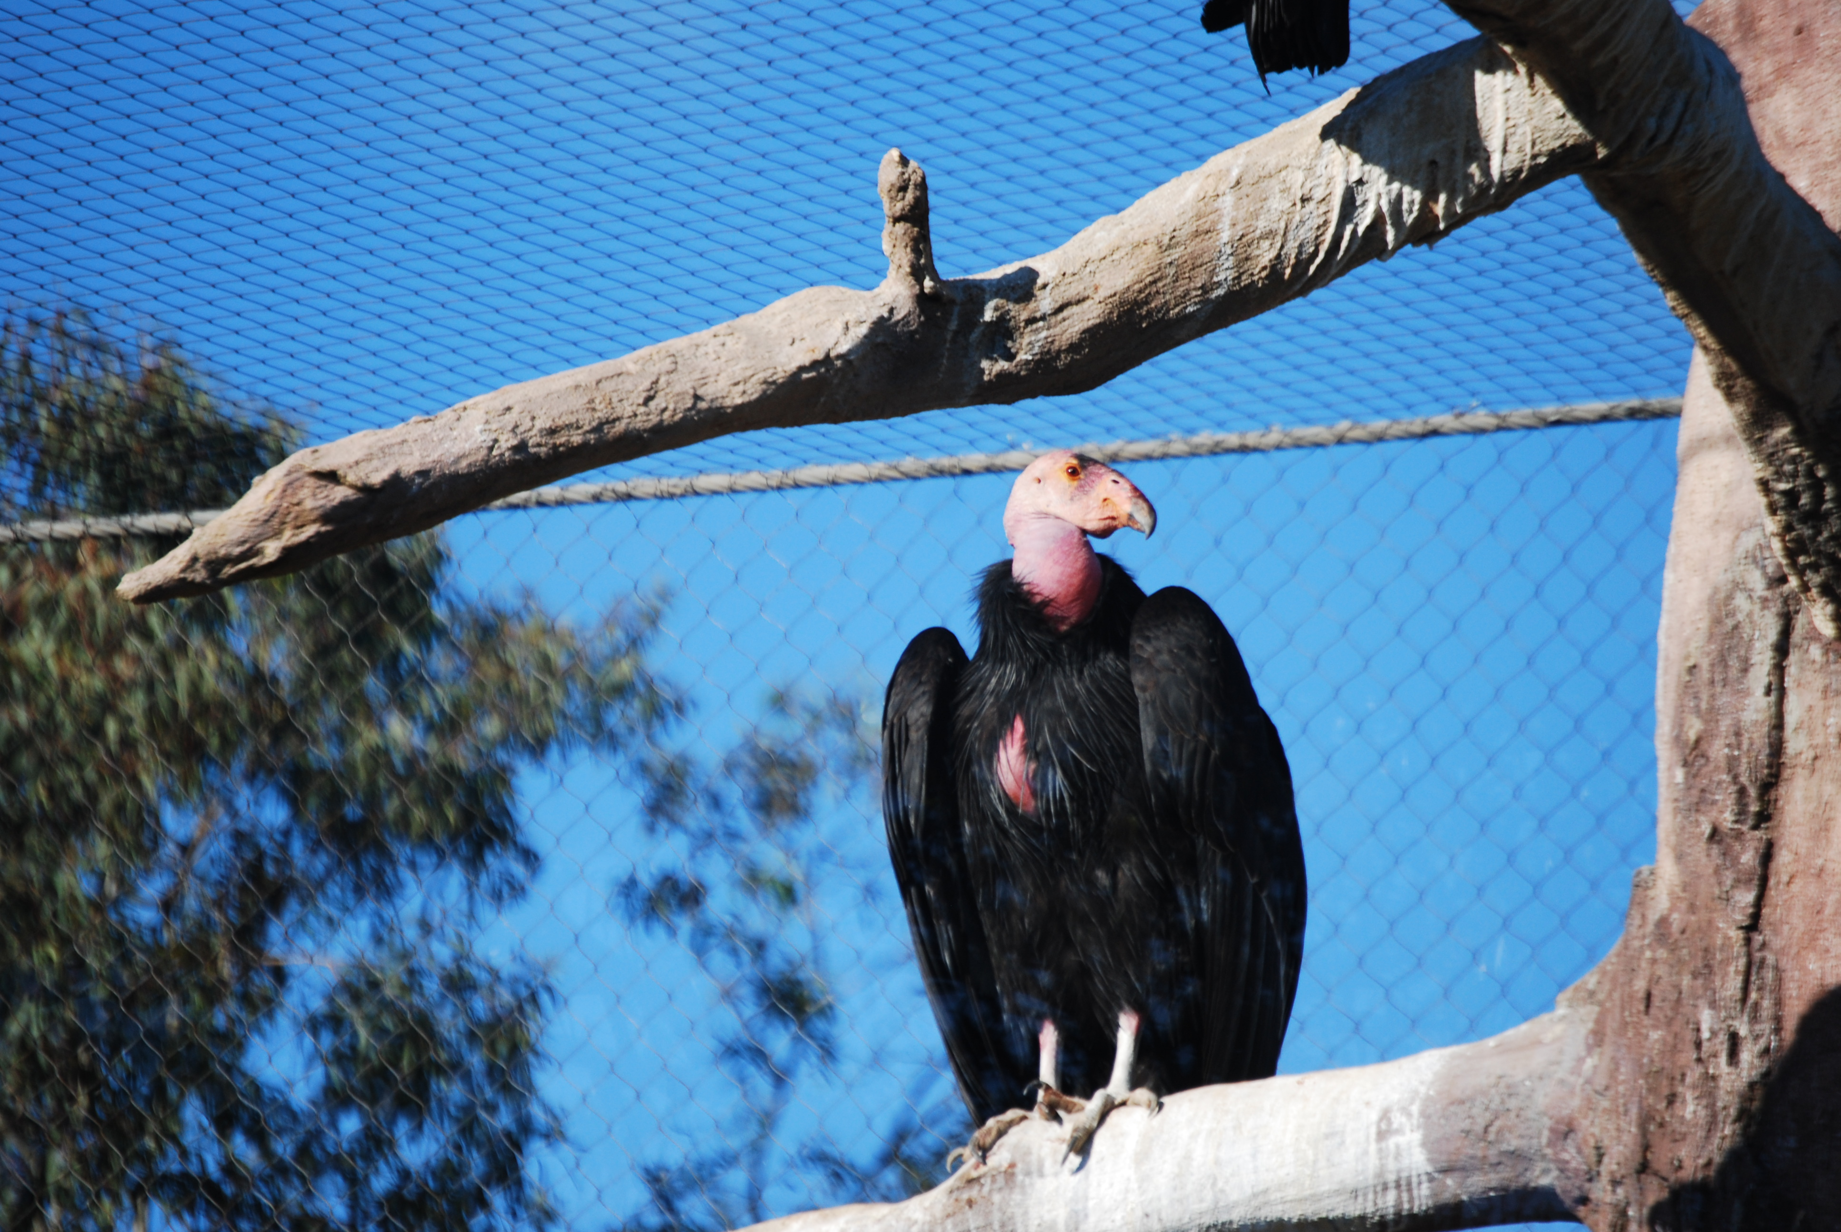
Name the Raptor

Slide 13
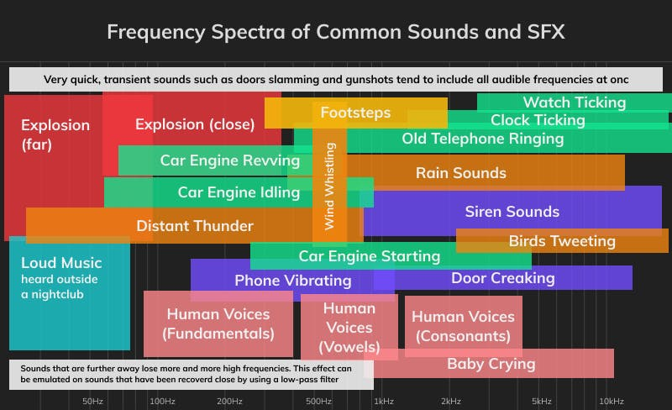
Special Senses - Hearing
10 times fainter than humans
Facial disc
Auditory centers in brain with more neurons
5-8.5 KHz
Great Gray Owl and Barn Owl
Notes:
Humans hear 20 Hz to 20 kHz

Slide 14
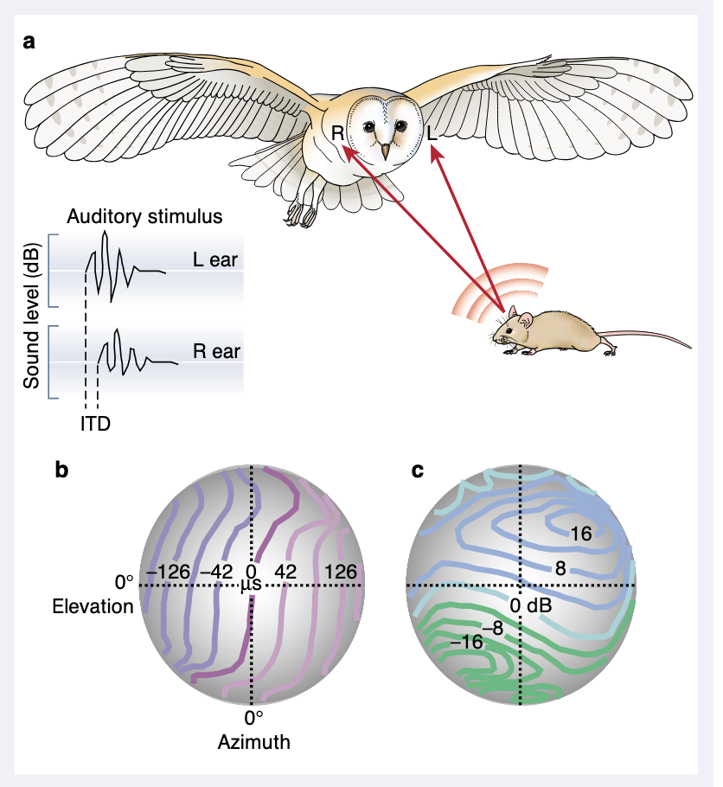
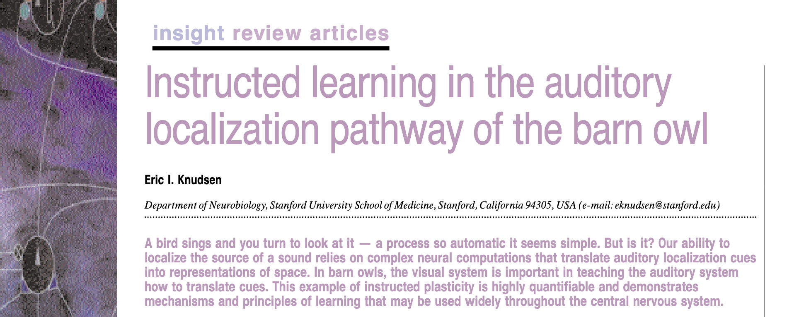
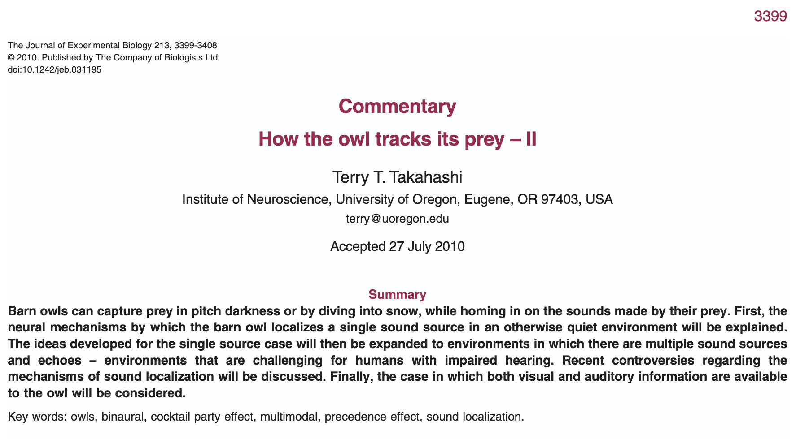
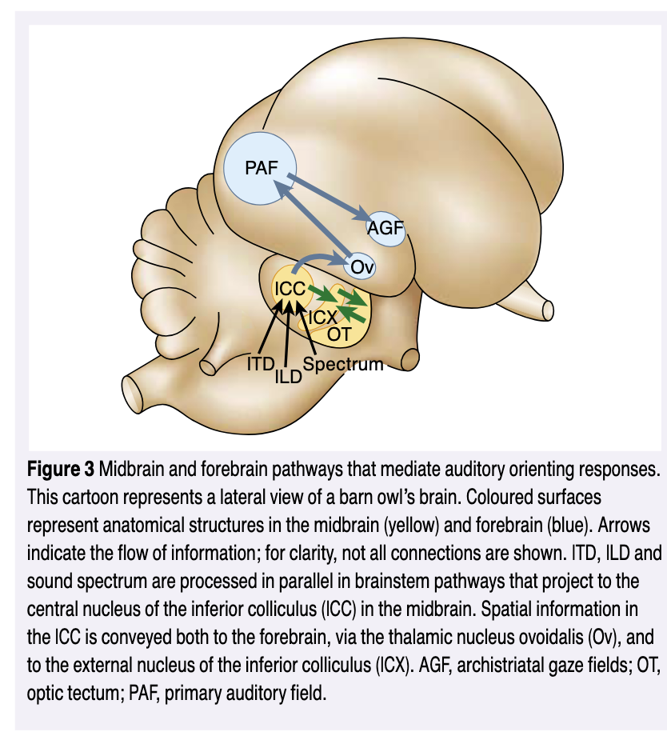

Slide 15
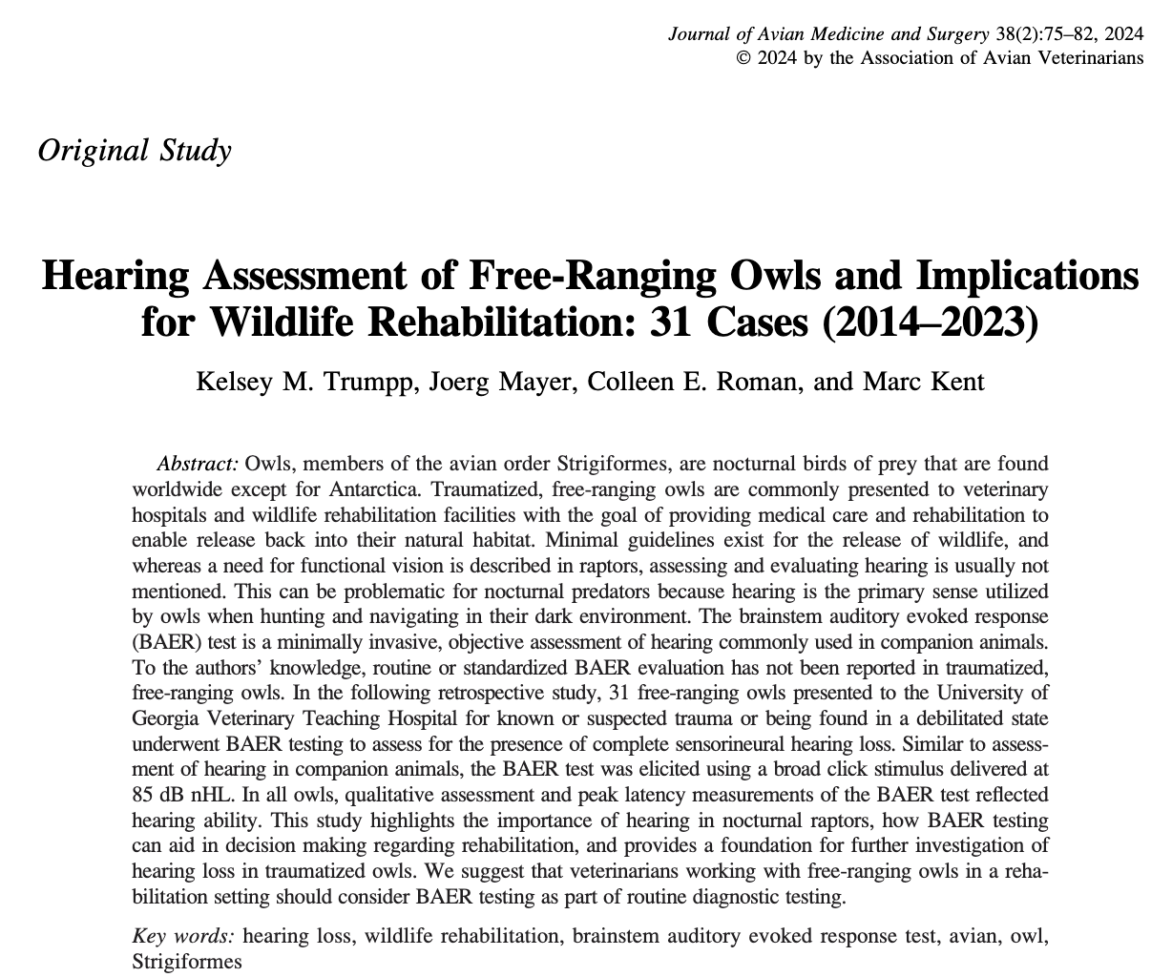
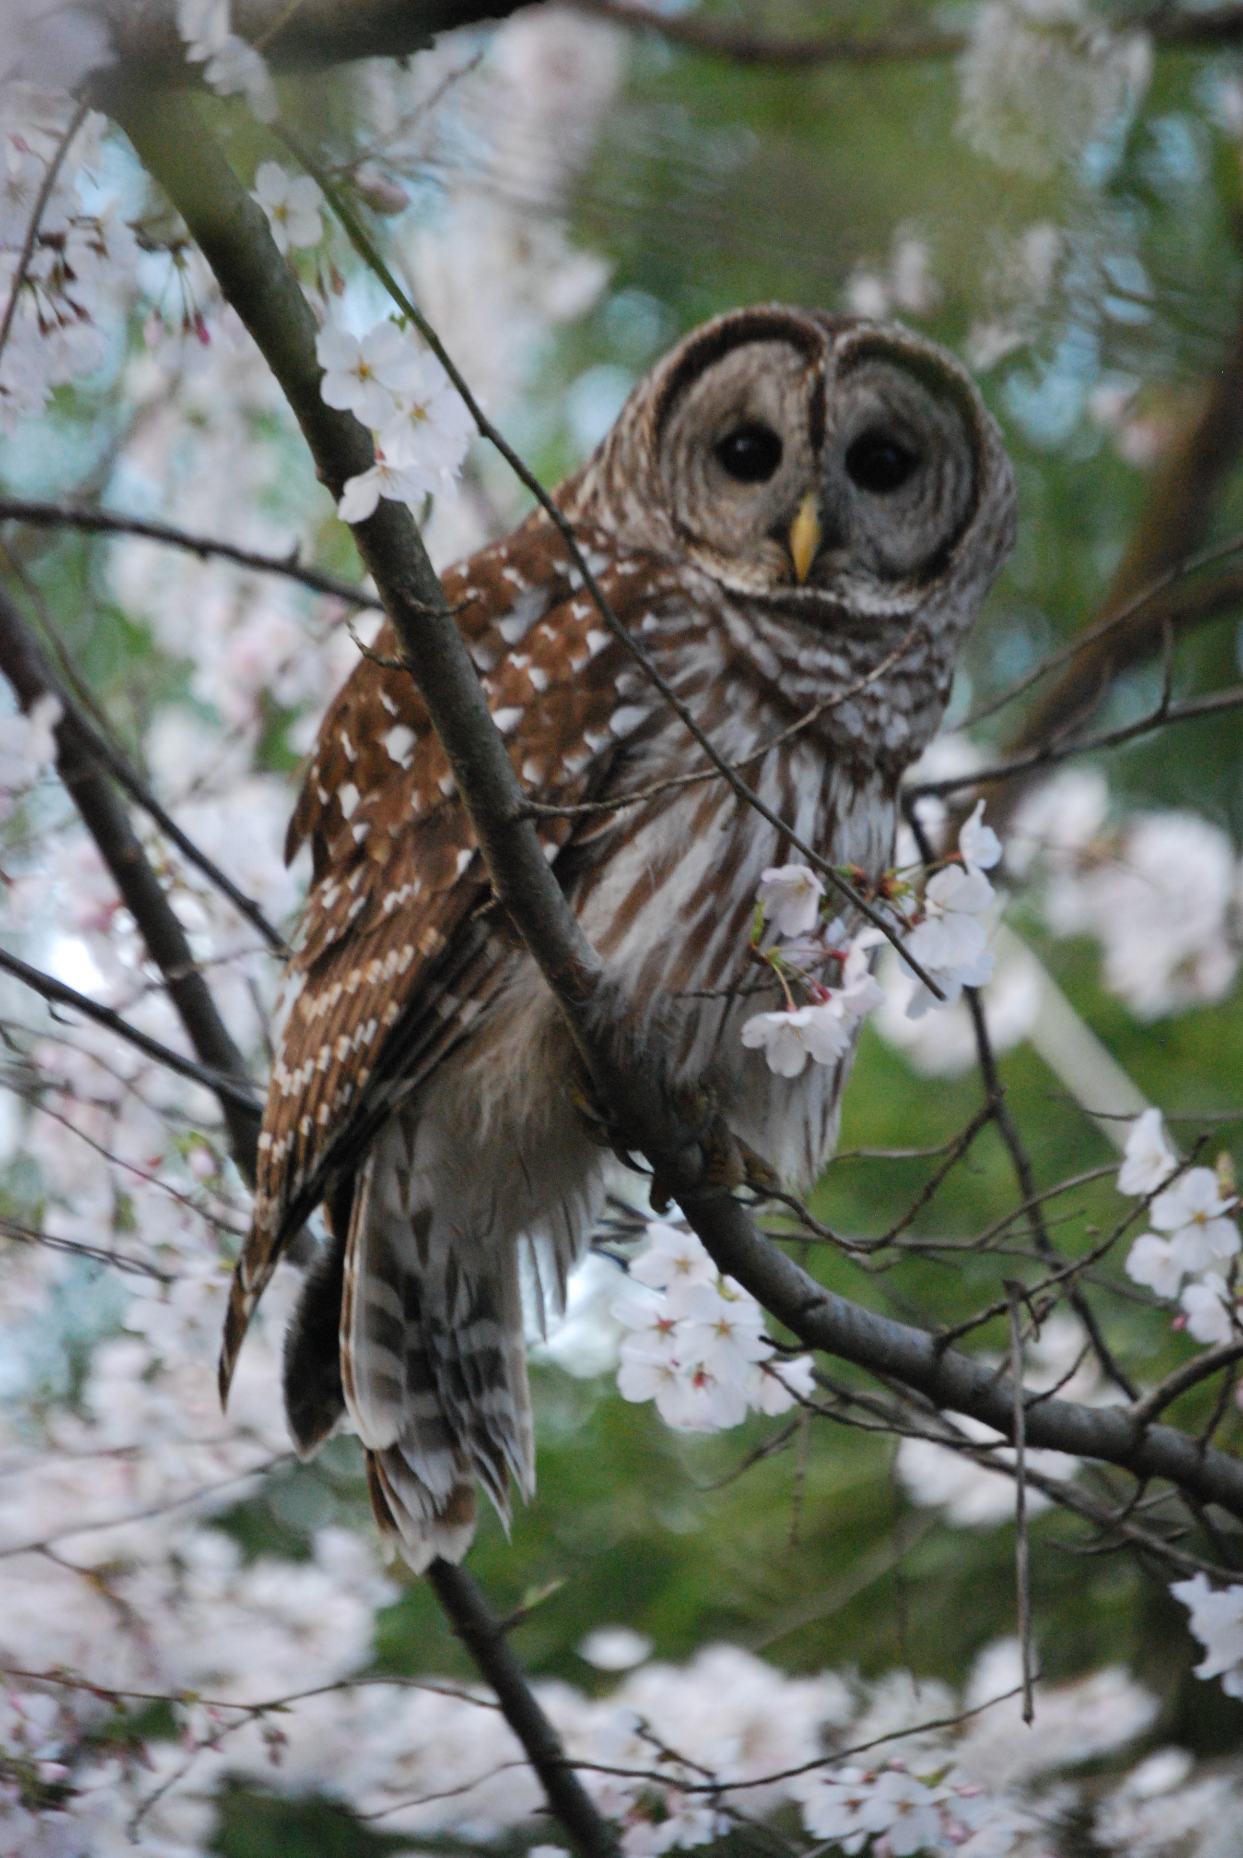
Stratton

Slide 16
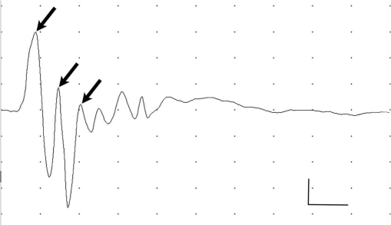
Question
The following graph depicts a brainstem auditory evoked response (BAER) test in an adult barred owl (Strix varia). The response of which nerve is shown in the first (left-most) peak?

Slide 17
Answer
The cochlear nerve. The 2nd wave is from the nucleus magnocellularis and nucleus angularis. The 3rd wave is from the nucleus laminaris.

Slide 18
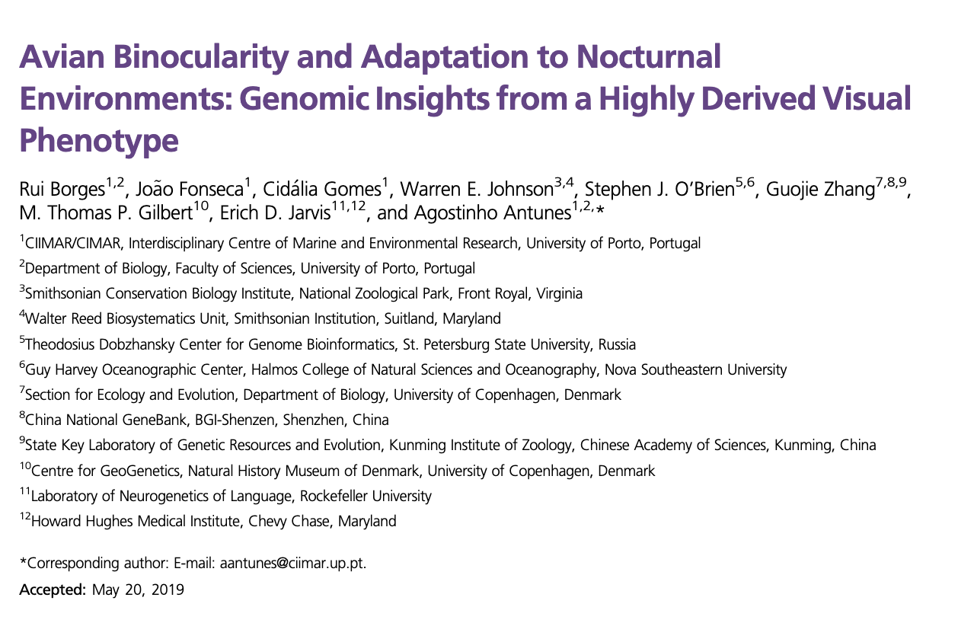
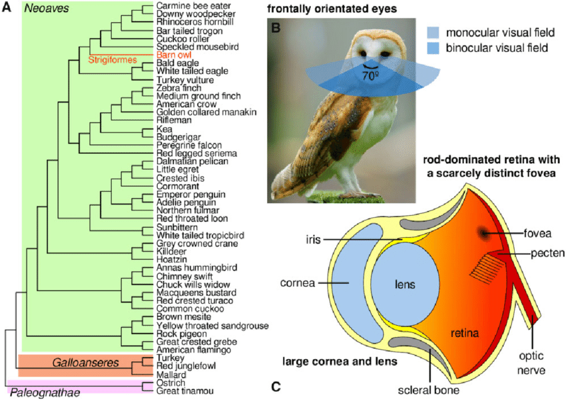
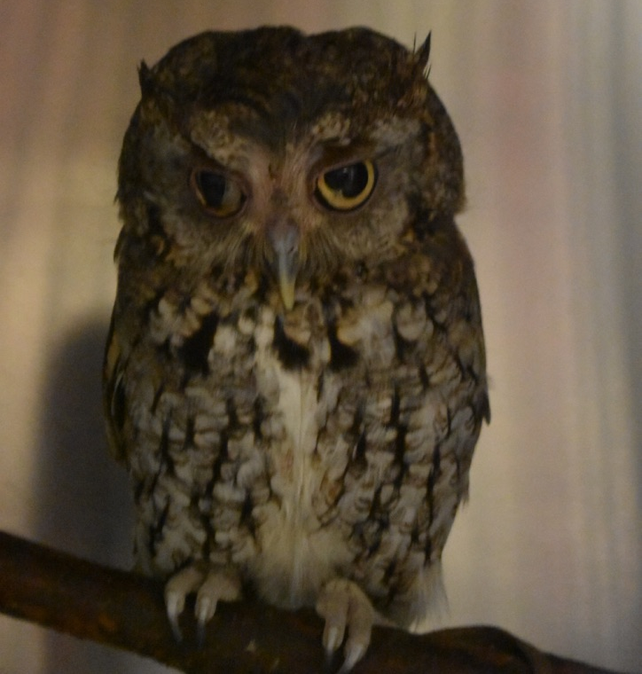
Sight
Owl eyes can be up to 70% of head/5% weight of bird
Raptors diurnal and nocturnal

Slide 19
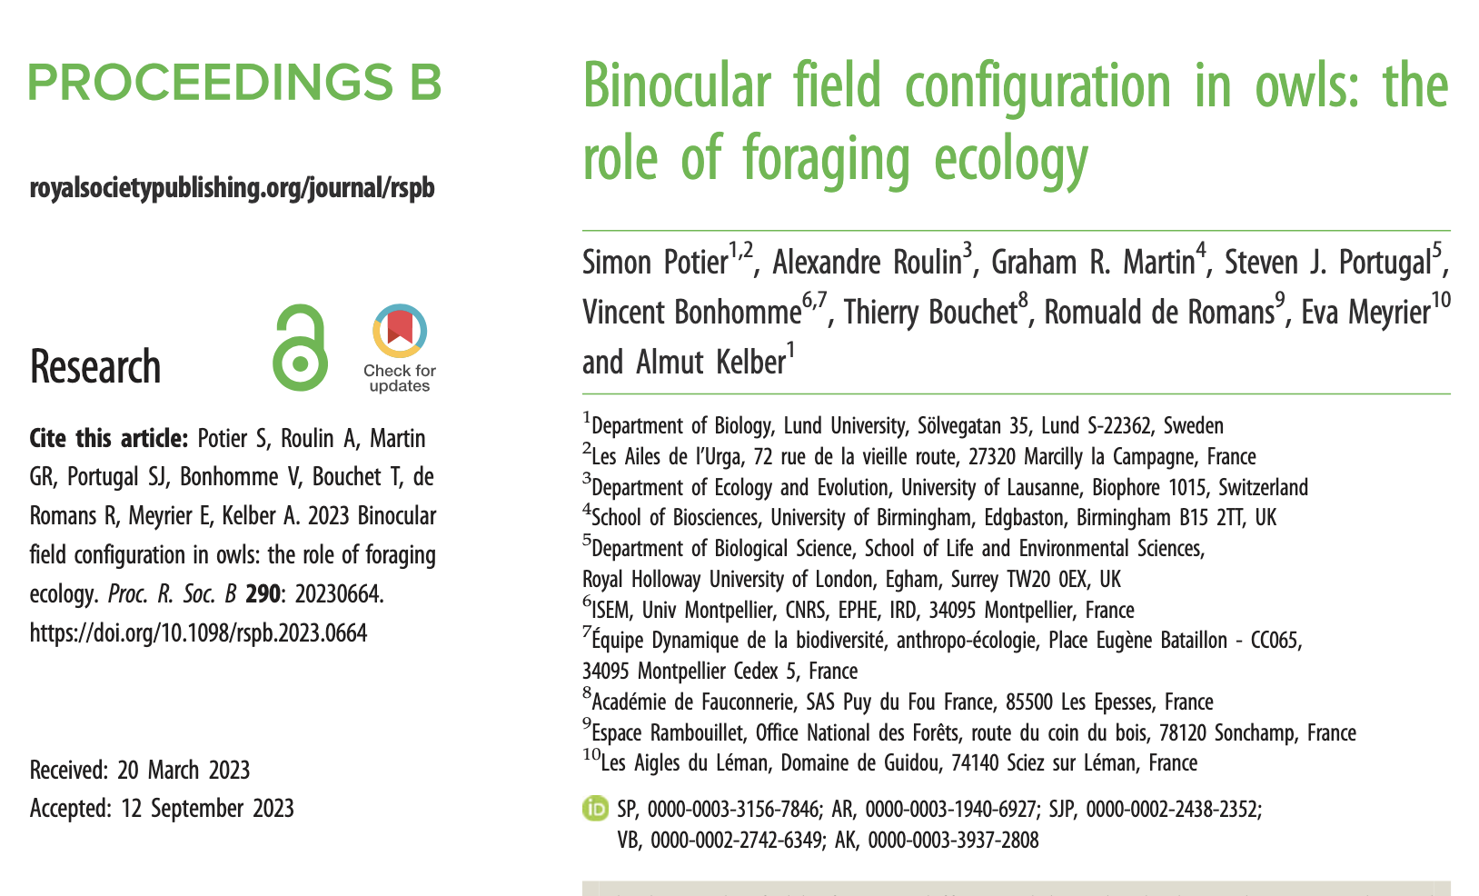
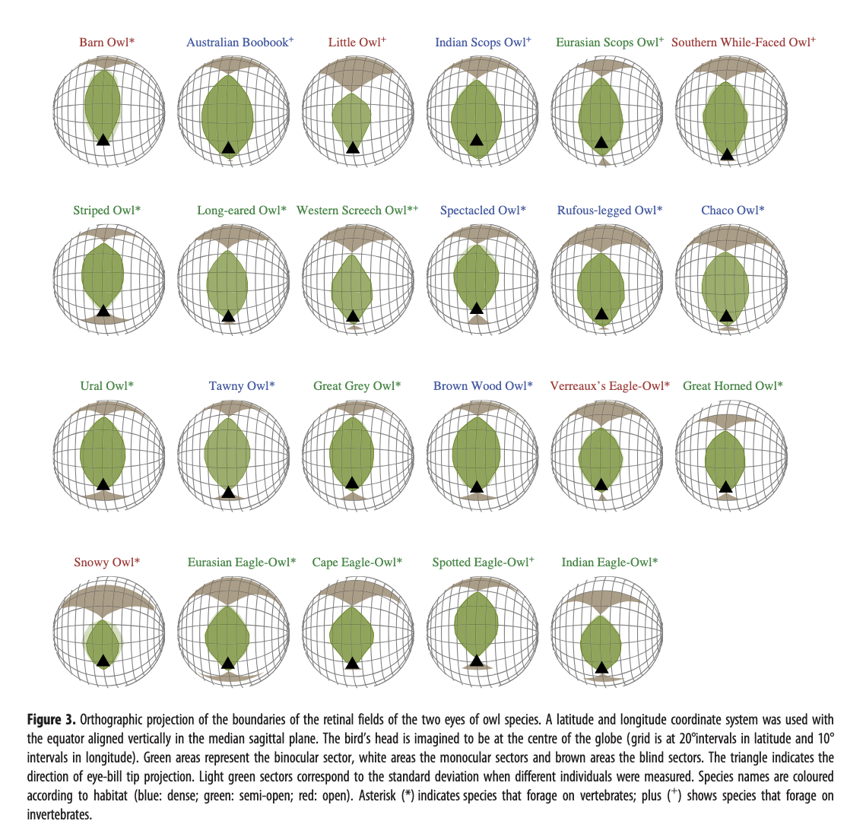
Notes:
Larger binocular vision in dense habitats

Slide 20
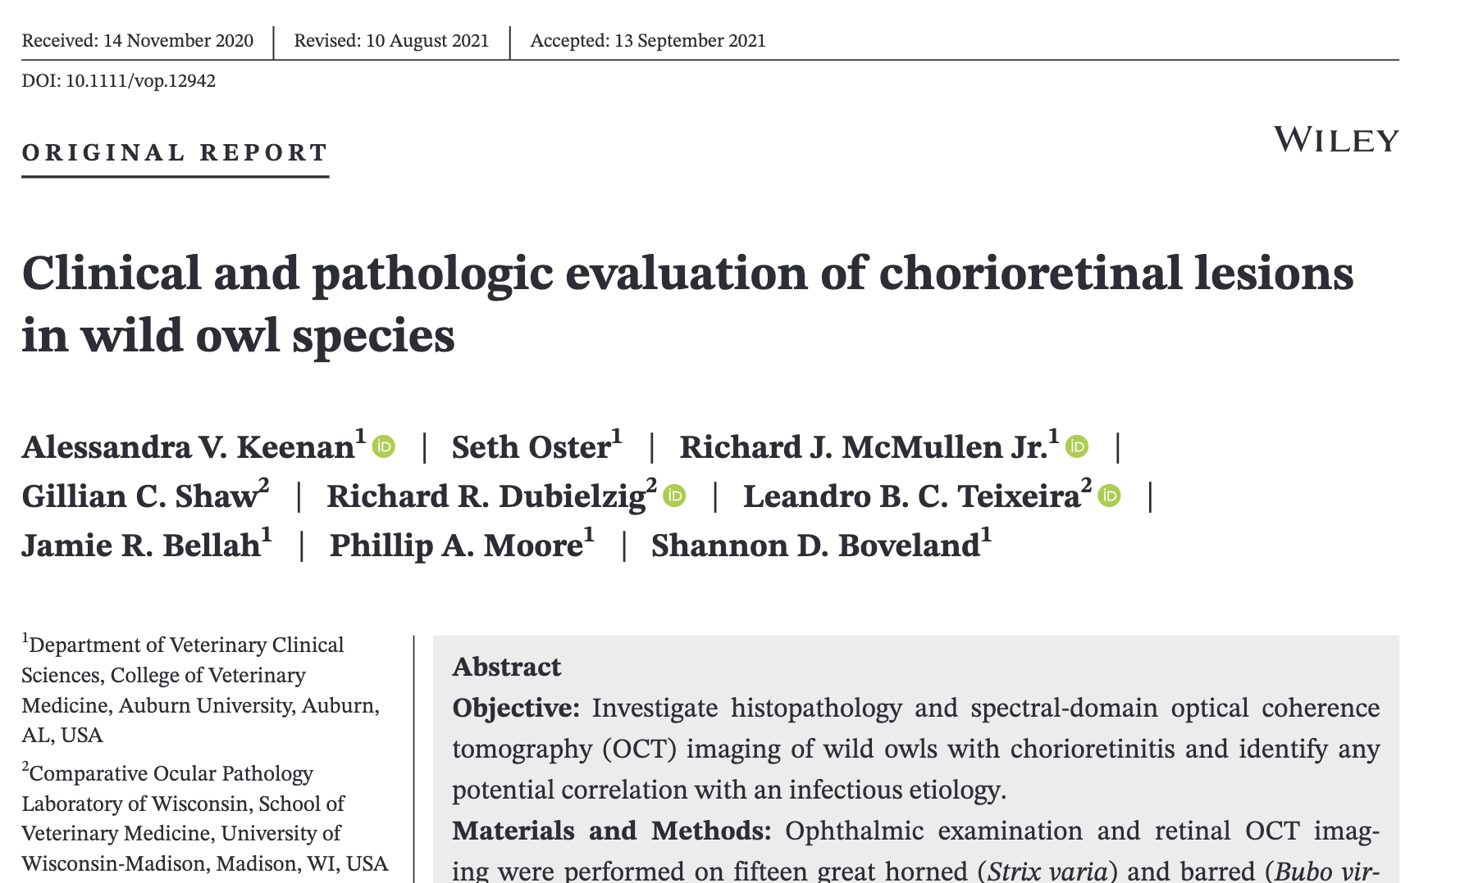
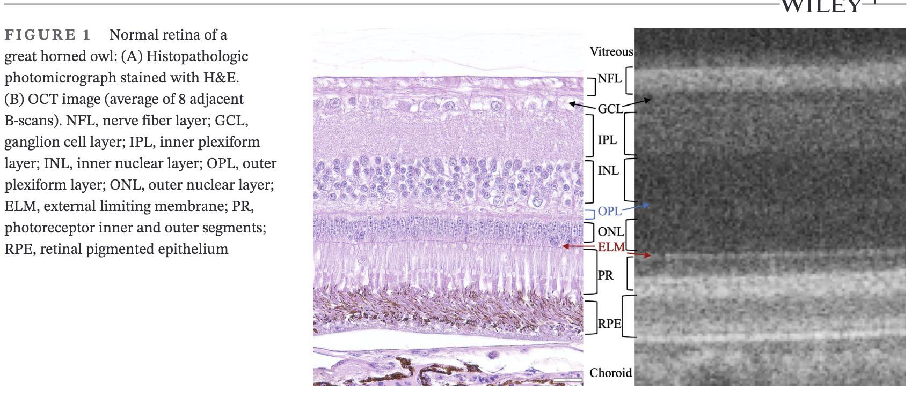
Notes:
Fundus lesions: retinal detachment (7/15 owls), depigmented lesions (12/15), pigment clumping (8/15), and retinal tear (4/15). All birds were negative for WNV and Avian Influenza on RT-PCR. Of the owls with chorioretinitis, 3/15 were seropositive for WNV and 7/15 for T. gondii. Optical coherence tomography of 25/30 affected eyes diagnosed outer retinal lesions (19/25 eyes), retinal detachment (16/25), and retinal tears (3/25). Histopathological examinations diagnosed outer nuclear layer atrophy (19/30 eyes), retinal detachment (18/30), retinal tears (7/30), suprachoroidal hemorrhage (12/30), scleral rupture (3/30), and ossicle fracture (3/30). (from abstract of paper)

Slide 21
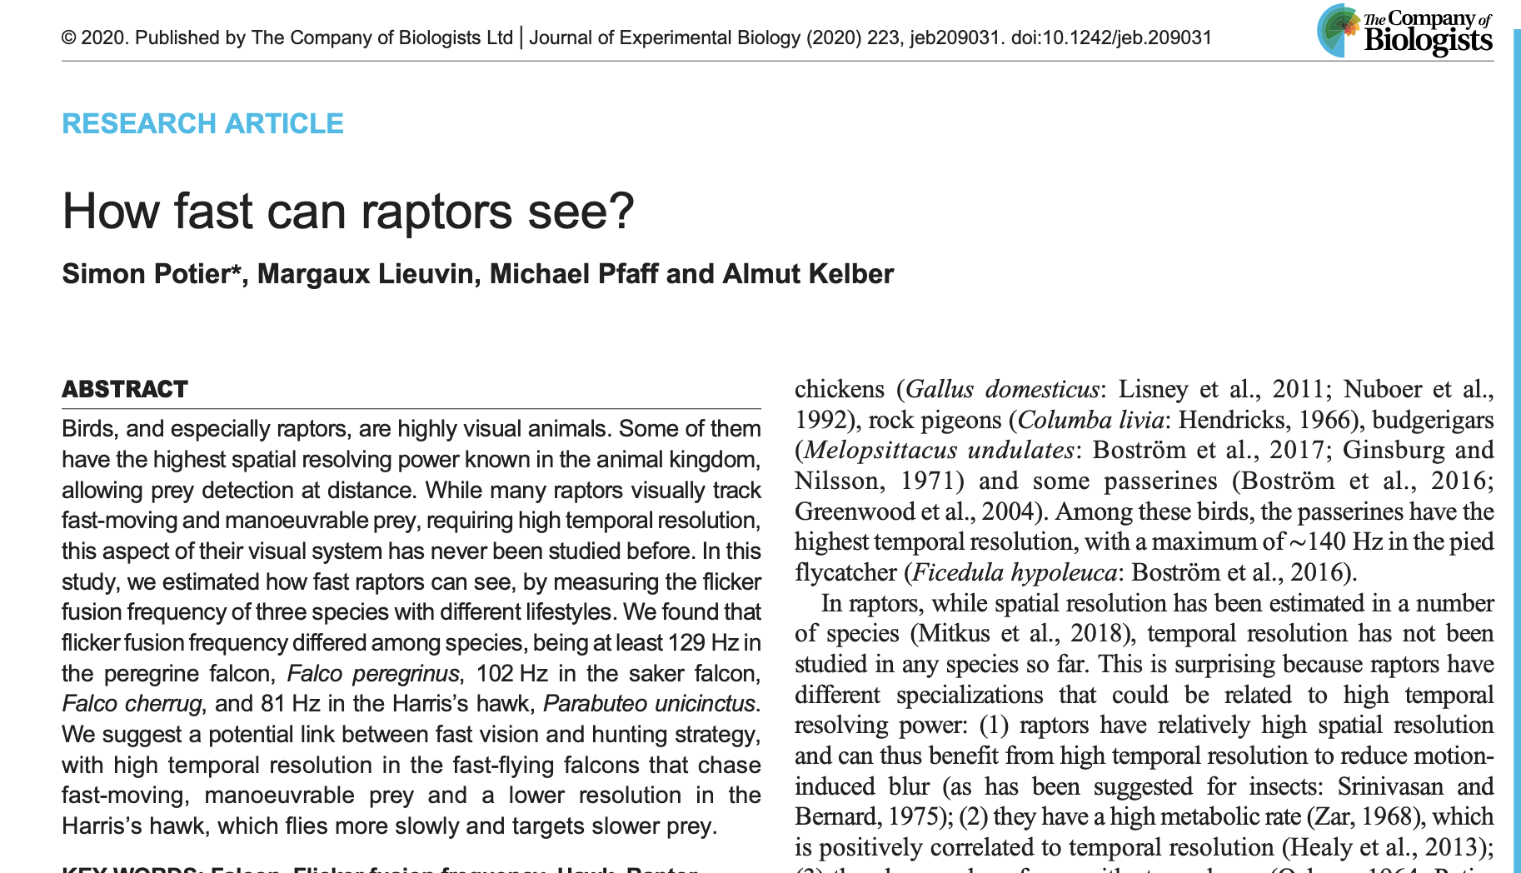
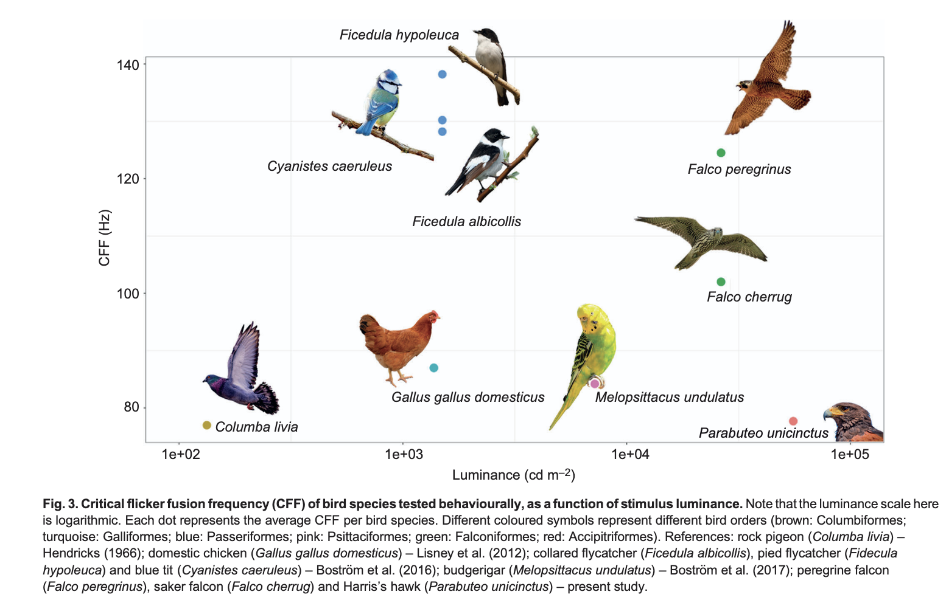

Slide 22
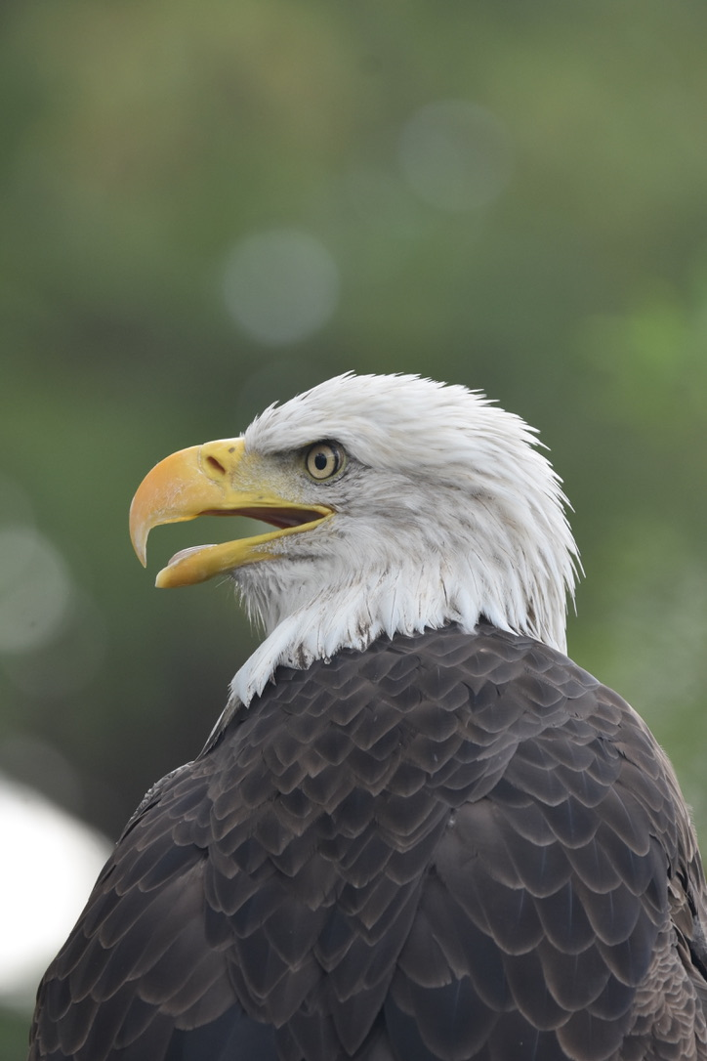
Capture Myopathy
Exertional rhabdomyolysis
Typically prey-type species
What about predators?
Vigorous muscle activity, stress, muscle damage
catecholamine release lead to cardiogenic shock
Gross lesions
Histology
Notes:
Gross lesions – pale foci in acute cases or delineated streaks in chronic cases in the heart and skeletal muscles (limbs, shoulder, pectoral, intercostal); hemorrhage, edema, and rupture of muscles
Histology: hemorrhage, monophasic degenerative and necrotic myofibers interspersed with normal myofibers, and small numbers of macrophages and neutrophils

Slide 23
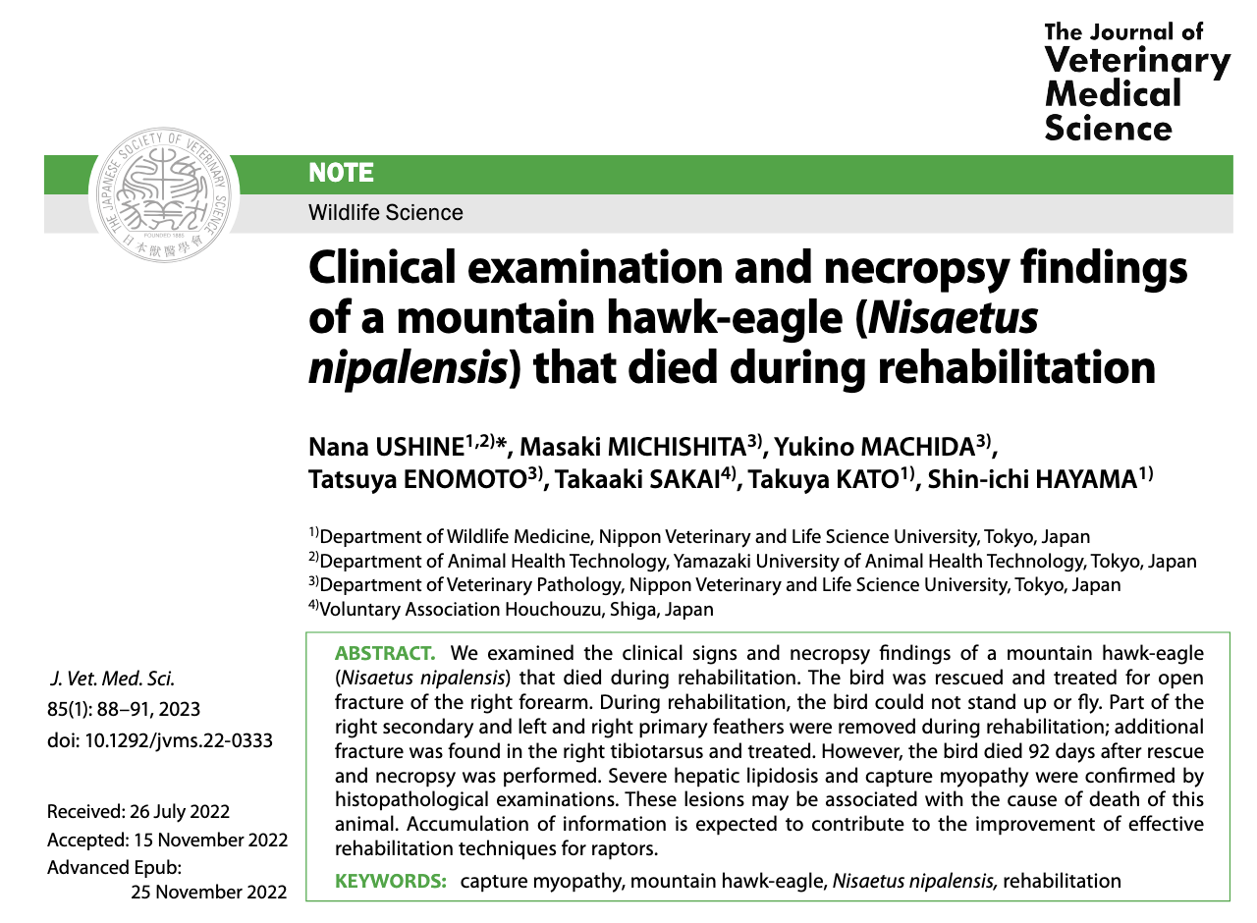
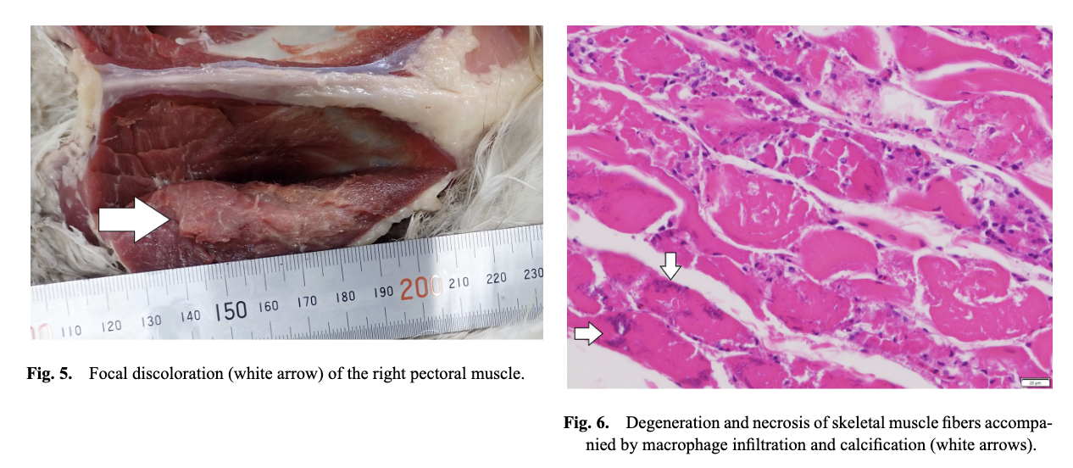

Slide 24
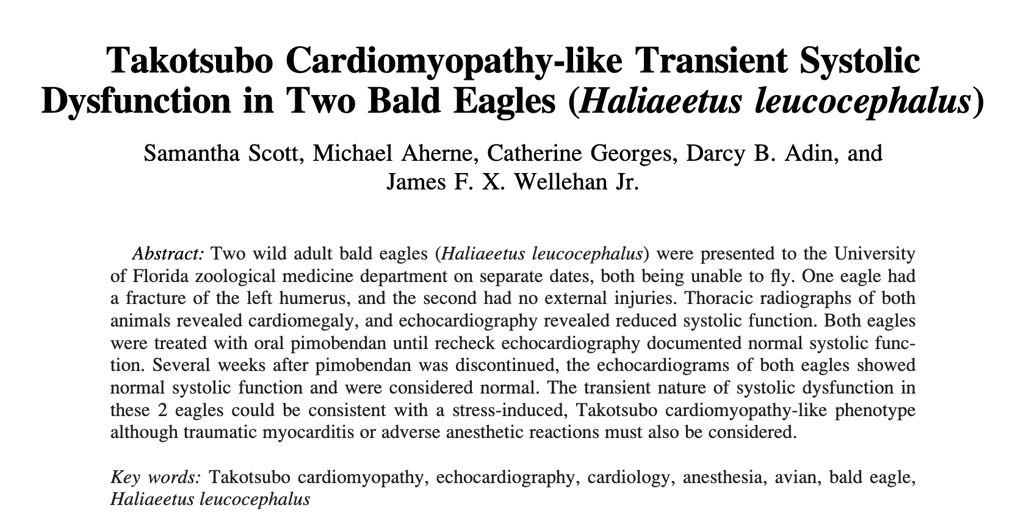
Martinelli

Slide 25
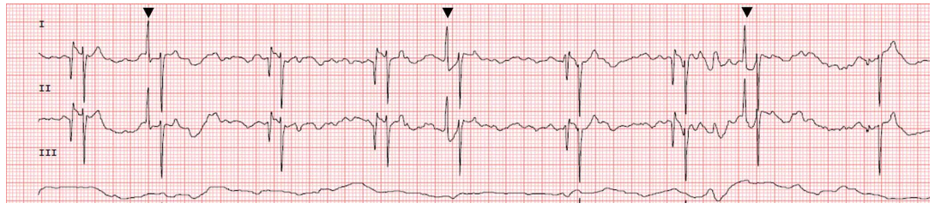
Question
List two differentials for the ECG changes below in a Bald Eagle (Haliaeetus leucocephalus). (Paper speed = 50 m/s; 1 cm = 1 mV).

Slide 26
Answers
Top differentials include stress-induced cardiomyopathy (akin to Takotsubo cardiomyopathy or “broken heart syndrome” in people) and isoflurane anesthesia. Other potential differentials include traumatic myocarditis or myocardial stunning.
ECG findings are atrial premature complexes, variable P-wave morphology, and underlying sinus bradycardia.

Slide 27
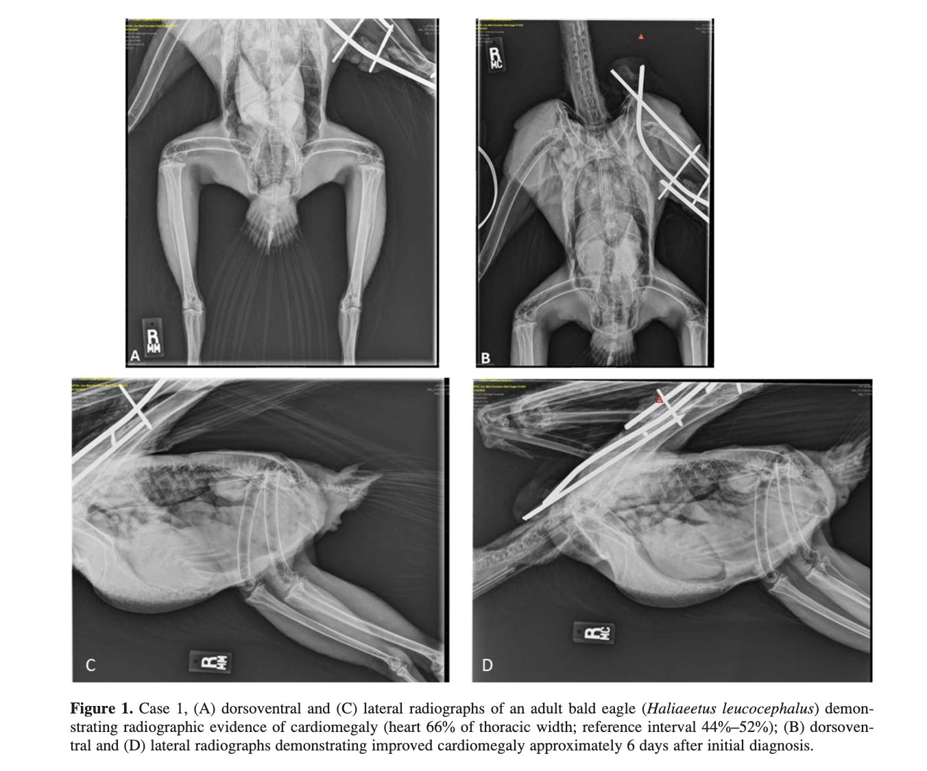
Takotsubo
Cardiomyopathy
“Broken Heart Syndrome”
Reduced systolic function and ballooning left ventricle secondary to extreme physical or emotional duress
Catecholamine-induced cardiotoxicity
Treatment - angiotensin-converting enzyme inhibitors, angiotensin receptor blockers, beta-blockers, and anticoagulants
Notes:
Revised Mayo Clinic criteria for diagnosis of Takotsubo cardiomyopathy are 1) transient hypokinesis, akinesis, or dyskinesis of the left ventricular midsegment with or without apical involvement (the regional wall motion abnormalities extend beyond a single epicardial vascular distribution; a stressful trigger is often, but not always present); 2) the absence of obstructive coronary artery disease or angiographic evidence of acute plaque
rupture; 3) new electrocardiographic abnormalities (either ST-segment elevation and/or T-wave inversion) or a modest elevation in cardiac troponin; and 4) absence of pheochromocytoma or myocarditis.

Slide 28
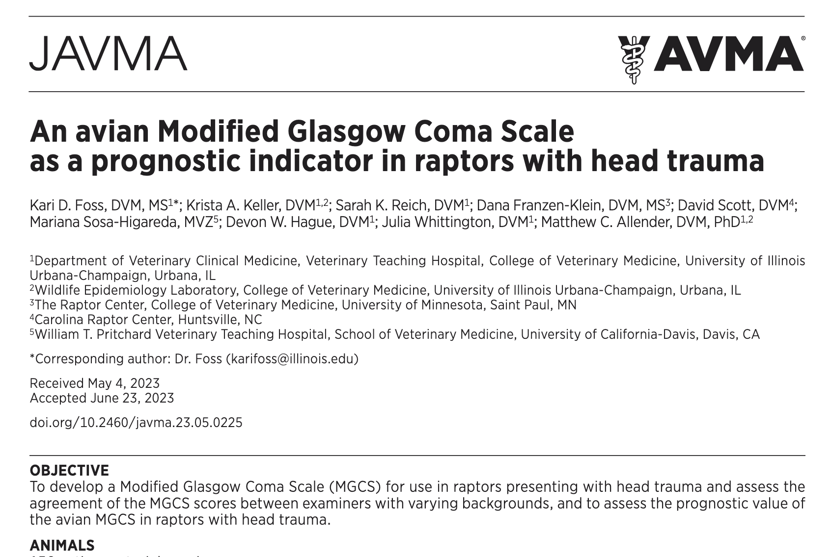
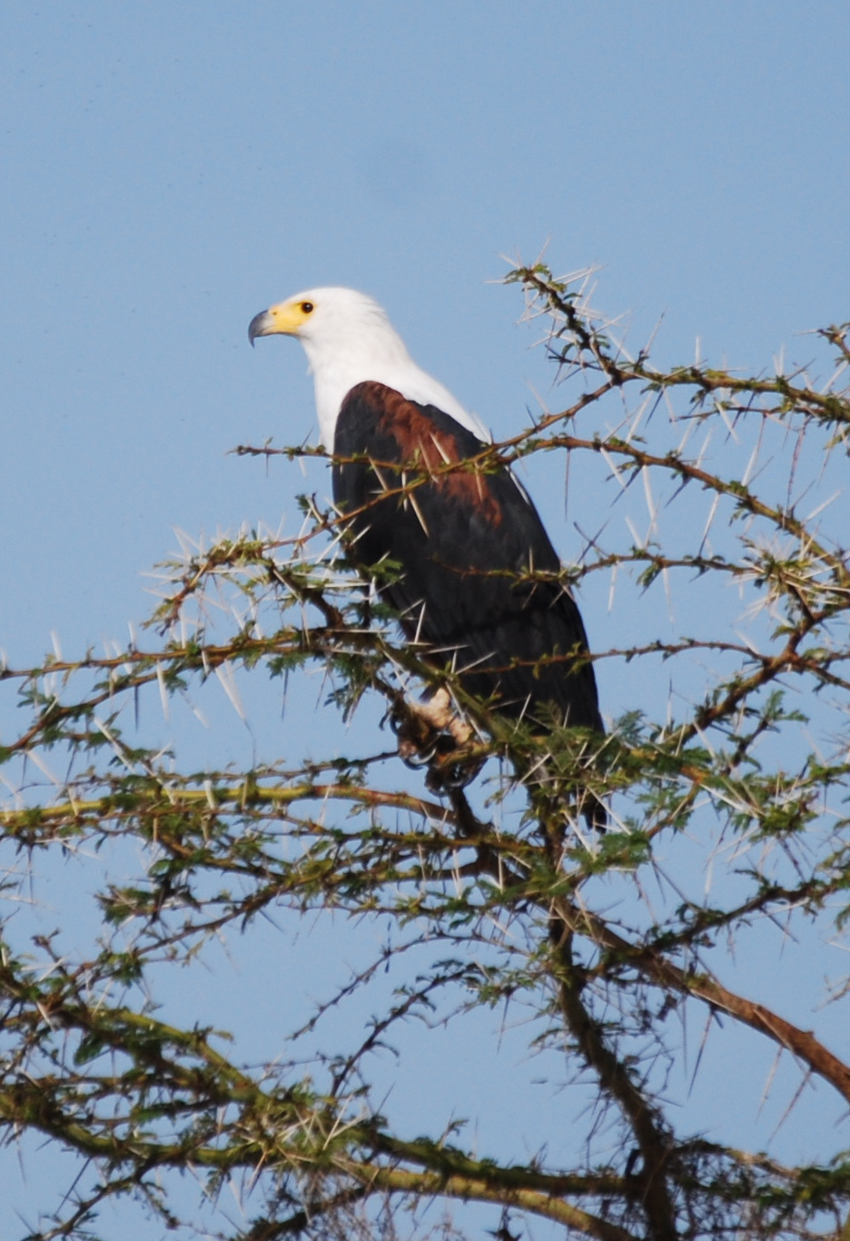
Roeder

Slide 29
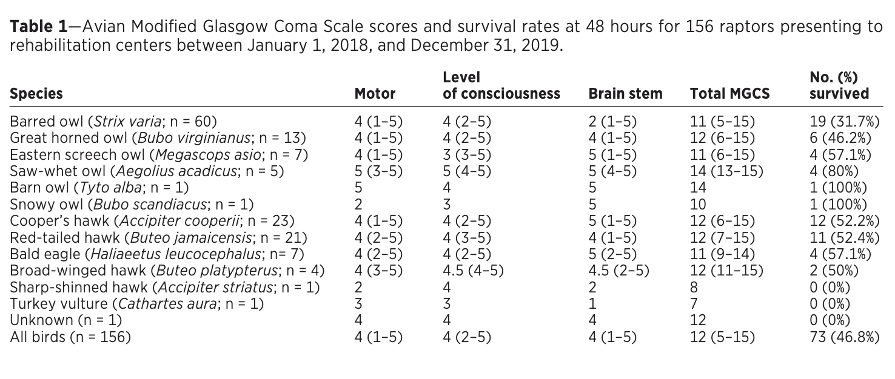

Slide 30
Question
In a study evaluating a modified Glasgow Coma Scale for use in raptors, which of the following was associated with lower survival?
Higher motor activity scores
Nocturnal raptor species
Higher level of consciousness scores
Higher brain stem reflex scores
Juvenile age of raptors

Slide 31
Answer
In a study evaluating a modified Glasgow Coma Scale for use in raptors, which of the following was associated with lower survival?
Higher motor activity scores
Nocturnal raptor species
Higher level of consciousness scores
Higher brain stem reflex scores
Juvenile age of raptors

Slide 32
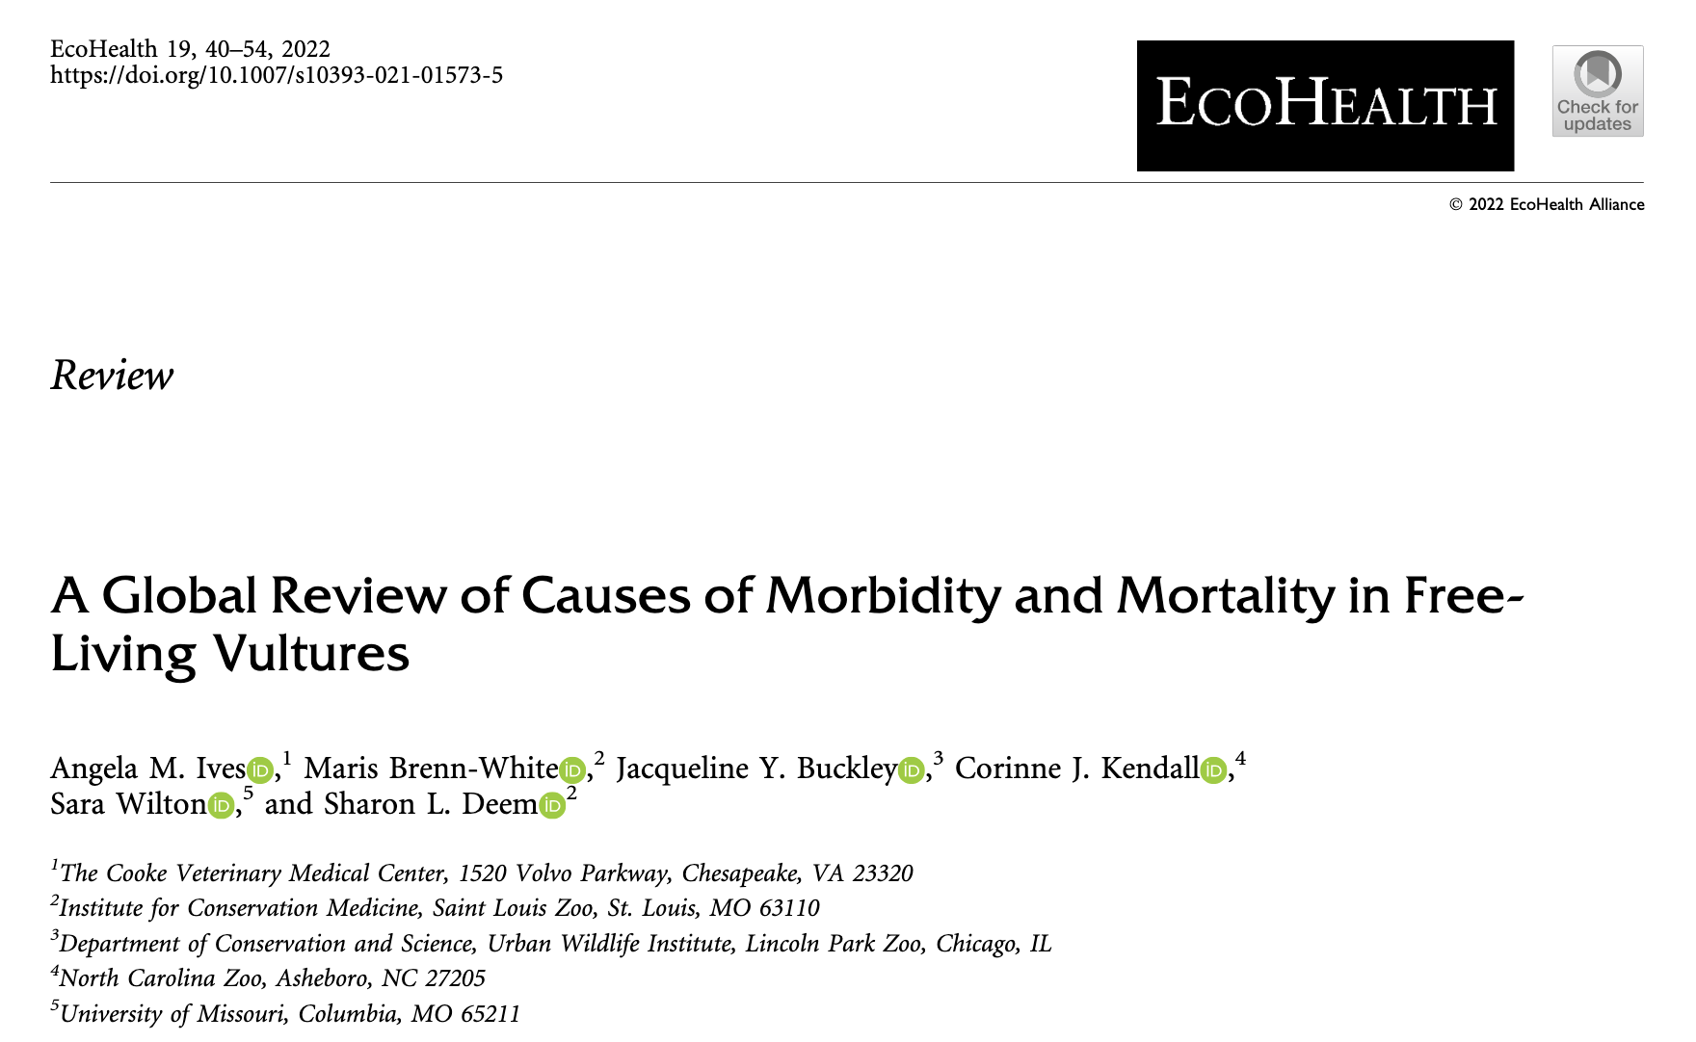
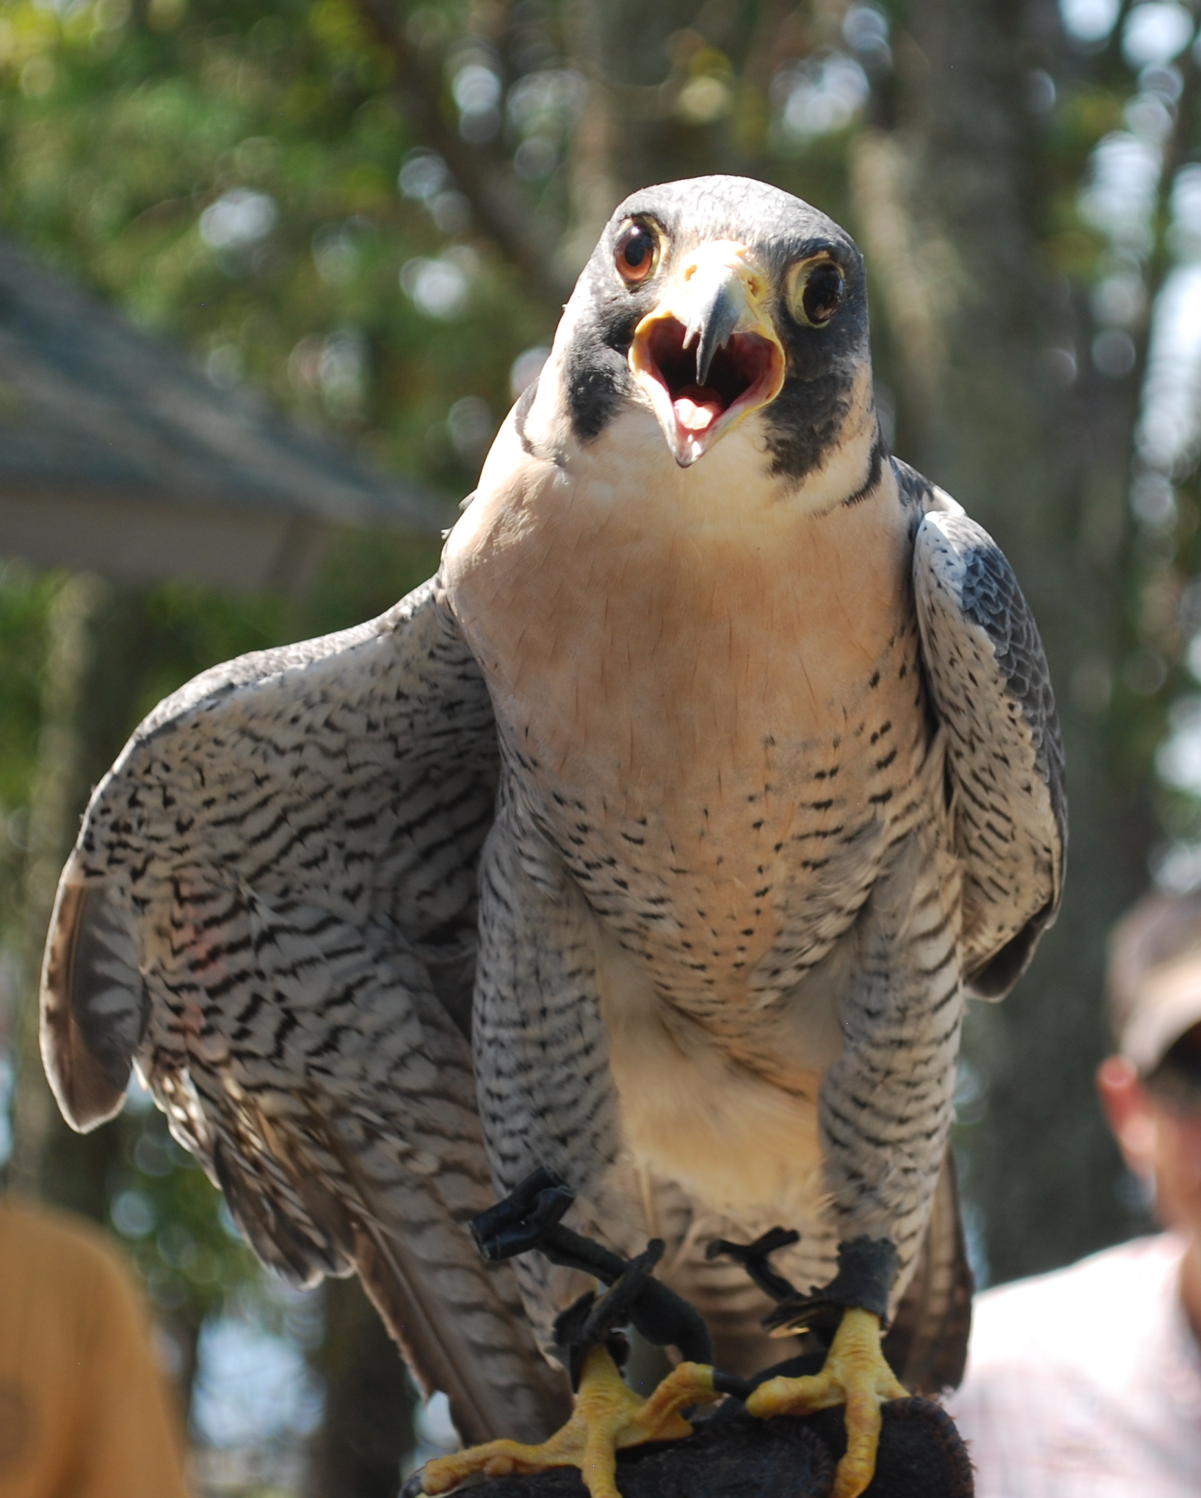
Toxins
60% of vulture deaths
Lead and Pesticides
Trauma 49%
Infectious diseases 16%?
Notes:
Concern that the 16% is under-estimated as not researched as often
Half of studies in Spain or USA . Highest studied Griffioen and Egyptian vultures

Slide 33
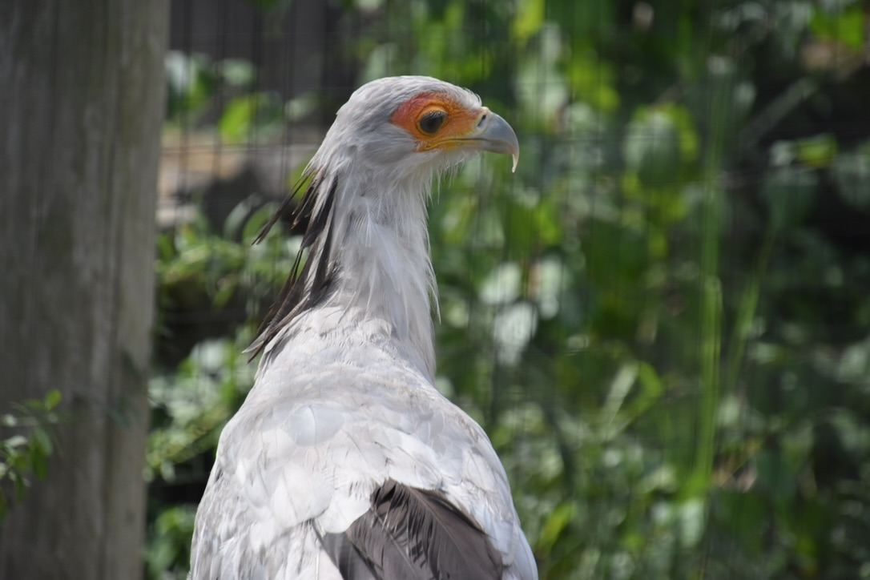
What type of Bias was reported on in the study?
Confirmation Bias
Selection Bias
Reporting Bias
Publication Bias
Implicit Bias
Explicit Bias

Slide 34
What type of Bias was reported on in the study?
Confirmation Bias – confirming existing beliefs
Selection Bias – not randomly chosen sample
Reporting Bias – selective revealing or concealing information
Publication Bias – only publishing positive or good results
Implicit Bias – unintentional judgement influencing perspectives/behaviors
Explicit Bias – consciously held and expressed stereotypes

Slide 35
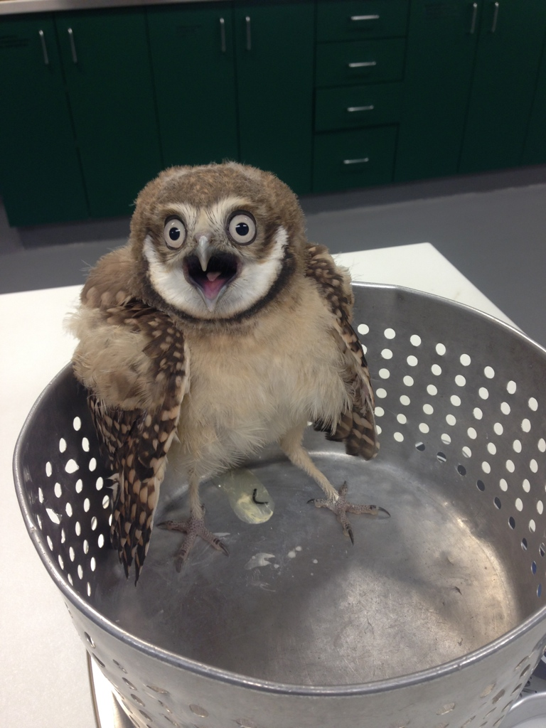
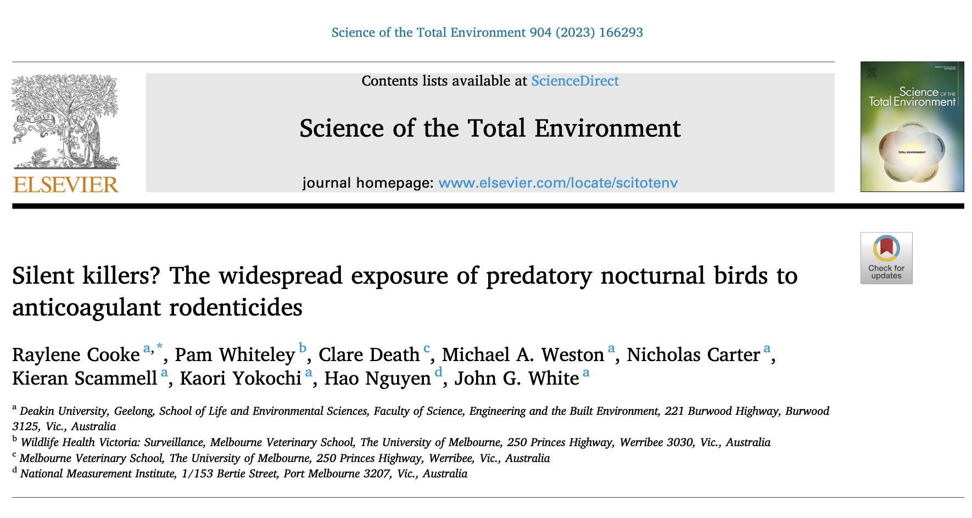
Rodenticides

Slide 36
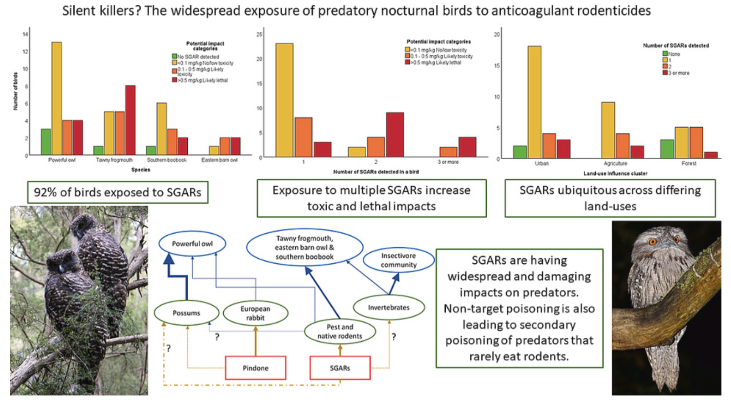

Slide 37
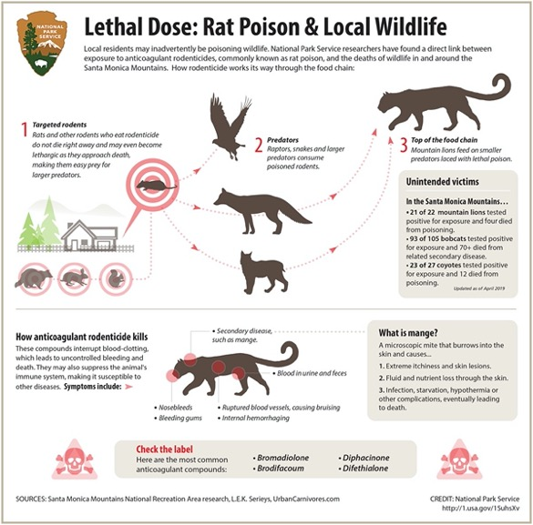
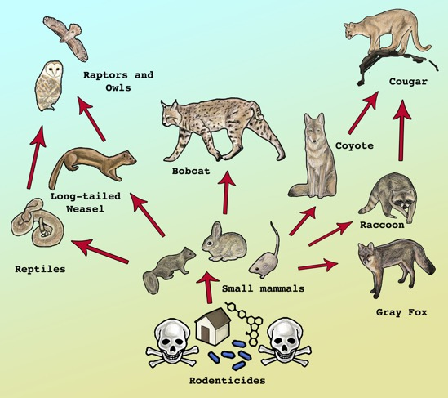

Slide 38
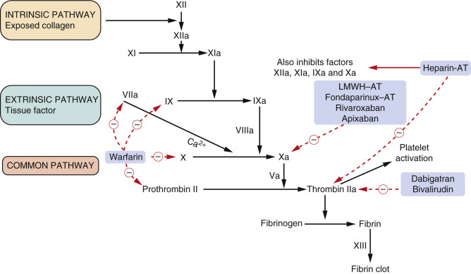
Notes:
Anticoagulant rodenticides mechanistically inhibit the enzyme vitamin K epoxide reductase, which is crucial in the recycling and production of vitamin K₁, a necessary component for clotting factors II, VII, IX, and X. When the production of these clotting factors in the liver is inhibited, prothrombin cannot be adequately converted to thrombin, and coagulopathy results. The serum half-life of the affected coagulation factors ranges from 6.2 to 16.5 hours, and circulating supplies are generally exhausted 24–64 hours after ingestion of a toxic dose of the rodenticide. Elevation of coagulation parameters is thus delayed for 2–5 days after ingestion, with clinical evidence of bleeding typically noted 3–7 days after ingestion of a toxic dose.

Slide 39
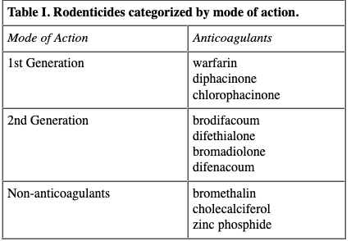
Notes:
Treat by vomiting within the first 4 hours of ingestion and activated charcoal 1-3 g/kg

Slide 40
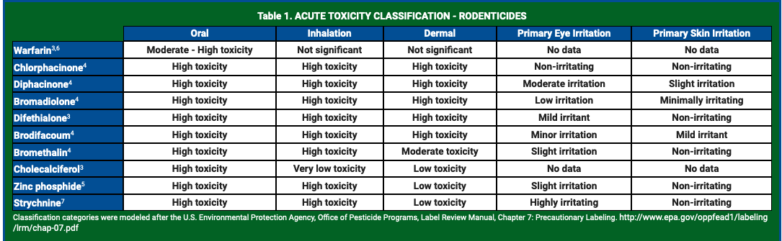
http://npic.orst.edu/factsheets/rodenticides.html

Slide 41
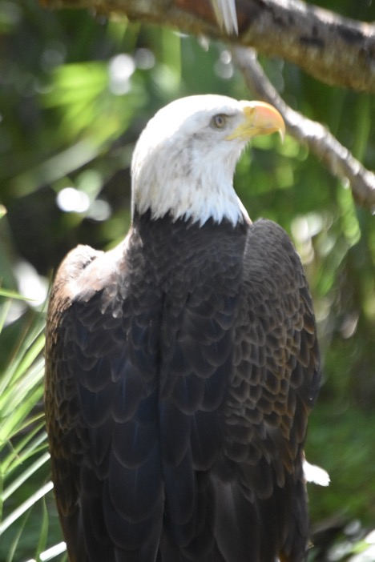
Anticoagulant mechanism of action
First generation
Multiple feedings to cause toxicity
Intermediate anticoagulants
Fewer feedings to cause toxicity
Second generation Highly toxic after a single feeding
Non-anticoagulant
Notes:
First generation anticoagulatnts - (warfarin, coumafuryl, isovaleryl indanedione); Intermediate anticoagulants - (Chlorophacionone and diphacinone); Second generation -(Brodifacoum, bromadiolone, difethiolone) non- anticoagulamt – bromethalin – these are also called the super warfarins and have LD50 2.5 – 200 times lower
Vitamin K epoxide reductase normally reactivates Vitamin K which is needed for clotting factors

Slide 42

Rodenticides
Half life of warfarin 15 hours
Diphacionone half life 5 days
Bromadiolone half life 6 days, maximum effects 12-15 days, up to 24 days

Slide 43

Clinical Signs
Hemorrhage
Anemia
Hematomas
Hemothorax
Epistaxis
Depression
Anorexia
Notes:
Clinical signs can be delayed 3-7 days after exposure

Slide 44

Diagnosis
Prolonged prothrombin time (PT)
Activated partial thromboplastin time (APTT)
Prolonged Thrombin time in presence of normal fibrinogen
Fibrinogen degradation products
Platelet count
Therapeutic response to vitamin K1
Stomach contents, serum, plasma anticoagulant screen
+/- Blood transfusion
Notes:
Vitamin K1 treatment 3–5 mg/kg/day, PO, for 3–4 weeks
If exposure is questionable and vitamin K₁ is withheld: PT 48 hours after ingestion. If PT is elevated, treatment should proceed.
If vitamin K₁ is administered: PT 2–3 days after treatment
A prolonged PT, PTT, or thrombin time in the presence of relatively normal fibrinogen, fibrin degradation products, and platelet counts strongly suggests anticoagulant rodenticide toxicosis, as does a positive therapeutic response to vitamin K₁. Gastric contents, serum, or plasma can be analyzed for the presence of anticoagulant to confirm a diagnosis. Some veterinary diagnostic laboratories offer an anticoagulant screen to detect most of the anticoagulant rodenticides available in the market in the serum, plasma, liver, or kidney; however, such screens are rarely performed.

Slide 45



Day

Slide 46
Question
Which of the following should be interpreted in light of a basal rate and not a reference interval when evaluating dynamic viscoelastic coagulometry in Strigiformes when using a glass bead (gb) or kaolin clay (k) as an activator?
gb activated clotting time (gbACT)
k activated clotting time (kACT)
gb clot rate (gbCR)
k clot rate (kCR)
k platelet function (kPF)

Slide 47
Answer
Which of the following should be interpreted in light of a basal rate and not a reference interval when evaluating dynamic viscoelastic coagulometry in Strigiformes when using a glass bead (gb) or kaolin clay (k) as an activator?
gb activated clotting time (gbACT)
k activated clotting time (kACT)
gb clot rate (gbCR)
k clot rate (kCR)
k platelet function (kPF)
Notes:
kCR and gbPF have a high index of variability, so a basal rate should be used for interpretation and not a reference interval

Slide 48

Case
Adult Emu
Found down
Neurologic

Slide 49
Rule Outs

Slide 50
Other history
So how does this relate to raptors?
Vultures regularly go in and out of exhibits to steal food
Over 10 black vultures found dead on grounds

Slide 51


Slide 52
Question
What was the primary mechanism by which highly pathogenic H5N1 influenza A virus was transmitted and maintained within Black Vulture (Coragyps atratus) populations during the 2022 outbreak?
A. Contact with contaminated aquatic environments at die-off sites B. Scavenging of infected bird carcasses C. Direct contact with infected migratory waterfowl at roosting sites D. Consumption of infected feces found in the environment E. Aerosol transmission within communal roosts

Slide 53
Answer
What was the primary mechanism by which highly pathogenic H5N1 influenza A virus was transmitted and maintained within Black Vulture (Coragyps atratus) populations during the 2022 outbreak?
A. Contact with contaminated aquatic environments at die-off sites B. Scavenging of infected bird carcasses C. Direct contact with infected migratory waterfowl at roosting sites D. Consumption of infected feces found in the environment E. Aerosol transmission within communal roosts

Slide 54

Questions?

Slide 55

Maybe I am a crazy bird lady after all….

