Slide 1
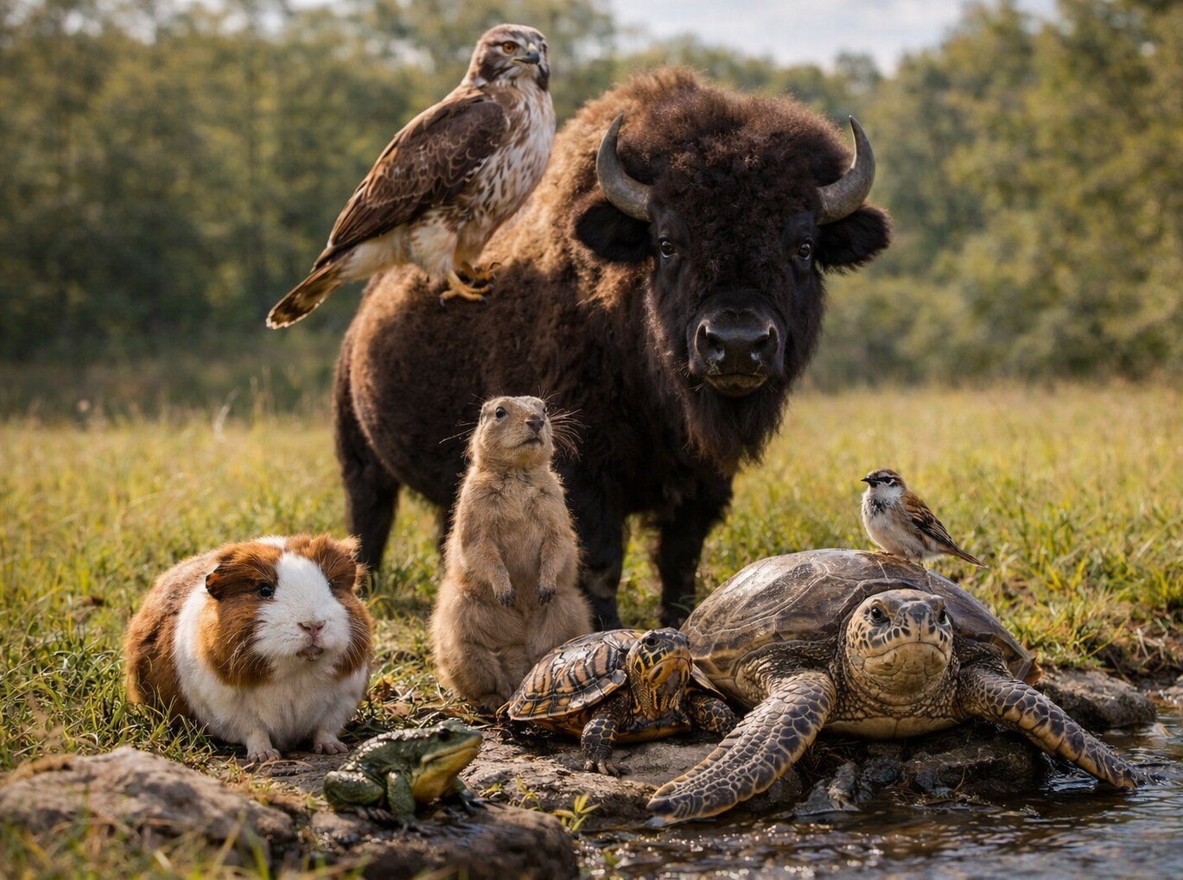
Welcome to CBS 818!
Advanced Zoo Topics
Spring 2026

Slide 2
Housekeeping items
Course website: https://emconnect.emc.ncsu.edu/
Syllabus
Schedule
Lecture materials
Resident guidelines
Moodle site – attendance, reading assignments, quizzes located HERE
Course objective: to prepare residents to take the ACZM board exam
ACZM = American College of Zoological Medicine
Taught at the resident level, but students are encouraged to actively participate!

Slide 3
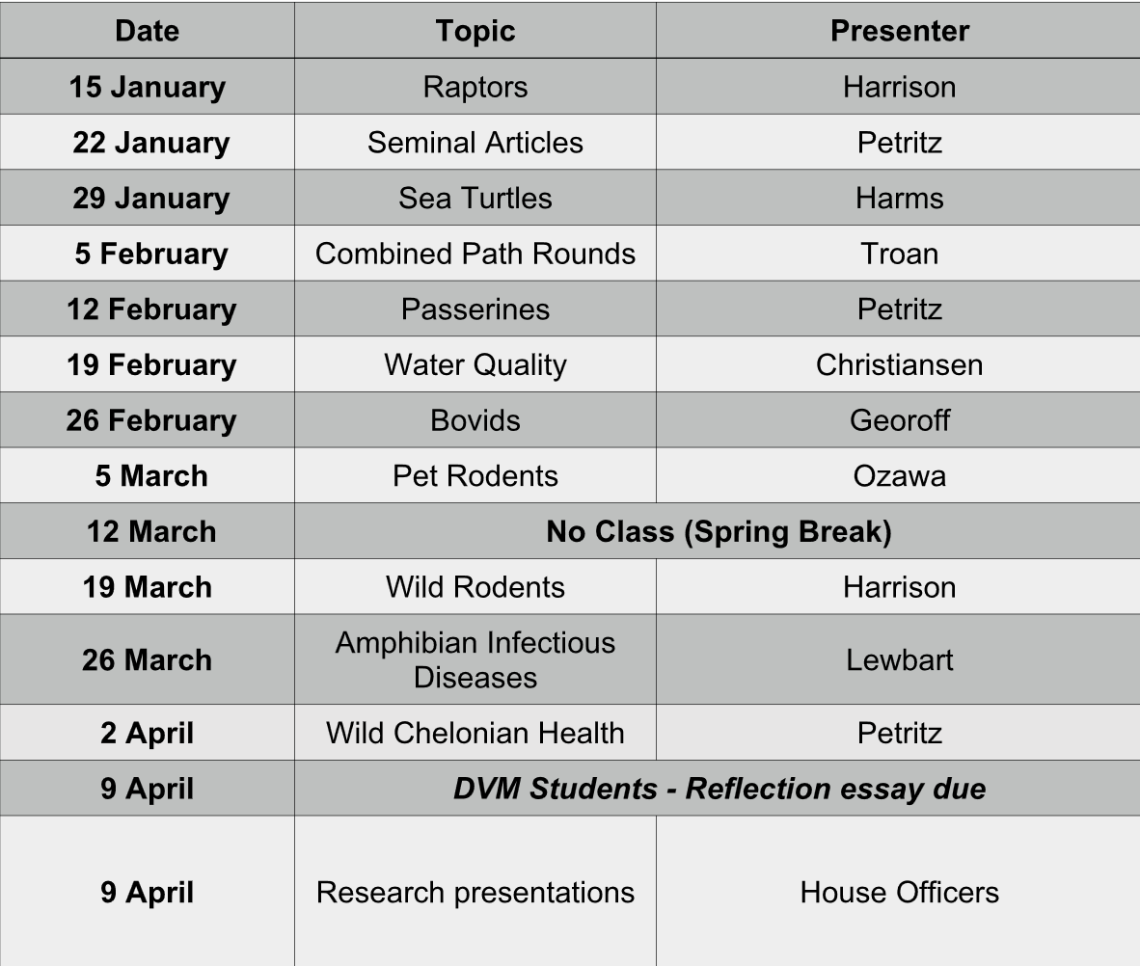
Schedule
12 classes
Held via IN PERSON and via Zoom
Thursdays: 4-5pm
Asynchronous attendance for students is allowed from Drs. Harrison or Petritz
Required to watch Zoom recordings if not able to attend live

Slide 4
Class outline
Combination of journal review and topic lecture
ACZM Residents review 2-3 of the assigned papers/book chapters for the week
Student participation is still encouraged!
We will review multiple choice questions written by presenter and residents about that topic or others
For ACZM board exam preparation

Slide 5
Student Responsibilities
Satisfactory/Unsatisfactory grading
Attendance:
A minimum of 10 classes must be attended to pass (asynchronously or synchronously)
Attendance counts as taking the class quiz after being in class or watching the zoom video
Reflective essay: due April 9th
Details in syllabus and on Moodle page

Slide 6
Student Responsibilities
Weekly reading assignments + brief QUIZ:
Book chapter or review article reading assignment per lecture
Located on Moodle site and on separate course webpage
1-3 multiple choice questions per quiz/reading assignment
Located on Moodle website – must read and complete ALL assignments to pass
Quizzes are open book-open note, but please complete individually
Quizzes open day of class (Thursday) and are due by the following Monday at 8am on Moodle
These count for attendance

Slide 7
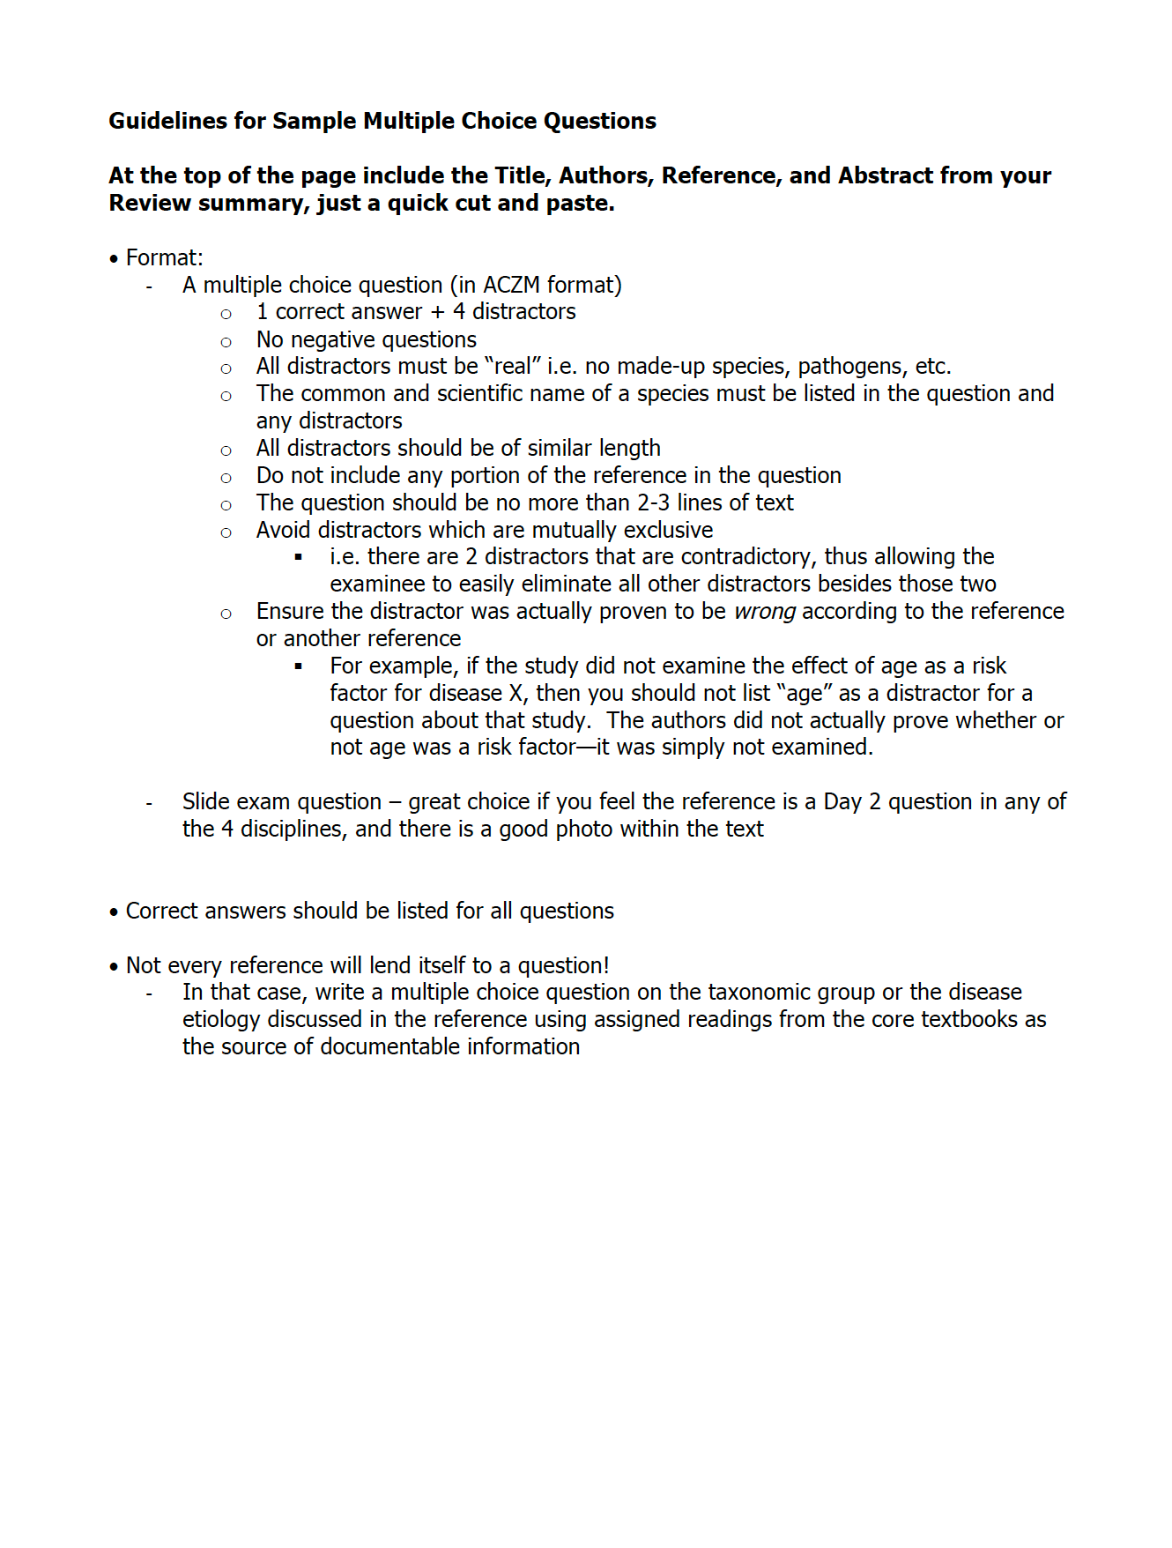
Resident Responsibilities
Email summaries and questions to Drs. Harrison + Petritz by Sunday evening
Please combine all summaries into ONE document and all questions into ONE (separate) document
Research presentations: 10 minutes
Case presentations: 10 minutes
NOTE: NO case presentations this semester

Slide 8
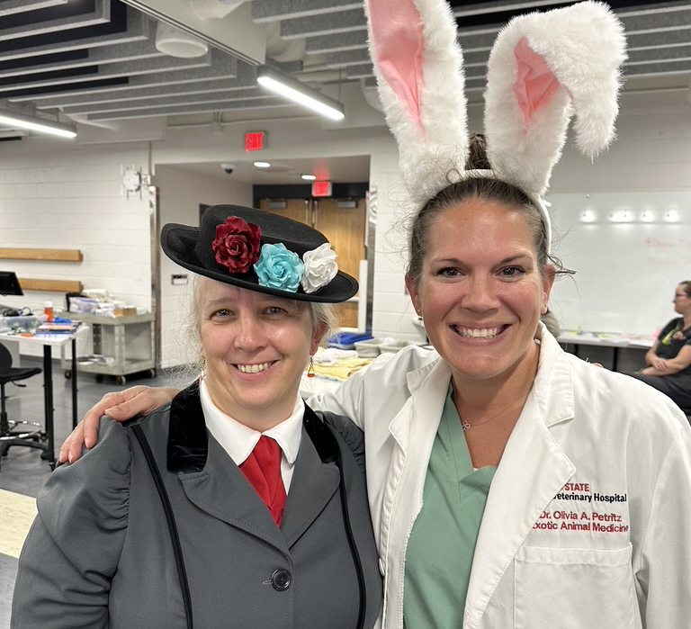
Questions?
Course Coordinators:
Dr. Tara Harrison: tmharri7@ncsu.edu
Website and Zoom coordinator
Dr. Olivia Petritz: oapetrit@ncsu.edu
Attendance and grading coordinator

