Slide 1
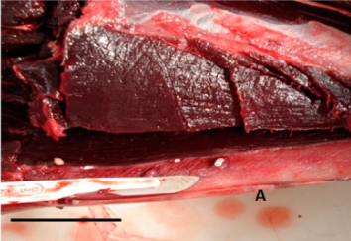
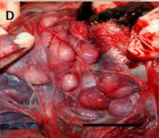
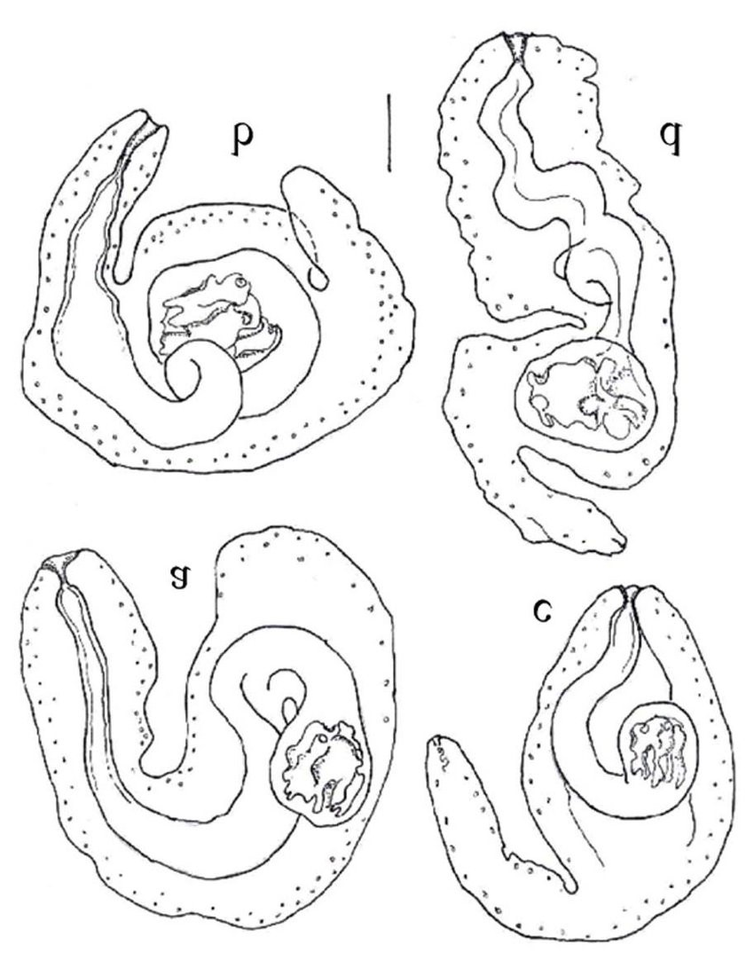
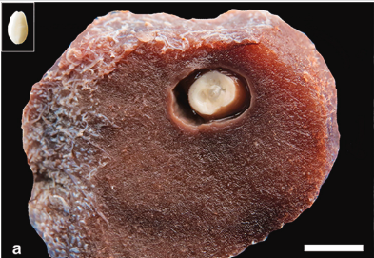
https://doi.org/10.3390/pathogens9080612
https://doi.org/10.1016/j.ijppaw.2021.12.005
10.5597/lajam00037

Slide 2
Phyllobothrium/Monorygma
Cestodes affecting marine mammals: Phyllobothrium in pinnipeds and cetaceans, Monorygma in cetaceans only
Marine mammals are intermediate/paratenic hosts, with larvae located in the abdominal cavity, peritoneum, mesentery, abdominal wall, testes, ovary, blubber or fascia (elasmobranchs are definitive host).
Stimulates localized inflammatory response and encapsulation, often more suppurative inflammation seen with Monorygma
Typically found in free-ranging animals with minimal clinical impact, and no treatment is identified/recommended

